Slide 1
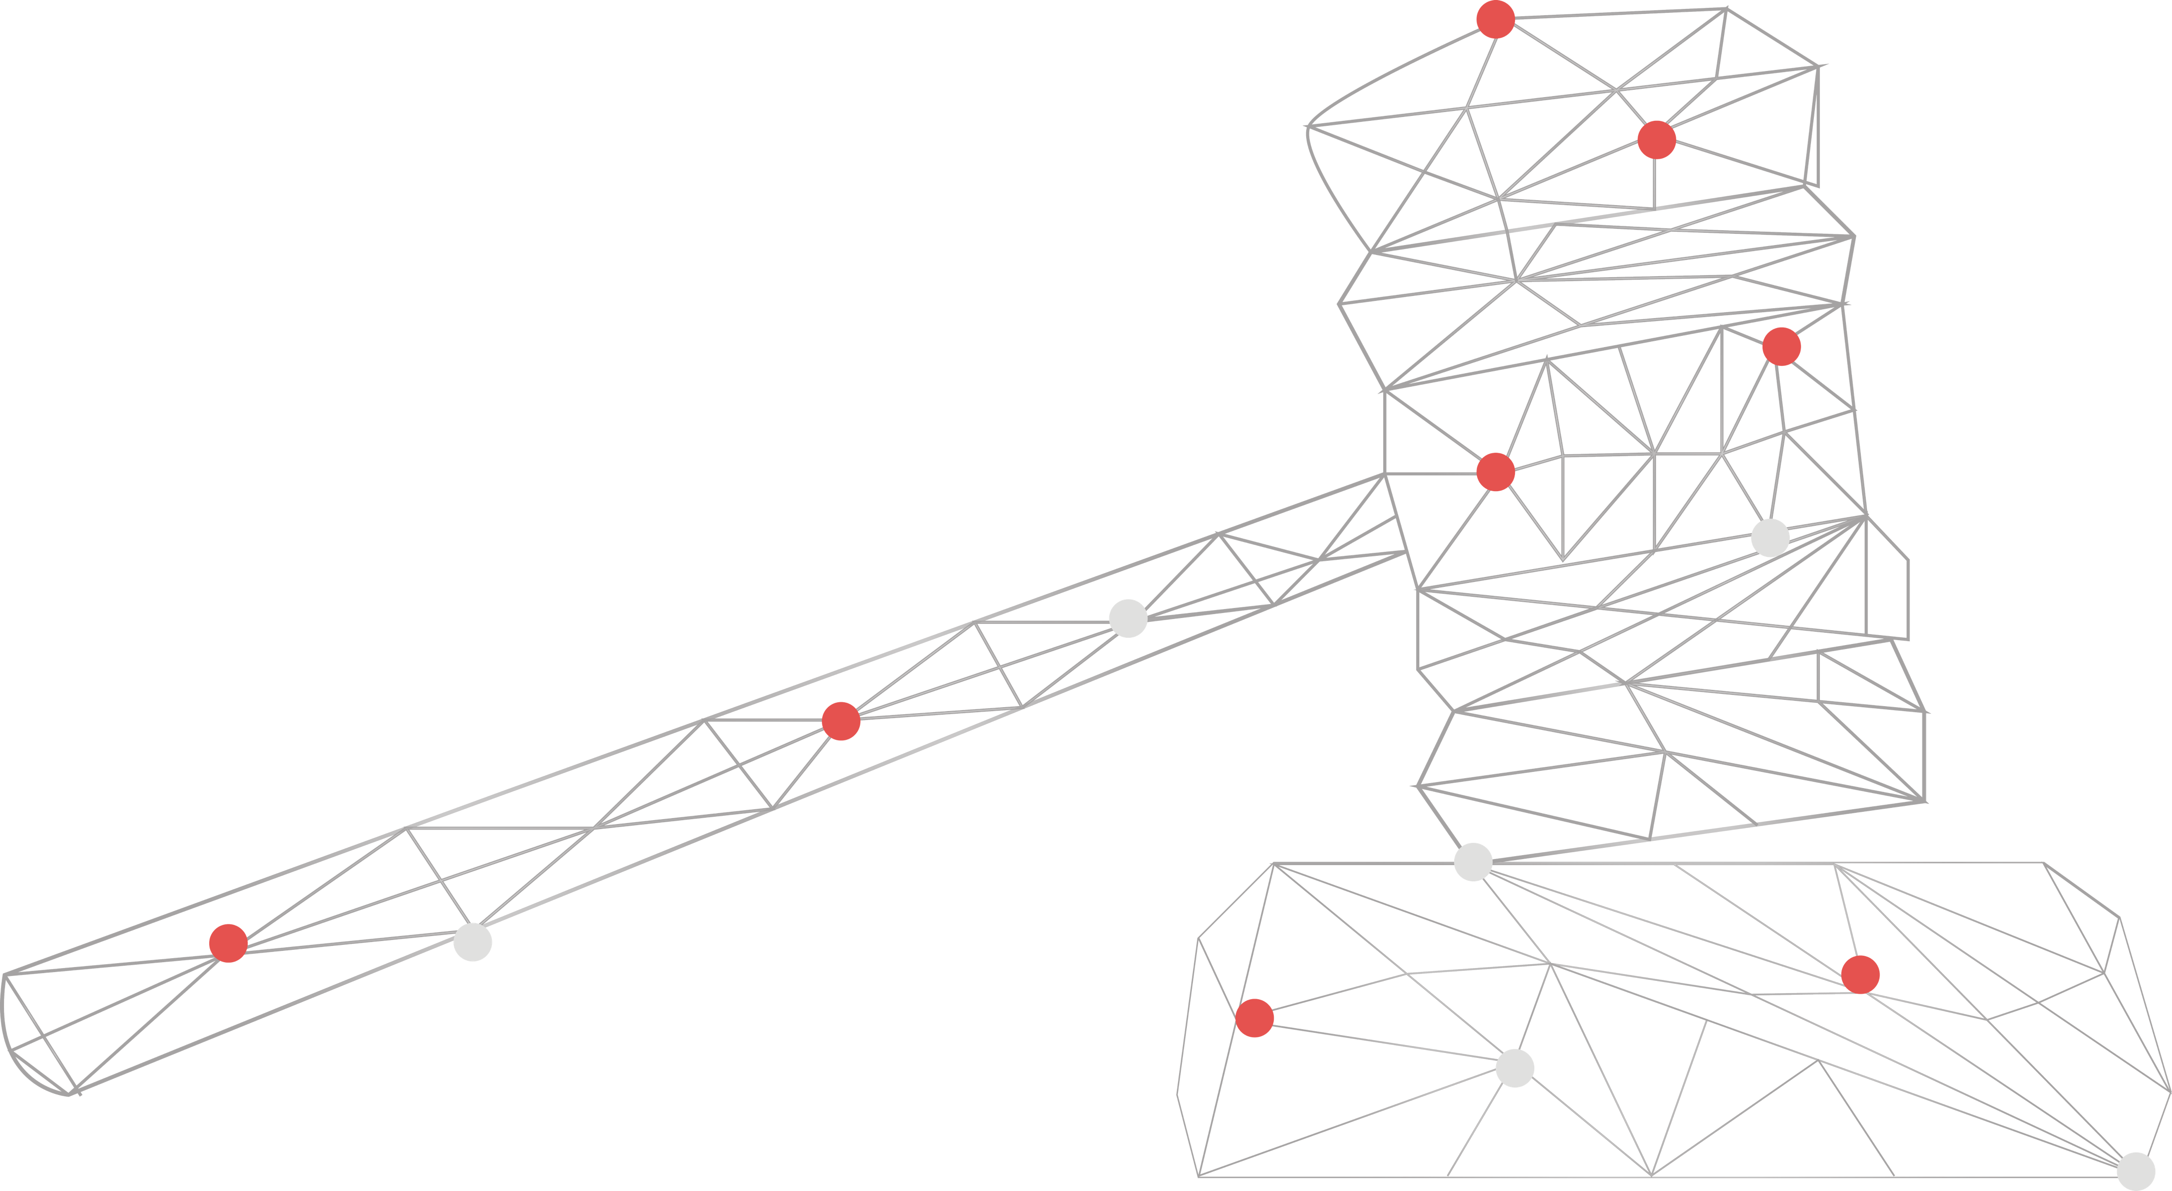
ADAPT Technology Trends
Unlocking AI Governance
and People Maturity

Slide 2
Technology Trends: AI
Below is a summary of Australian CDAOs’ perspectives on the maturity of their AI governance and people maturity.
Leadership, governance and use cases
About 45% of CDAOs say that AI governance is currently led by the CIO or equivalent executive. However, 38% of CDAOs believe they should lead AI governance.
Half of CDAOs report low governance coverage on AI, highlighting that while some organisations have mature governance, others are behind in maturity.
Most agentic AI use cases are still in the exploration/pilot stages. Some organisations have already deployed fully autonomous systems to improve operational efficiency.
Governance and people maturity
About 75% of Australian organisations are unprepared to manage an agentic workforce. Only 1% are ready to scale an agentic workforce.
Organisations with high governance and people maturity have higher maturity levels in:
operational practices for deploying, monitoring and maintaining AI / ML
(including GenAI) systems
governance coverage on AI pilots, tools or models
data and AI architectures that support scalable, modular adoption of new GenAI models
preparedness for employees to work with AI.
Key takeaways
ADAPT’s Data and AI Edge Survey
(Apr 2026) presents Australian Chief Data & Analytics Officers (CDAO) views on:
leadership, governance and AI use cases
governance and people maturity
drivers that relate to high governance
and people maturity.

Slide 3
Leadership, governance and use cases

Slide 4
AI governance leadership (CIOs and CDAOs)
Source : ADAPT CIO, and Data and AI Edge Surveys in Feb and Apr 2026. Sample size: 418 Australian CIOs and CDAOs

Slide 5
Percentage of AI pilots, tools, or models that are known and covered by formal governance or risk frameworks
Source : ADAPT Data and AI Edge Survey in Apr 2026. Sample size: 169 Australian CDAOs

Slide 6
Which agentic AI use cases are you exploring or deploying and what is their maturity?
Source : ADAPT Data and AI Edge Survey in Apr 2026. Sample size: 159 Australian CDAOs

Slide 7
Technology Trends
Leadership, governance and use cases
AI governance leadership outlines a strong technology-driven model
This reinforces a framework where governance lives within technology leadership rather than traditional business leadership roles.
Data and digital roles are emerging, with 38% reporting ownership from chief data officers or digital/product leaders, suggesting these roles are becoming part of governance structures but are not yet the primary execution owners.
Higher concentrations at both ends of maturity governance coverage on AI initiatives
About 35% of organisations report low governance coverage (<25%) and 34% report high governance coverage (>75%). This implies that some organisations have mature governance while others struggle with oversight on AI pilots, tools and models.
Most agentic AI use cases are still in the exploration/pilot stage
CDAOs say their organisations prioritise operational and technical use cases, where the scope is well-defined and risks are manageable. This can also be explained by most organisations striving to set AI guidelines and policies before AI upskilling (ADAPT Data and AI Edge Survey, Apr 2026).
Product and pricing decisions remain largely unexplored. This shows that organisations are intentionally creating use cases before expanding agentic AI capabilities into higher-risk decision areas.
AI governance is strongly dominated by CIO
and CTO roles.
CDAOs say that 50% of AI models in pilot and deployment are not covered by governance.
CDAOs confirm that the top use cases for the following deployment maturity levels are:
  no activity: product and pricing decisions
  exploration/pilots: operational improvements
  task-based or scripted agents: policy and knowledge management
  goal-oriented agents: code generation and testing.
Only a minority of organisations have fully autonomous decisions/actions for some use cases: operational improvements, code generation and testing, admin tasks and CX.

Slide 8
Governance and people maturity

Slide 9
How prepared is your organisation to manage an agentic workforce
(roles, processes and change management in place)?
Source : ADAPT Data and AI Edge Survey in Apr 2026. Sample size : 170 Australian CDAOs

Slide 10
High governance and people maturity as it relates to
data foundations and architecture maturity
¹ Please note that the percentages shown are rounded to the nearest whole number. As a result, the total may appear slightly above or below 100% due to rounding.
Source : ADAPT Data and AI Edge Survey in Apr 2026. Sample size : 170 Australian CDAOs

Slide 11
High governance and people maturity
as it relates to AI governance and readiness
¹ Please note that the percentages shown are rounded to the nearest whole number. As a result, the total may appear slightly above or below 100% due to rounding.
Source : ADAPT Data and AI Edge Survey in Apr 2026. Sample size : 170 Australian CDAOs

Slide 12
Governance and people maturity
A high proportion of CDAOs say their organisations have only started preparing to manage an agentic workforce. These organisations either haven't defined roles or processes or are still in the early planning stages.
ADAPT analysis finds that organisations who say they are already prepared indicate high maturity
in these four areas:
Highly capable or fully future-ready data and AI architectures strongly support scalability, modularity and the ability to adopt new generative AI models. Organisations reporting high maturity in their architectures show readiness to scale an agent workforce. This means that roles, governance processes and change management are already in place to manage AI agents operating within the workforce.
Advanced or fully mature in AI/ML operational practices. Organisations at these levels have either strong CI/CD, monitoring and governance or enterprise-grade AI Ops for an agentic workforce. This allows organisations to ensure that agents operate within predefined boundaries.
Having dedicated AI champions or mandating AI training helps establish governance, skills and cultural readiness required for human and AI collaboration. Organisations with AI champions drive organisational capability and are more likely to develop the governance and operational frameworks needed to supervise AI agents. Mandatory training ensures employees understand AI capabilities, limitations and responsible usage, which is essential when agents execute autonomously.
At least 75% of AI pilots, models and tools are covered by governance. These organisations are more
likely to have established risk management processes, monitoring frameworks and accountability structures. Organisations with low governance coverage on AI show a lack of visibility into how AI tools are deployed
and controlled, causing significant challenges in managing an agentic workforce.
Technology Trends
Drivers that relate to high governance and people maturity
75% of Australian CDAOs say their organisations are still in the early stages of preparing to manage an agentic workforce.
ADAPT's Data and AI Edge Survey analysis (Apr 2026) finds organisations that are prepared to manage an agentic workforce have higher maturity in the following areas:
  data and AI architecture that supports the adoption of generative AI models (7.3x)
  operational practices for deploying, monitoring and maintaining AI/ML (including generative AI) systems (5.1x)
  workforce preparation strategies to work with generative AI and AI agents (3.2x)
  governance coverage on AI (2.5x).

Slide 13
ADAPT Decision Tree: Preparedness to manage an agentic workforce
Source : ADAPT Data and AI Edge Survey in Apr 2026. Sample size : 170 Australian CDAOs

Slide 14
Technology Trends
ADAPT’s Decision Tree on governance and people maturity
Analysis reveals that the 25% of organisations sitting in the moderately prepared, well prepared and very prepared stages of agentic workforce management show mid to high levels in these four areas.
  Maturity in operational practices for deploying, monitoring and maintaining AI/ML systems: Operations have defined workflows with partial automation, strong CI/CD monitoring and governance, or enterprise-grade AIOps with automated retraining, risk controls, and strong internal capability.
  Maturity in data and AI architecture: Organisations support moderate AI workloads; however, they must be cautious as rapid model evolution may cause issues. Other organisations may already have scalable, modular and good AI/ML/GenAI integration or cloud-native architecture, optimised for continuous model evolution.
  Governance coverage on AI initiatives: At least 25% of AI pilots, tools and models are known and covered by governance frameworks and roles.
  Workforce preparation strategies to work with AI: Organisations have encouraged
  AI-assisted workflows, dedicated AI champions or mandated AI awareness training.
Governance and
people maturity
ADAPT's Decision Tree analysis finds that organisations who are at least moderately prepared to manage an agentic workforce have more:
  maturity in AI/ML systems operational practices
  governance coverage on AI pilots,
  tools and models
  maturity in data and AI architectures and better workforce preparation strategies to work with Al.

Slide 15
Survey demographics
and methodology

Slide 16
Survey demographics: Australian CDAOs in 2026

Slide 17

ADAPT Data Analytics:
Notes on sample sizes
For sector, segment and persona comparisons
Central limit theorem a fundamental concept in statistics that determines when a sample size is large enough to be considered reliable. There are different formulas and some debate amongst statisticians about the appropriate sample size. For industry comparisons or other subset analyses, a sample size of ( n > 20 ) is generally considered acceptable for drawing meaningful insights. This threshold aligns with common statistical practices, where a sample size of 20 to 30 is generally the minimum needed to assume a normal distribution of the data.
Why does sample size matter?
Each set of statistics is unique with measures,
distribution, variance and sample size. It is generally accepted in statistics that as sample size increases, analysts make fewer assumptions about the data, resulting in statistics that more accurately represent the truth.
ADAPT endeavours to provide transparency of sample size, whereby we provide a source on data slides with the number of respondents and the survey where those respondents come from. In data and insights slide decks, ADAPT usually provides some insight on the breakdown of the demographics at the end of the slide deck.
To protect privacy, ADAPT does not release lists
of individual respondents to surveys.
Sample sizes below 20, but equal to or greater than 15
When the sample size is between 15 and 20, while not fully representative, it can still offer valuable insights
into trends. These statistics should be viewed as indicative, highlighting general directions in industry efforts
or barriers to investment but treated with some caution due to the smaller number of observations.
Sample sizes less than 15, but greater or equal to 10
For samples between 10 and 15, the data provides a snapshot guideline only. While such small samples can
show early trends, it's important to recognise that this doesn't guarantee future respondents will reflect the same trends. For instance, while 100% of respondents in a sample of 10 might invest in AI, it'd be unrealistic to assume this pattern will hold as the sample size grows. However, if the sample size increases to 20, it's unlikely
that the trend will change drastically, and the next 10 respondents will have no investment.

Slide 18
Tech Trends: Governance/People Maturity
Statistical significance of ADAPT’s Decision Tree for enabling high governance/people maturity
Performance metrics such as accuracy and kappa were used to assess the Decision Tree.
  Accuracy: Good model accuracy is indicated by a proportion that is close to 100%.
  Models are considered accurate when they predict at 20% above proportional chance.
  ADAPT defines proportion chance accuracy metrics as:
    less than 15% – low (below 78%)
    15% – moderate (between 78% and 79%)
    20% – high (between 79% and 82%)
    30% and above – extremely high (between 82% and 100%).
  Cohen’s kappa values are used to determine the strength of agreement. The value is defined as:
    below 0.3 – weak
    between 0.3 and 0.5 – moderate
    0.5 and above – strong.
ADAPT targeted a decision tree with a moderate to high accuracy level, and moderate
to strong kappa value.
    ADAPT’s decision tree for enabling high technology maturity correctly predicted 89% of low capability outcomes and 62% of highly capable/fully future-ready outcomes with 82% accuracy and 0.533 kappa.
Methodology
ADAPT’s Data and AI Edge Survey identified a list of factors that Australian organisations need to focus on to successfully enable high governance/people maturity.
The potential model outcomes determine whether an organisation is at least moderately prepared to manage an agentic workforce.
This report provides a decision tree for enabling high governance/people maturity.
ADAPT developed this decision tree by first cleaning and analysing the data and identifying the strongest statistical correlation(s). With this information, ADAPT then used machine learning to uncover the most important factors, with limits on the depth and size of the model.

Slide 19


Written by
Gabby Fredkin
Head of Data and Analytics at ADAPT
Honey Mari Gay
Junior Data Analyst at ADAPT
Gabby’s primary role is managing ADAPT’s overall strategy for Data Analytics. He has extensive experience in using data to identify trends in technology that help shape Australian organisations. Using modern data science techniques, he ensures the accuracy and validity of the information that supports ADAPT’s research, advisory services, and events, giving both ADAPT and its customers greater confidence in the insights provided.
With a passion for creating stories with data, Gabby is consistently rated as one of the top speakers at ADAPT Events. In round table discussions, he specialises in using statistics to initiate thought-provoking discussions. Gabby is effective in translating information into insights, enabling ADAPT’s customers to become more data-driven.
As a Junior Data Analyst at ADAPT, Mari enables the discovery and definition of market trends through visually meaningful statistics. She ensures data presentations are accurate and aligned with modern statistical standards.
Mari is passionate about data and transforming it into actionable insights. With over three years of experience in project management and academic research, she has led end-to-end survey and research projects, processed and analysed data using a range of statistical tools and techniques, and provided clients with statistical
consultation and insights.

Slide 20
About ADAPT
ADAPT is a specialist Research & Advisory firm providing local market insights and benchmarking data
to Australia and New Zealand’s senior technology and business community.
Since 2011, we’ve been empowering the leaders of the region’s top enterprise and government organisations
to stay at the forefront of modern trends and build for the future. Our industry leading conferences, private roundtable events and custom research projects equip business leaders with the knowledge, relationships, inspiration and tools they need to make better strategic decisions.
adapt.com.au | hello@adapt.com.au
Data Validation
Results contained in this report (Report) are based on survey responses as provided by our clients and publicly available information. ADAPT does not subject the data contained in the Report to audit or review procedures or any other testing to validate the accuracy or reasonableness of the data provided by the participating clients. While we do not manipulate the survey responses, we do make an effort to identify outlier data or conflicting results that could lead to misinterpretations before the preparation of the Report.
Intended Use of the Report
The Report is designed to help technology executives in Australia and New Zealand make independent decisions regarding financial, resourcing and operational performance matters. The information and data contained in the Report are provided as is and are for information purposes only. They are not intended or implied to be recommendations and in no event will ADAPT be liable for any decisions or actions taken in reliance of the results obtained through the use of the information and/or data contained in the Report.
Research MSA and Privacy Policy
The Report and any other information provided by ADAPT is subject to the Research and Advisory Master Services Agreement and the ADAPT Privacy Policy.

Slide 21




Additional resources you can access
Members of ADAPT’s Research & Advisory platform have access to an entire suite of market leading content, insights and resources to help you execute in your role. For any assistance contact your Account Manager in the help section.
Community case studies and interviews
Case studies detailing the successes
and challenges of projects and initiatives.
Market Trend Reports Access a library of fact-based actionable insights, deep dives on ANZ business & IT trends.
Live access to ADAPT analysts
Through live ADAPT analyst market briefings and Q&A sessions
Downloadable data and insights
Elevate your business cases with downloadable market and industry data.
Industry expert presentations
Watch keynotes or read distilled 1-page executive summaries from our Edge Events.
Bespoke analysis of ADAPT data
Receive custom cuts and analysis of ADAPT proprietary data.
Premier executive community
Unlock access to our exclusive network of Australia’s leading technology and business executives.
Dedicated account manager and impact assessments
Your Account Manager will ensure you and your team are getting the most out of your subscription.
Dedicated analyst briefing
Leverage a dedicated briefing with an ADAPT analyst to help validate your strategies.
*Inclusions may vary depending on subscription level.

