Slide 1

ADAPT Persona Map
CFOs Move Beyond Cost Optimisation to Drive Growth and Take a Bigger Role in Tech Decisions

Slide 2
Persona Mapping: CFO
In this report, you’ll find insights into why Australian CFOs are pivoting from cost optimisation to enabling business growth, while taking a more strategic role in technology decisions.
The key areas of focus are:
CFOs are now striving for business growth, rather than optimising costs
To strengthen this goal, CFOs are increasing their strategic focus on operational excellence and AI, reframing modernisation and digitisation as supportive capabilities, and driving financial performance alongside organisational change. As CFOs concentrate more on tech-enabled outcomes, talent and customer growth have become relatively lower priorities, yet they remain crucial and continue to rank among the top ten goals.
The #1 initiative closely aligns with the #1 investment priority
To drive business growth, CFOs are focusing their execution on data analytics and visualisation,
supported by strong investment in performance visibility, financial forecasting and data governance.
As they become more heavily involved in tech-enabled changes, IT and corporate alignment has surged in initiative priority. Although modernisation has declined in strategic importance, CFOs continue to prioritise streamlining processes, embedding automation and modernising systems as their top initiatives.
Evolving tech decision roles, yet holding back on AI deployment
CFOs are becoming more strategic in tech decisions yet remain cautious about AI deployment maturity.
Low maturity of AI deployments is primarily due to insufficient foundational data readiness and integration challenges, leaving ROI largely unproven.
Labour shortages rising, funding issues stabilising
This shift indicates that CFOs have already tightened control over funding and resources to maximise
value, despite continuing to struggle with a lack of expertise to deliver growth initiatives.
Key takeaways
ADAPT’s CFO Edge Survey (Nov 2025) reveals that the #1 goal of Australian CFOs is to enable business growth.
The #1 initiative priority is data analytics
and visualisation, while the top investment priority is business performance visibility
and tracking.
CFOs are becoming more strategic in tech decisions, with 78% regularly involved
in co-driving tech-enabled change.
However, generative AI deployment
remains low in most cases and its return on investment (ROI) is still unclear. Agentic AI adoption is also slow due to low data readiness (64% of respondents say they
are unprepared or in the early stages).
Insufficient staff in key roles is now the primary barrier. Funding issues have dropped from the #1 to #5 barrier.

Slide 3

Goals, initiatives and investment priorities

Slide 4
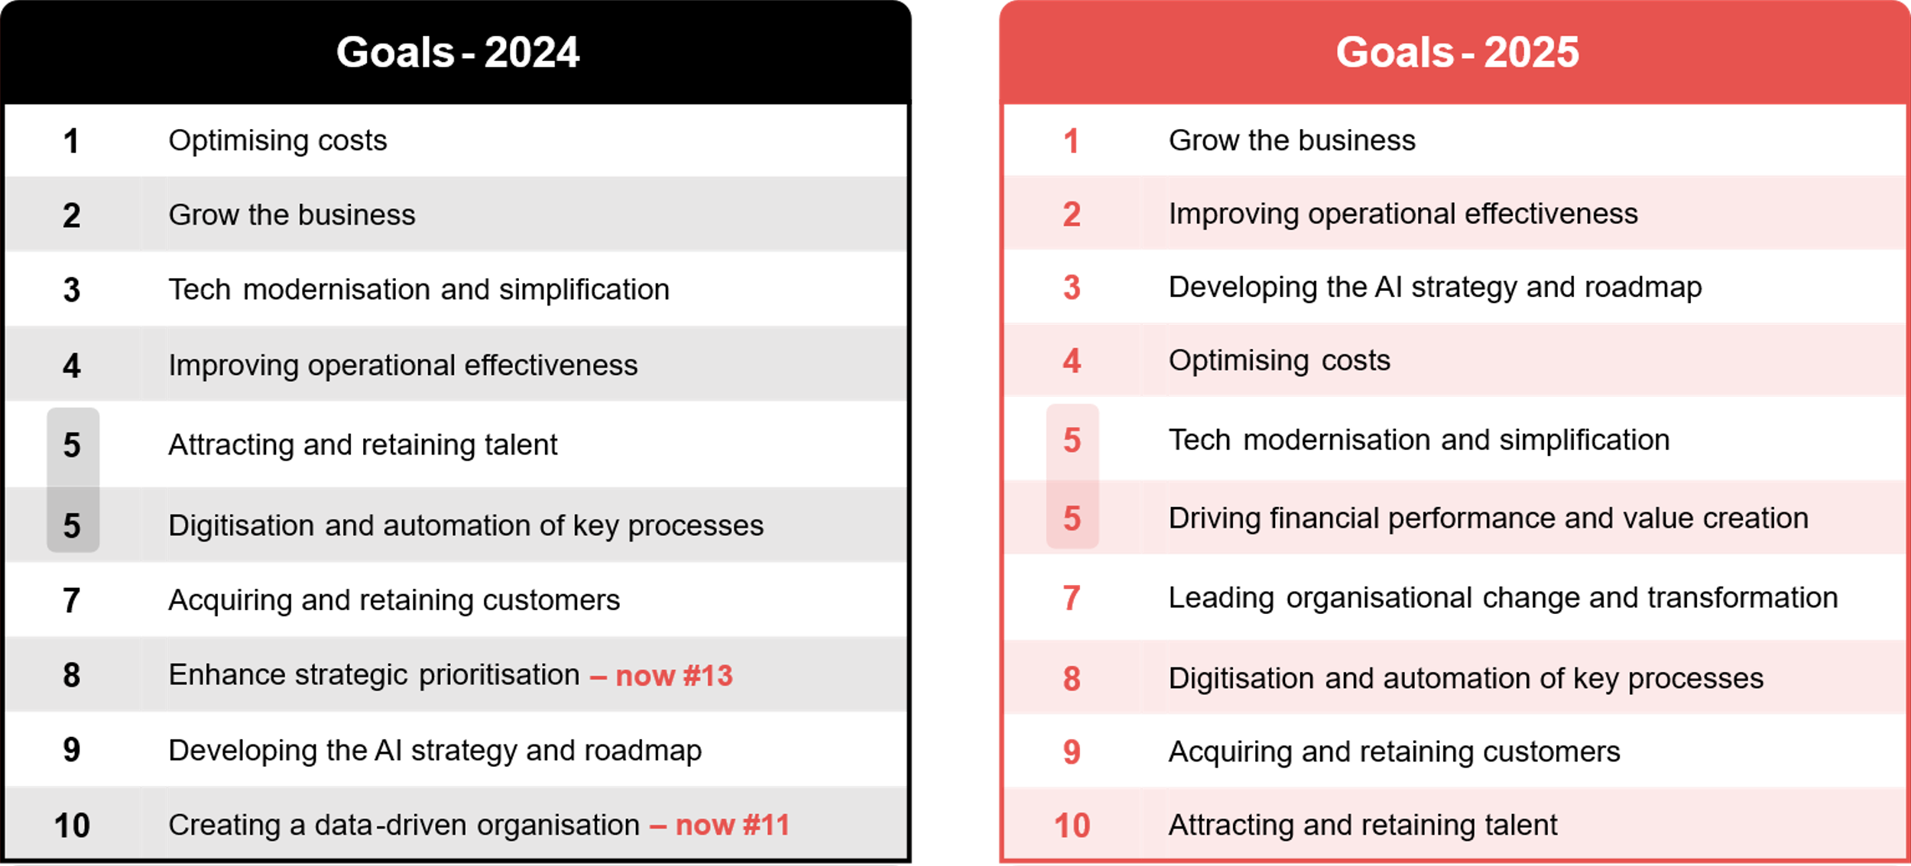
CFOs’ organisational goals (2024 and 2025)
Source: ADAPT CFO Edge Surveys in Nov 2024 and Nov 2025. Sample size:231 Australian CFOs

Slide 5
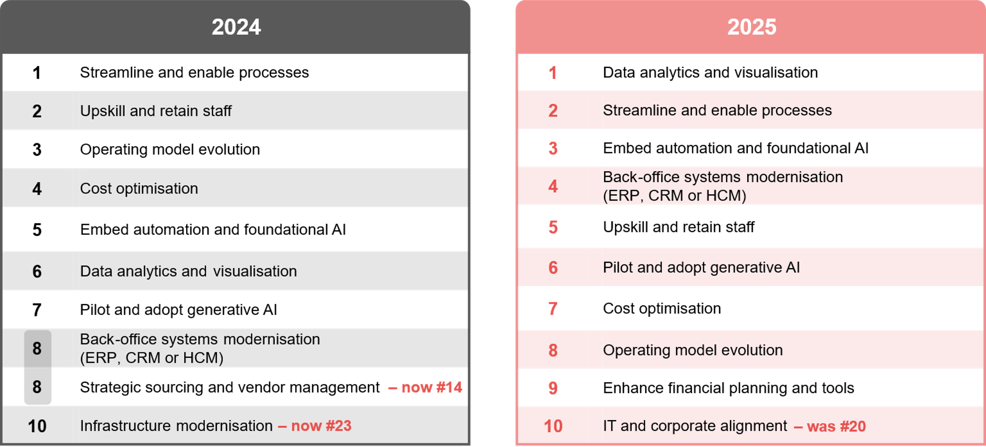
CFOs’ initiatives (Nov 2024 and Nov 2025)
Source: ADAPT CFO Edge Surveys in Nov 2024 and Nov 2025. Sample size: 228 Australian CFOs

Slide 6
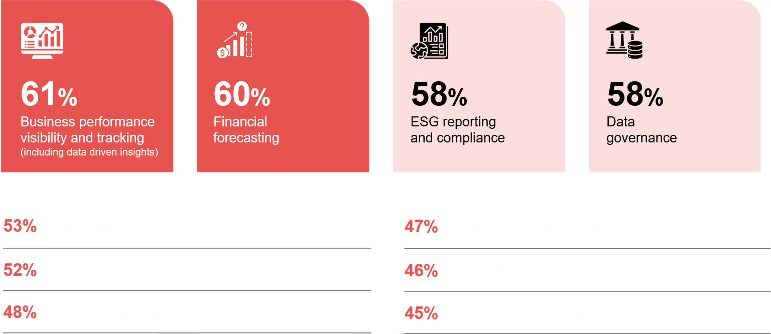
CFOs’ investment priorities in the next 12 months
Source : ADAPT CFO Edge Survey in Nov 2025. Sample size :132 Australian CFOs

Slide 7
Moving away from a cost-defensive stance to drive growth
CFOs are shifting from simply optimising costs to enabling business growth. This means they can no longer
rely solely on managing cost pressures.
Talent and customer growth have also dropped in priority as CFOs focus more on transformation goals.
Elevating operational excellence and AI as growth enablers
To strengthen support for growth, CFOs are prioritising operational effectiveness and AI strategies.
Alongside business growth, they continue to drive financial performance and lead structural changes,
both increasingly tied to tech-enabled outcomes.
Reframing tech modernisation and process simplification as enablers
Modernisation and digitisation are now viewed as supportive capabilities for driving revenue, efficiency
and AI adoption. They are no longer seen as frontline drivers compared to operational excellence and AI. However, initiatives to streamline processes, embed automation and modernise ERP remain crucial for
driving high-value analytics.
Strong alignment between initiative and investment priorities
To drive business growth, CFOs are focusing on data analytics, backed by significant investment in real-time and data-driven dashboards. The top 3 investment priorities are areas where AI can be quietly embedded
to drive performance such as automating monitoring dashboards.
Cyber risk mitigation also remains an important safeguard underpinning business continuity.
Other initiatives remain important despite lower priority
While talent has dropped to the tenth-ranked goal, CFOs still need upskilling to prepare teams for AI-driven
and digital work without increasing headcount. Operating model evolution has also slipped as an initiative,
with CFOs prioritising fast-return data, AI and digital initiatives over slower structural changes.
As finance becomes dependent on tech outcomes, IT alignment is now crucial for achieving growth.
Persona Mapping: CFO
From optimising
costs to achieving business growth
Growing the business is now the #1 goal
of Australian CFOs. Cost optimisation has dropped from #1 to #4 as a goal, and #4
to #6 as an initiative over the past year.
Operational effectiveness has risen from #4
to #2, while AI strategy has leapt from #9 to #3, signaling a rapid elevation of AI significance.
Modernisation drops from #3 to #5 in priority, reframing it as a support for the top goals.
The top initiative and investment priorities focus on enabling faster data-driven decision making.
While upskilling and operating model changes have dropped in initiative priorities, IT and corporate alignment has surged from #20 in 2024 to #10 in 2025.

Slide 8
AI deployment maturity

Slide 9
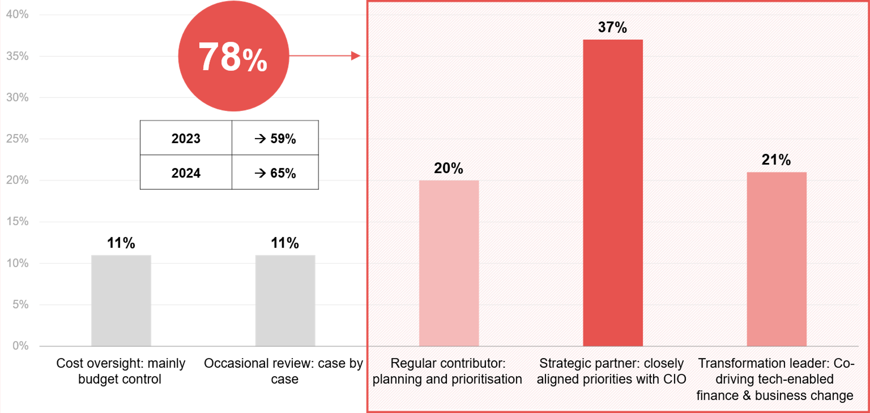
“Describe the CFO’s role in the technology & transformation strategy?”
Source : ADAPT CFO Edge Survey in Nov 2025. Sample size : 130 Australian CFOs

Slide 10
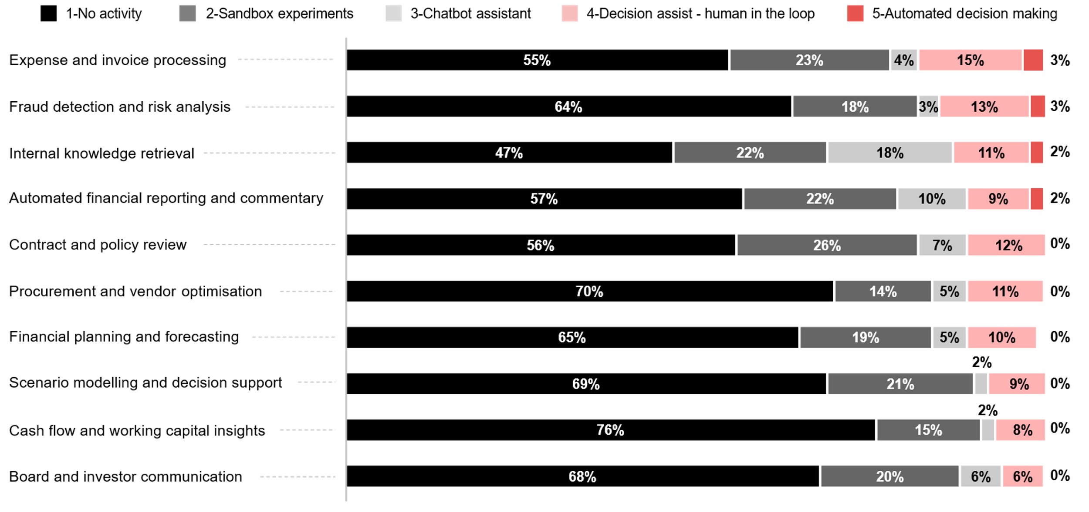
What are your primary generative AI use cases and the maturity of their deployments?
Please note that the percentages shown are rounded to the nearest whole number.
As a result, the total may appear slightly above or below 100% due to rounding.
Source : ADAPT CFO Edge Survey in Nov 2025. Sample size : 118 Australian CFOs

Slide 11
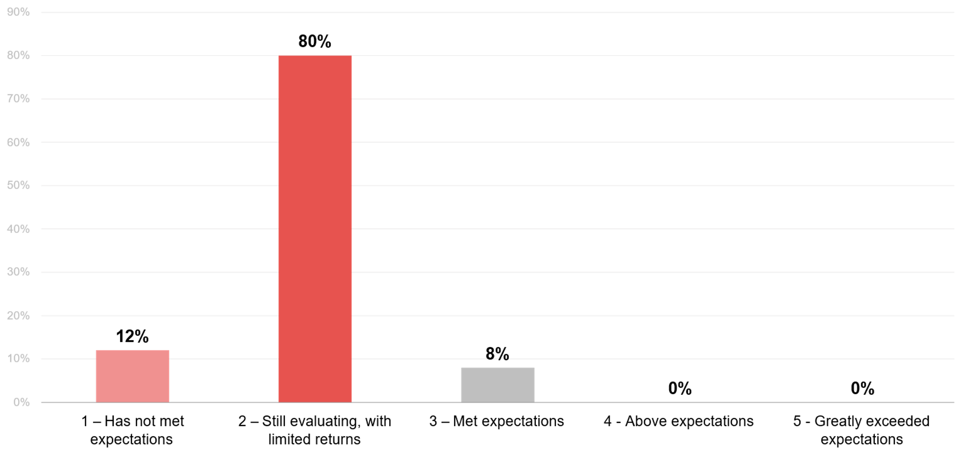
To what extent has your organisation's investments in generative AI met ROI expectations?
Source : ADAPT CFO Edge Survey in Nov 2025. Sample size : 104 Australian CFOs

Slide 12
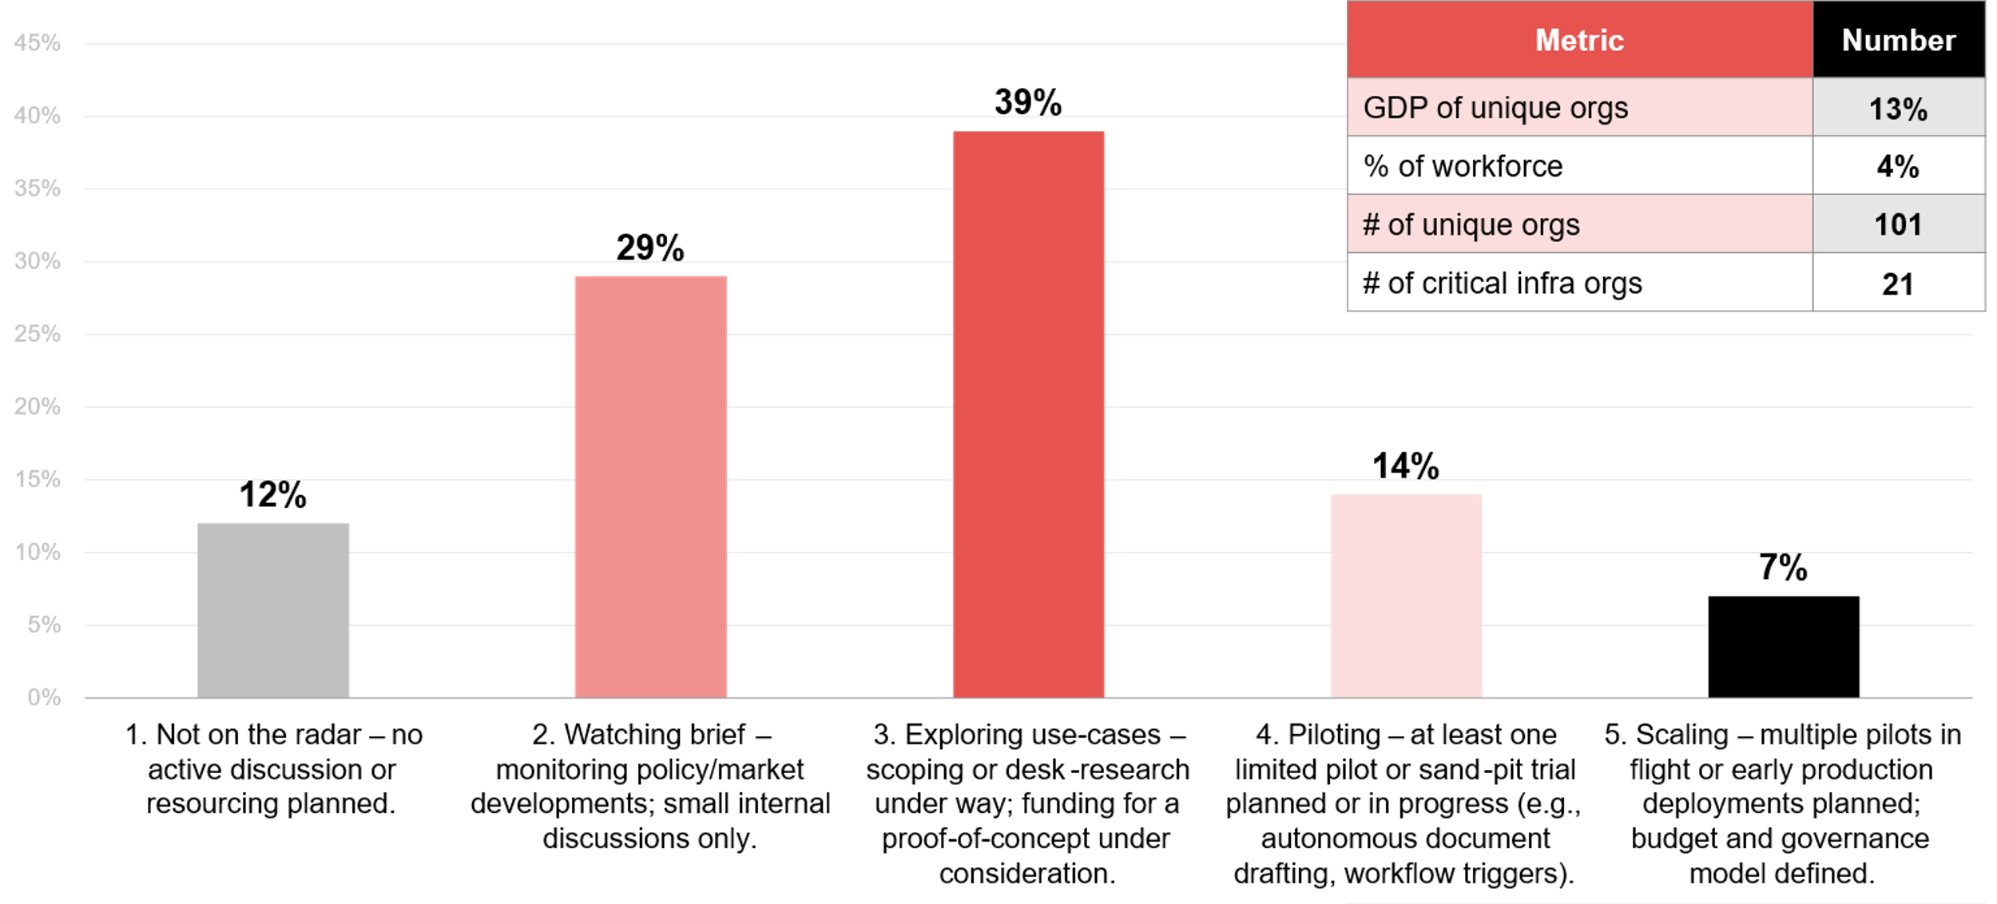
Which statement best describes your organisation's current appetite and capability
to leverage agentic AI over the next 18 months?
Source : ADAPT CFO Edge Survey in Nov 2025. Sample size : 104 Australian CFOs

Slide 13
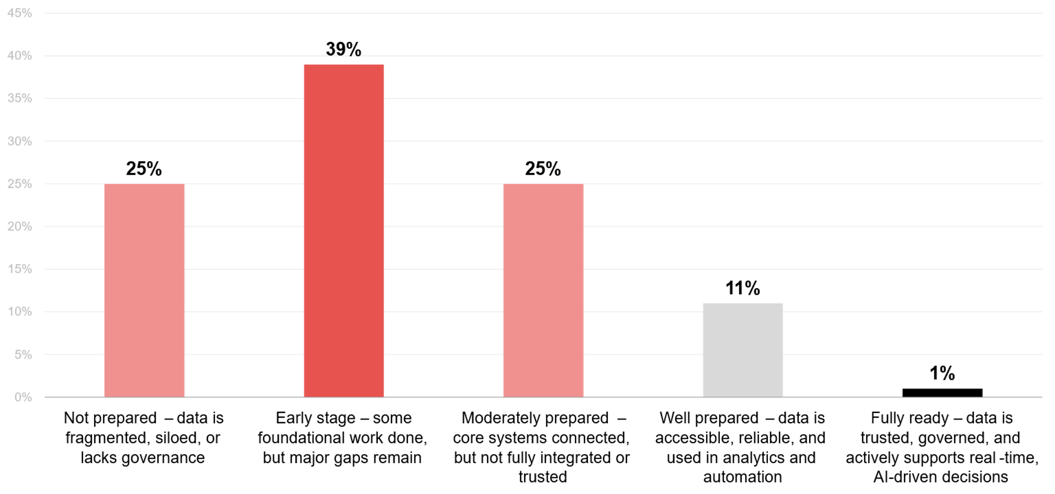
How prepared is your organisation’s data environment to support automated
decision making and agentic AI use cases?
Source : ADAPT CFO Edge Survey in Nov 2025. Sample size : 114 Australian CFOs

Slide 14
CFOs are key players in tech decisions
CFOs are moving beyond traditional financial management roles to drive strategic growth. Their involvement in technology decisions has grown year on year, from 59% in 2023 to 65% in 2024, and rising again to 78% in 2025.
IT and corporate alignment are an initiative priority indicating that CFOs are now aligning investment roadmaps with IT delivery. In fact, CFOs, along with tech leaders, are the most strategically involved stakeholders in tech decisions (ADAPT CIO Edge Survey, Aug 2025).
Remaining cautious about generative AI value realisation
CFOs are becoming more strategic in tech decisions, yet they remain cautious about realising the value of
GenAI amid rising investments in AI.
The low deployment maturity of GenAI use cases is caused by the lack of foundational readiness,
with only 12% being data-ready, and unclear ROIs. Other constraints are shown in slide 17.
Unclear ROI pathways
As 69-90% of CFOs are still in no-activity or sandbox phases, there’s not enough operational deployment
to generate measurable ROI. This makes it harder to quantify ROI. Most CFOs are still evaluating it.
Agentic AI adoption
Agentic AI maturity shows greater alignment with that of CIOs and government leaders. More insights are discussed in two ADAPT Tech Trend reports: CIO (Nov 2025) and Government (Dec 2025).
For CFOs, low agentic AI adoption is caused by low data readiness and integration challenges.
Foundational data readiness is low
CFOs have cited integration challenges as the #1 barrier to AI adoption; data readiness remains low.
Additionally, a mere 14% of organisations have fully modernised their ERP systems, which significantly undermines data quality (ADAPT CFO Edge Survey, Nov 2025).
Persona Mapping: CFO
CFOs are more involved in tech decisions but
AI deployments remain immature
More CFOs are taking a strategic role in technology decisions, with 78% reporting regular involvement in co-driving tech-enabled change.
CFOs are using generative AI (GenAI) for fraud detection and expense processing, but most use cases
are not yet deployed.
ROI for GenAI remains unproven, with 80% still evaluating with limited returns.
Agentic AI adoption is still early, with 68% monitoring or exploring use-cases.
Foundational data readiness is low,
with 64% not prepared or in the early stages for automated or AI-driven decision-making.

Slide 15
Execution barriers

Slide 16
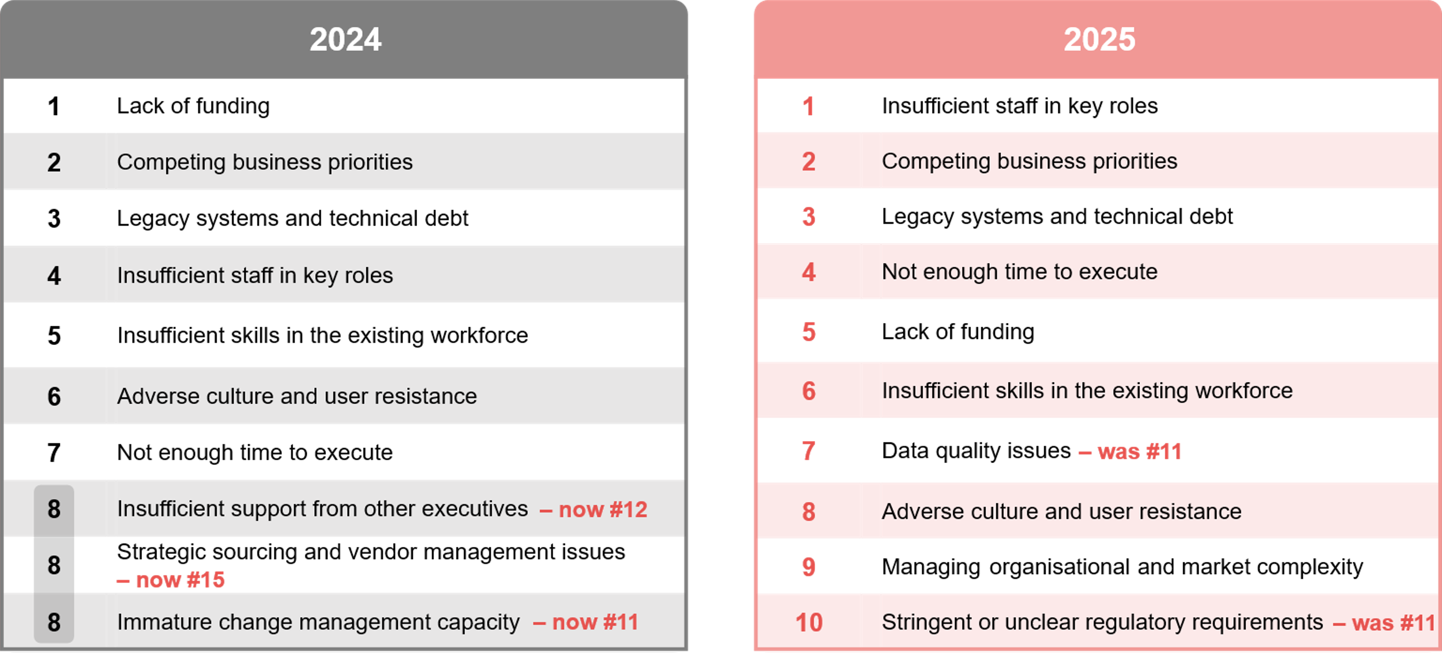
CFOs’ main execution barriers in 2024 and 2025
Source: ADAPT CFO Edge Surveys in Nov 2024 and Nov 2025. Sample size: 226 Australian CFOs

Slide 17
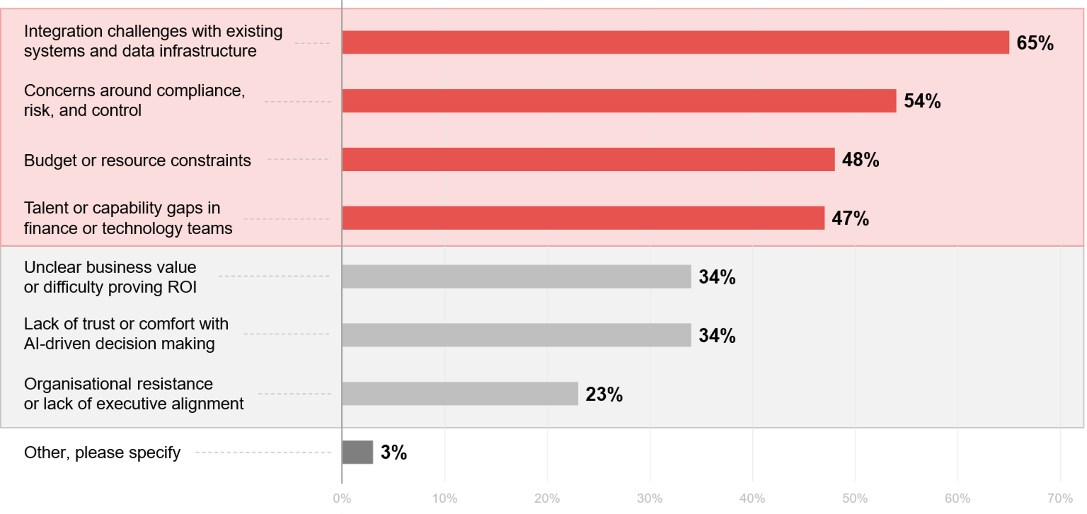
What are the most significant barriers preventing your
organisation from scaling agentic AI?
Source : ADAPT CFO Edge Survey in Nov 2025. Sample size : 116 Australian CFOs

Slide 18
Persona Mapping: CFO
The primary barrier has shifted from budget availability to operational constraints
CFOs stress that they lack the people and expertise to deliver organisational changes. As CFOs shift
from cost-cutting to growth, they struggle with execution capacity, competing priorities and legacy tech.
These top 3 barriers also affect the ability of CFOs to secure enough time to execute their initiatives.
CFOs also continue to face challenges with upskilling their staff and overcoming cultural resistance.
Funding & resource constraints: No longer the dominant barrier
Funding and resource constraints, once the top barrier, are now either stable or declining. This aligns with reduced investment in expenditure management—from the #1 initiative priority in 2024 (ADAPT CFO Persona Map report) to #7 IP in 2025, indicating that many CFOs have already optimised spending for maximum value. The shift from optimising costs to enabling growth suggests that funding is already secured.
Slow data readiness raises quality concerns
Although CFOs are increasingly focused on data-driven performance visibility, concerns about
data quality persist. These challenges hinder accurate forecasting and informed financial decisions.
As growth ambitions and AI adoption introduce greater operational risks and structural demands on
finance functions, CFOs face rising concerns about organisational complexity and regulatory pressure.
The top 3 agentic AI barriers mirror the top 10 execution barriers
Issues relating to legacy systems, data quality and compliance creates integration difficulties. While funding is no longer the leading barrier, it remains a constraint for agentic AI. In line with this, 67% of CFOs view strategic alignment as critical for making GenAI budget decisions (ADAPT CFO Edge Survey, Nov 2025).
Other agentic AI challenges highlight the need to strengthen AI foundations, improve security and trust,
invest in AI capability, and enhance performance tracking to ensure measurable ROI.
Top challenges
Labor shortage constraints are rising, from #4 in 2024 to #1 in 2025.
The lack of funding / resources
has dropped from #1 to the #5
execution barrier.
Other top 10 barriers are affecting CFOs’ finance functions.
The leading barrier to scaling agentic AI is integration challenges, followed by concerns around compliance,
risk and control, budget constraints, and talent gaps.
Other challenges in adopting agentic AI include proving ROI, building trust in AI-driven decisions, and overcoming organisational resistance.

Slide 19
Survey demographics

Slide 20
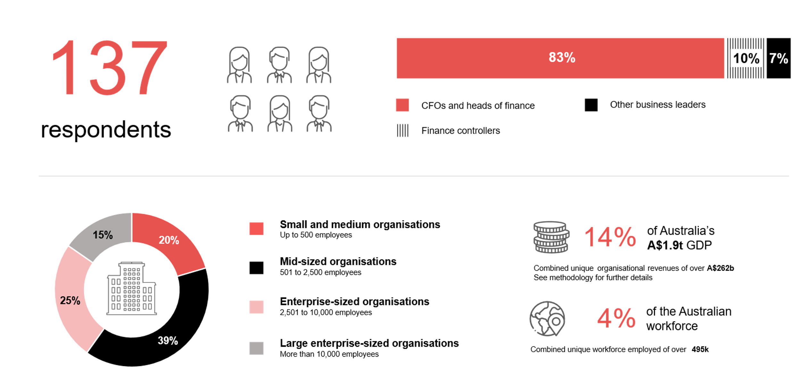
Survey demographics: Australian CFOs in 2025

Slide 21

For sector, segment and persona comparisons
Central limit theorem a fundamental concept in statistics that determines when a sample size is large enough
to be considered reliable. There are different formulas and some debate amongst statisticians about the appropriate sample size. For industry comparisons or other subset analyses, a sample size of ( n > 20 ) is generally considered acceptable for drawing meaningful insights. This threshold aligns with common statistical practices, where a
sample size of 20 to 30 is generally the minimum needed to assume a normal distribution of the data.
Sample sizes below 20, but equal to or greater than 15
When the sample size is between 15 and 20, while not fully representative, it can still offer valuable insights
into trends. These statistics should be viewed as indicative, highlighting general directions in industry efforts
or barriers to investment but treated with some caution due to the smaller number of observations.
Sample sizes less than 15, but greater or equal to 10
For samples between 10 and 15, the data provides a snapshot guideline only. While such small samples can
show early trends, it's important to recognise that this doesn't guarantee future respondents will reflect the same trends. For instance, while 100% of respondents in a sample of 10 might invest in AI, it'd be unrealistic to assume this pattern will hold as the sample size grows. However, if the sample size increases to 20, it's unlikely
that the trend will change drastically, and the next 10 respondents will have no investment.
ADAPT Data Analytics:
Notes on sample sizes
Why does sample size matter?
Each set of statistics is unique with measures,
distribution, variance and sample size. It is generally accepted in statistics that as sample size increases, analysts make fewer assumptions about the data, resulting in statistics that more accurately represent the truth.
ADAPT endeavours to provide transparency of sample size, whereby we provide a source on data slides with
the number of respondents and the survey where those respondents come from. In data and insights slide decks, ADAPT usually provides some insight on the breakdown
of the demographics at the end of the slide deck.
To protect privacy, ADAPT does not release lists
of individual respondents to surveys.

Slide 22

Written by
Honey Mari Gay
Junior Data Analyst at ADAPT
As a Junior Data Analyst at ADAPT, Mari enables the discovery and definition of market trends through visually meaningful statistics.
She ensures data presentations are accurate and aligned with modern statistical standards.
Mari is passionate about data and transforming it into actionable insights. With over three years of experience in project management and academic research, she has led end-to-end survey and research projects, processed and analysed data using a range of statistical tools
and techniques and provided clients with statistical consultation and insights.

Slide 23

About ADAPT
ADAPT is a specialist Research & Advisory firm providing local market insights and benchmarking data
to Australia and New Zealand’s senior technology and business community.
Since 2011, we’ve been empowering the leaders of the region’s top enterprise and government organisations
to stay at the forefront of modern trends and build for the future. Our industry leading conferences, private roundtable events and custom research projects equip business leaders with the knowledge, relationships, inspiration and tools they need to make better strategic decisions.
adapt.com.au | hello@adapt.com.au
Data Validation
Results contained in this report (Report) are based on survey responses as provided by our clients and publicly available information. ADAPT does not subject the data contained in the Report to audit or review procedures or any other testing to validate the accuracy or reasonableness of the data provided by the participating clients. While we do not manipulate the survey responses, we do make an effort to identify outlier data or conflicting results that could lead to misinterpretations before the preparation of the Report.
Intended Use of the Report
The Report is designed to help technology executives in Australia and New Zealand make independent decisions regarding financial, resourcing and operational performance matters. The information and data contained in the Report are provided as is and are for information purposes only. They are not intended or implied to be recommendations and in no event will ADAPT be liable for any decisions or actions taken in reliance of the results obtained through the use of the information and/or data contained in the Report.
Research MSA and Privacy Policy
The Report and any other information provided by ADAPT is subject to the Research and Advisory Master Services Agreement and the ADAPT Privacy Policy.

Slide 24




Additional resources you can access
Members of ADAPT’s Research & Advisory platform have access to an entire suite of market leading content, insights and resources to help you execute in your role. For any assistance contact your Account Manager in the help section.
Community case studies and interviews
Case studies detailing the successes
and challenges of projects and initiatives.
Market Trend Reports Access a library of fact-based actionable insights, deep dives on ANZ business & IT trends.
Live access to ADAPT analysts
Through live ADAPT analyst market briefings and Q&A sessions
Downloadable data and insights
Elevate your business cases with downloadable market and industry data.
Industry expert presentations
Watch keynotes or read distilled 1-page executive summaries from our Edge Events.
Bespoke analysis of ADAPT data
Receive custom cuts and analysis of ADAPT proprietary data.
Premier executive community
Unlock access to our exclusive network of Australia’s leading technology and business executives.
Dedicated account manager and impact assessments
Your Account Manager will ensure you and your team are getting the most out of your subscription.
Dedicated analyst briefing
Leverage a dedicated briefing with an ADAPT analyst to help validate your strategies.
*Inclusions may vary depending on subscription level.

Slide 25

adapt.com.au | hello@adapt.com.au | +61 (2) 9435 3535

