Slide 1

ADAPT Technology Trends
How CFOs Evaluate, Fund and Accelerate Technology: Insights on Value, Adoption and Modernisation

Slide 2
Technology Trends: Finance
The following key points describe CFOs’ perspectives on IT / business initiatives and finance functions.
CFOs agree with CIO IT metrics and value timelines, yet CIOs struggle to secure budget approval
CFOs and CIOs use similar frameworks to evaluate IT and business initiatives, but CFOs prioritise risk reduction more than CIOs, who focus more on cost savings.
CIOs often face budget constraints when seeking approval for funding from CFOs.
Both CFOs and CIOs place less emphasis on delivery speed and employee experience as primary metrics, expecting instead to realise measurable value from these initiatives within a year.
Finance systems improving, yet tech waste persists
Despite most organisations having made progress in modernising ERP and core finance systems, around 39% of technology spend is still wasted.
When accelerating financial transformation, tech departments tend to excel at cyber security
and resilience but struggle to operate effectively within finance functions..
Key takeaways
ADAPT’s CFO Edge Survey
(Nov 11, 2025) presents Australian
CFOs’ views on:
major IT & business initiatives, including their top critical evaluation metrics, value timelines and IT funding barriers
technology performance and digital capabilities to accelerate financial transformations.

Slide 3
Critical metrics, value timelines and CIO funding barriers

Slide 4
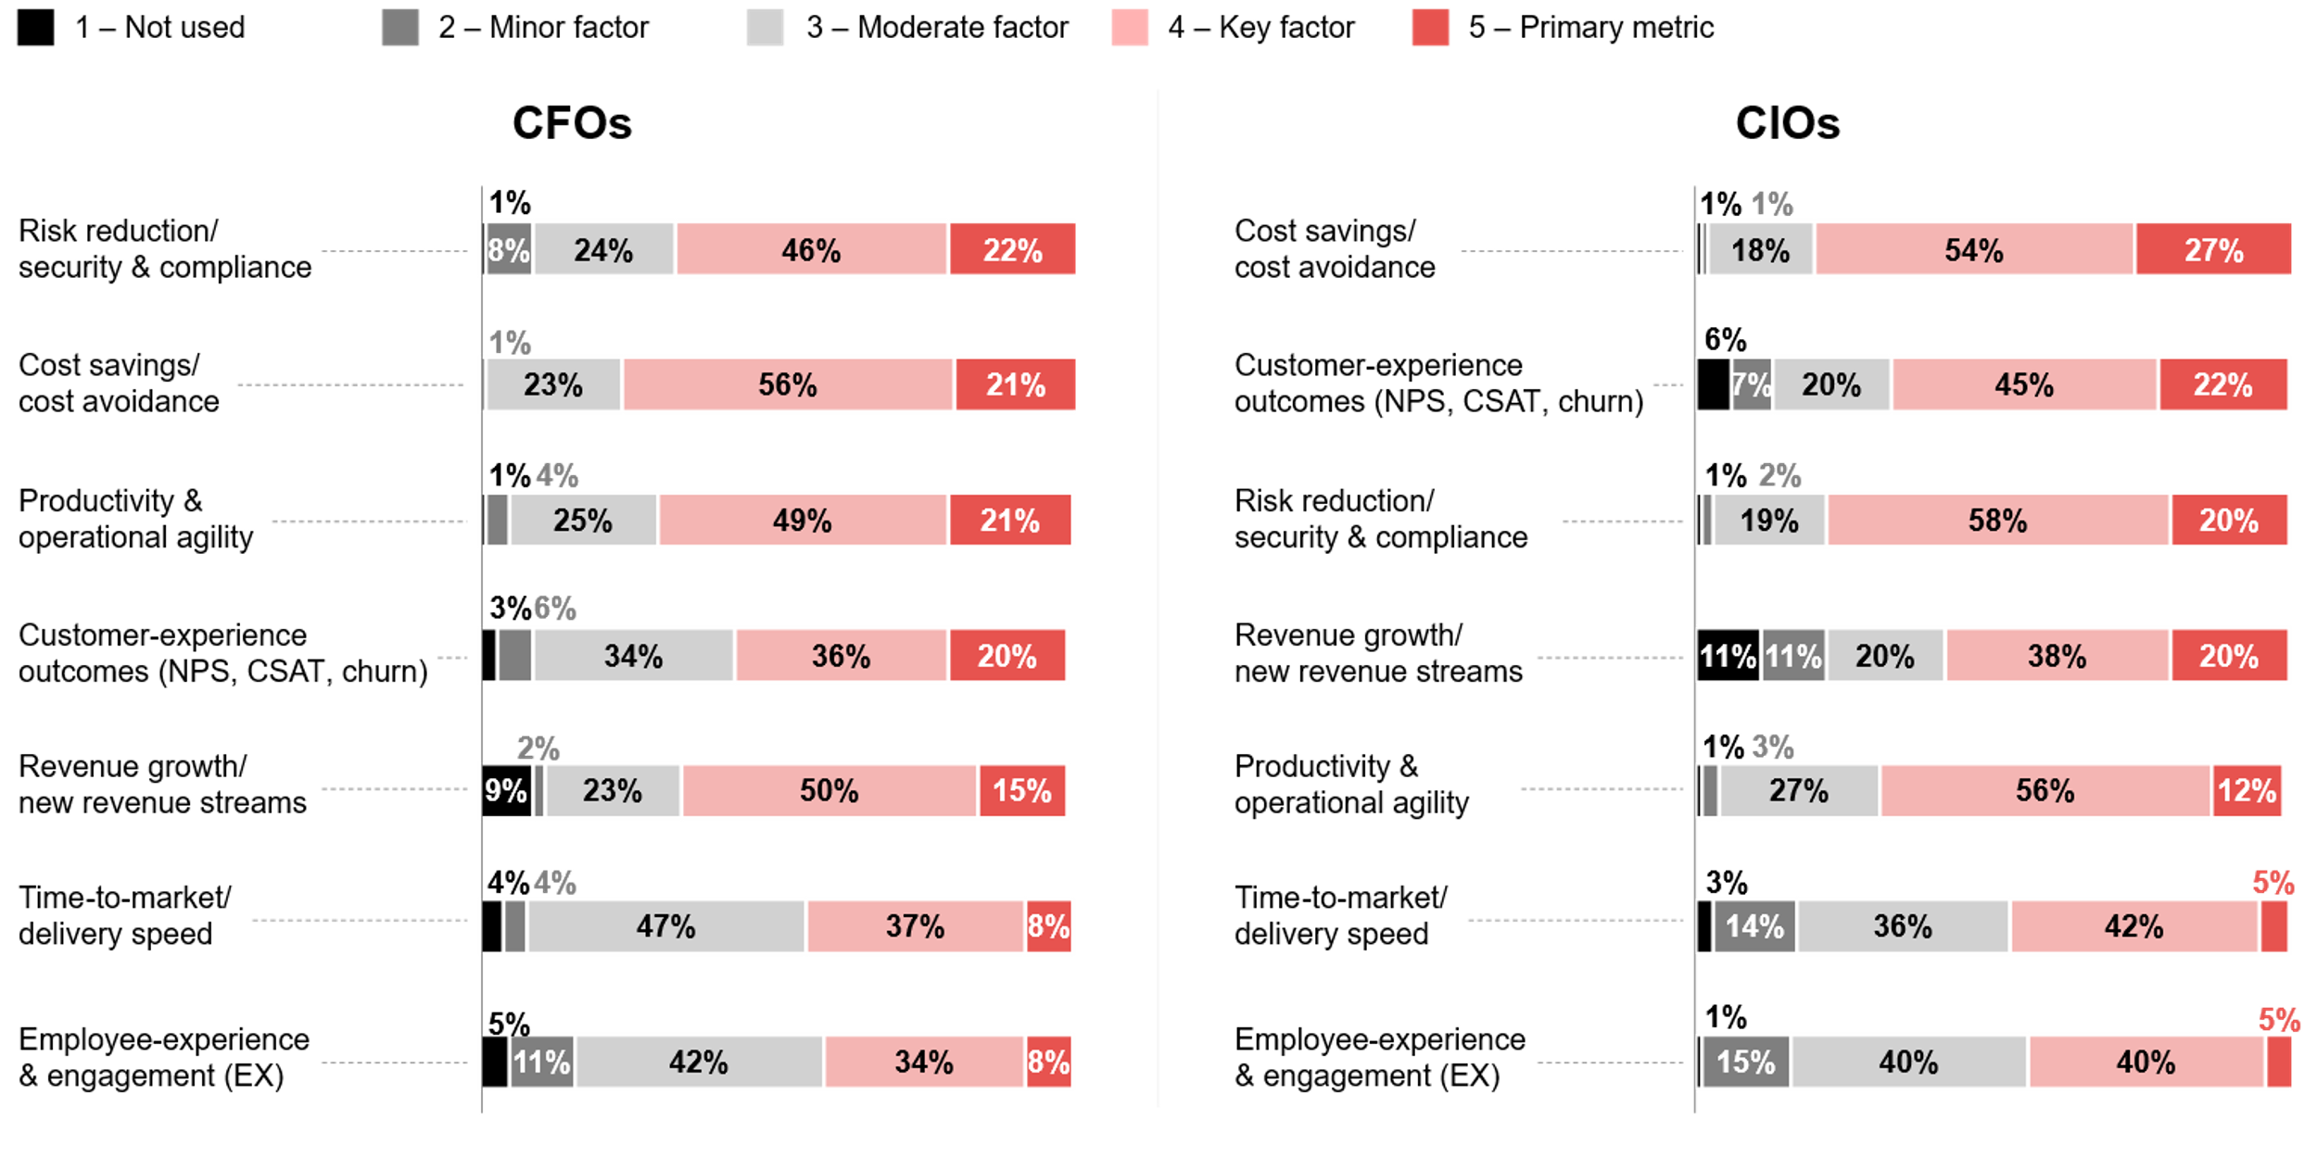
When reviewing major IT initiatives, how important is each metric for your evaluation and approval process? (CFOs and CIOs)
Source : ADAPT CIO and CFO Edge Surveys in Aug and Nov 2025. Sample size : 277 Australian CIOs and CFOs

Slide 5
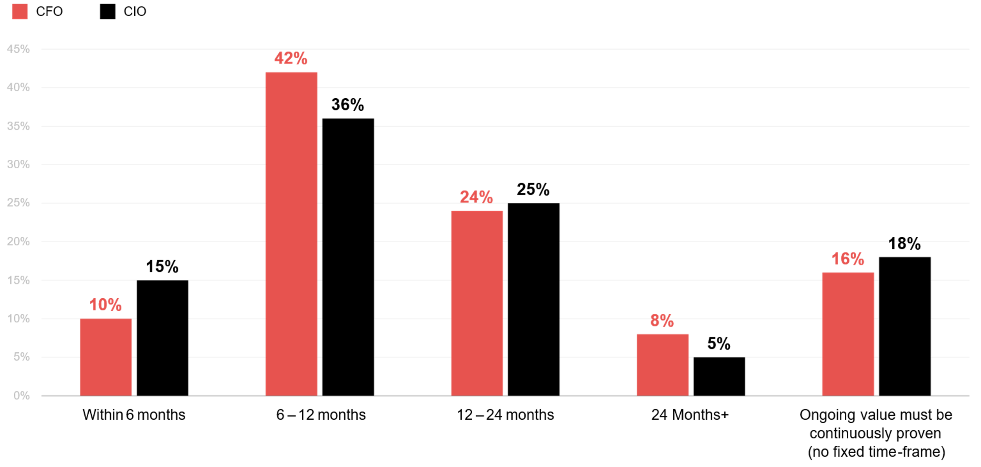
When does your department expect to realise measurable value after major IT initiatives go live? (CFOs and CIOs)
Source : ADAPT CIO and CFO Edge Surveys in Aug and Nov 2025. Sample size : 277 Australian CIOs and CFOs

Slide 6
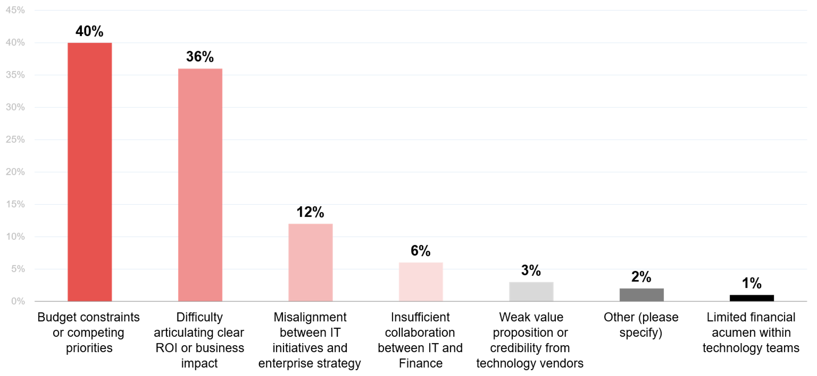
What do you see as the biggest challenge CIOs and technology leaders face in securing budget approval from CFOs?
Source : ADAPT CFO Edge Survey in Nov 2025. Sample size : 124 Australian CFOs

Slide 7
Top evaluation metrics for IT initiatives
CFOs and CIOs use similar frameworks when assessing IT initiatives, prioritising risk reduction, costs, productivity, customer experience and revenue growth. Lower emphasis is placed on delivery speed and employee experience. However, CIOs weigh cost savings more heavily, while CFOs emphasise risk reduction..
Reducing risk and driving rapid business growth
As CFOs and CIOs aim for business growth in 2025 (ADAPT CIO and CFO Persona Map reports, Dec 2025), they are shifting from long-term transformation programs toward initiatives that deliver immediate productivity impact. This requires early evidence of success to unlock further investment.
With AI strategy now a top priority, both leaders expect accelerated impact, better insights, and shorter cycle times.
CIOs face stricter scrutiny as CFOs tighten spending
CIOs struggle to secure IT funding as CFOs demand clearer links to business growth, with a strong focus on data analytics initiatives.
CFOs’ investment in expenditure management (#7 IP) aims to quantify savings with transparent outcomes. Tech initiatives lacking visibility or fast ROI often face approval delays.
Challenges in securing budget approval
CIOs report challenges such as misalignment between IT initiatives and enterprise strategy, along with poor collaboration with finance. To address this, CFOs are prioritising IT-business alignment, moving from #20 to #10 initiative priority in 2025. Only a few CFOs cite other issues, such as vendor credibility and limited financial acumen within tech teams.
Technology Trends
Critical metrics, value timelines and CIO funding barriers
When evaluating IT initiatives, CFOs prioritise risk reduction, while CIOs focus on cost savings and cost avoidance.
More than half of CFOs and CIOs expect IT initiatives to deliver measurable value within one year.
The biggest challenges CIOs and technology leaders face in securing budget approval from CFOs are:
  Budget constraints (40%)
  Difficulty articulating ROI (36%)
Additionally, about 12% of CFOs cite misalignment between IT initiatives and enterprise strategy as a challenge, while 6% point to poor collaboration with finance.

Slide 8
Assessing technology performance and finance-ready capabilities

Slide 9
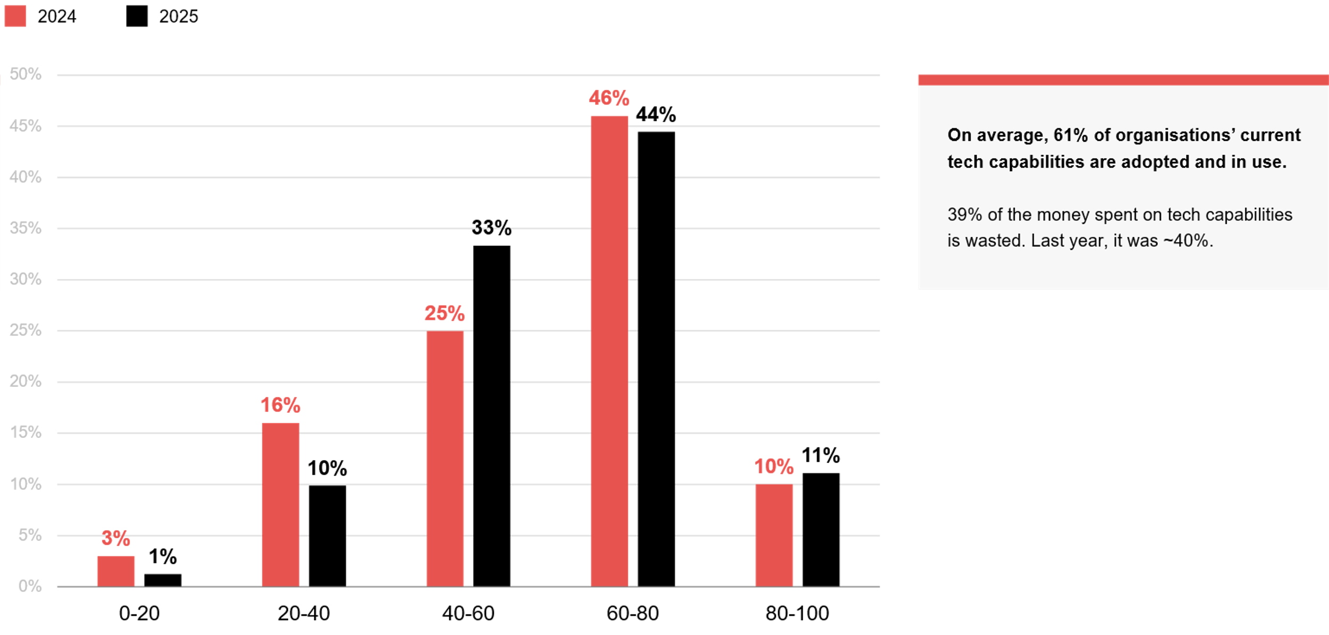
Roughly what % of your organisation's technology capabilities are adopted and in use? (2024 vs 2025)
Source : ADAPT CFO Edge Surveys in Nov 2024 and Nov 2025. Sample size : 159 Australian CFOs

Slide 10
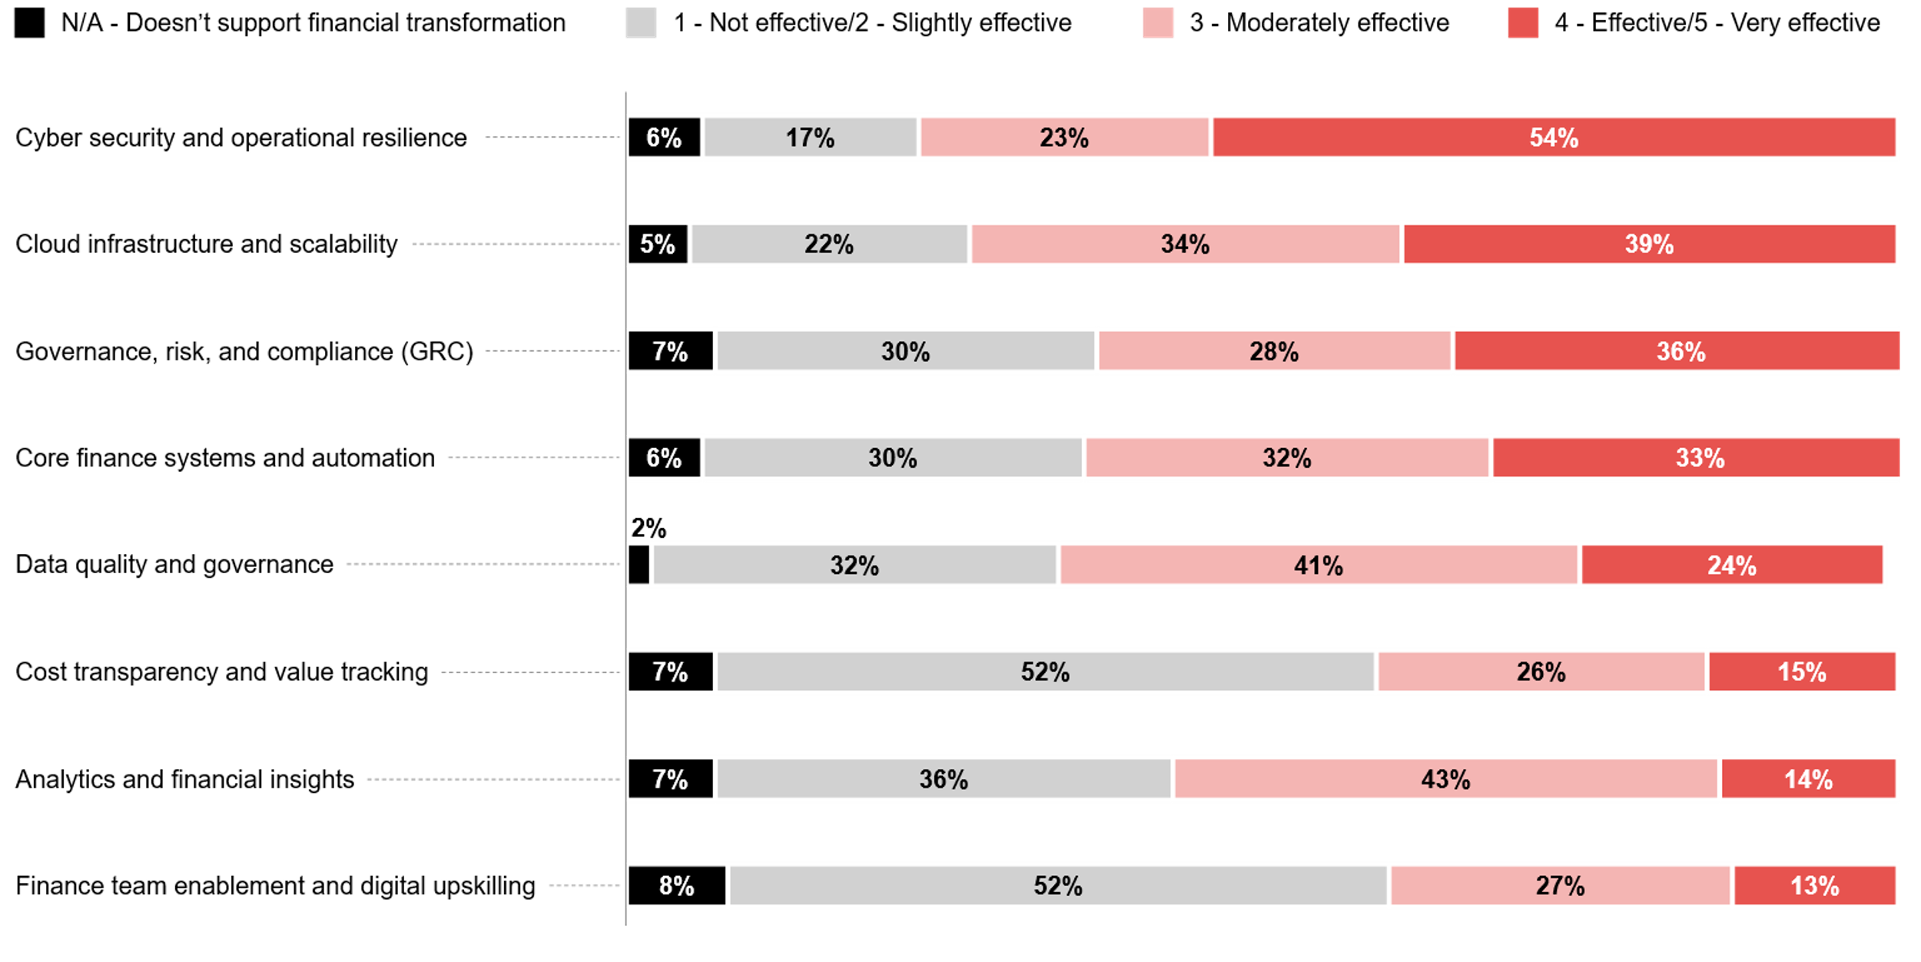
How effectively does your technology department support the following capabilities to accelerate financial transformation?
Source : ADAPT CFO Edge Survey in Nov 2025. Sample size : 125 Australian Chief Financial Officers

Slide 11
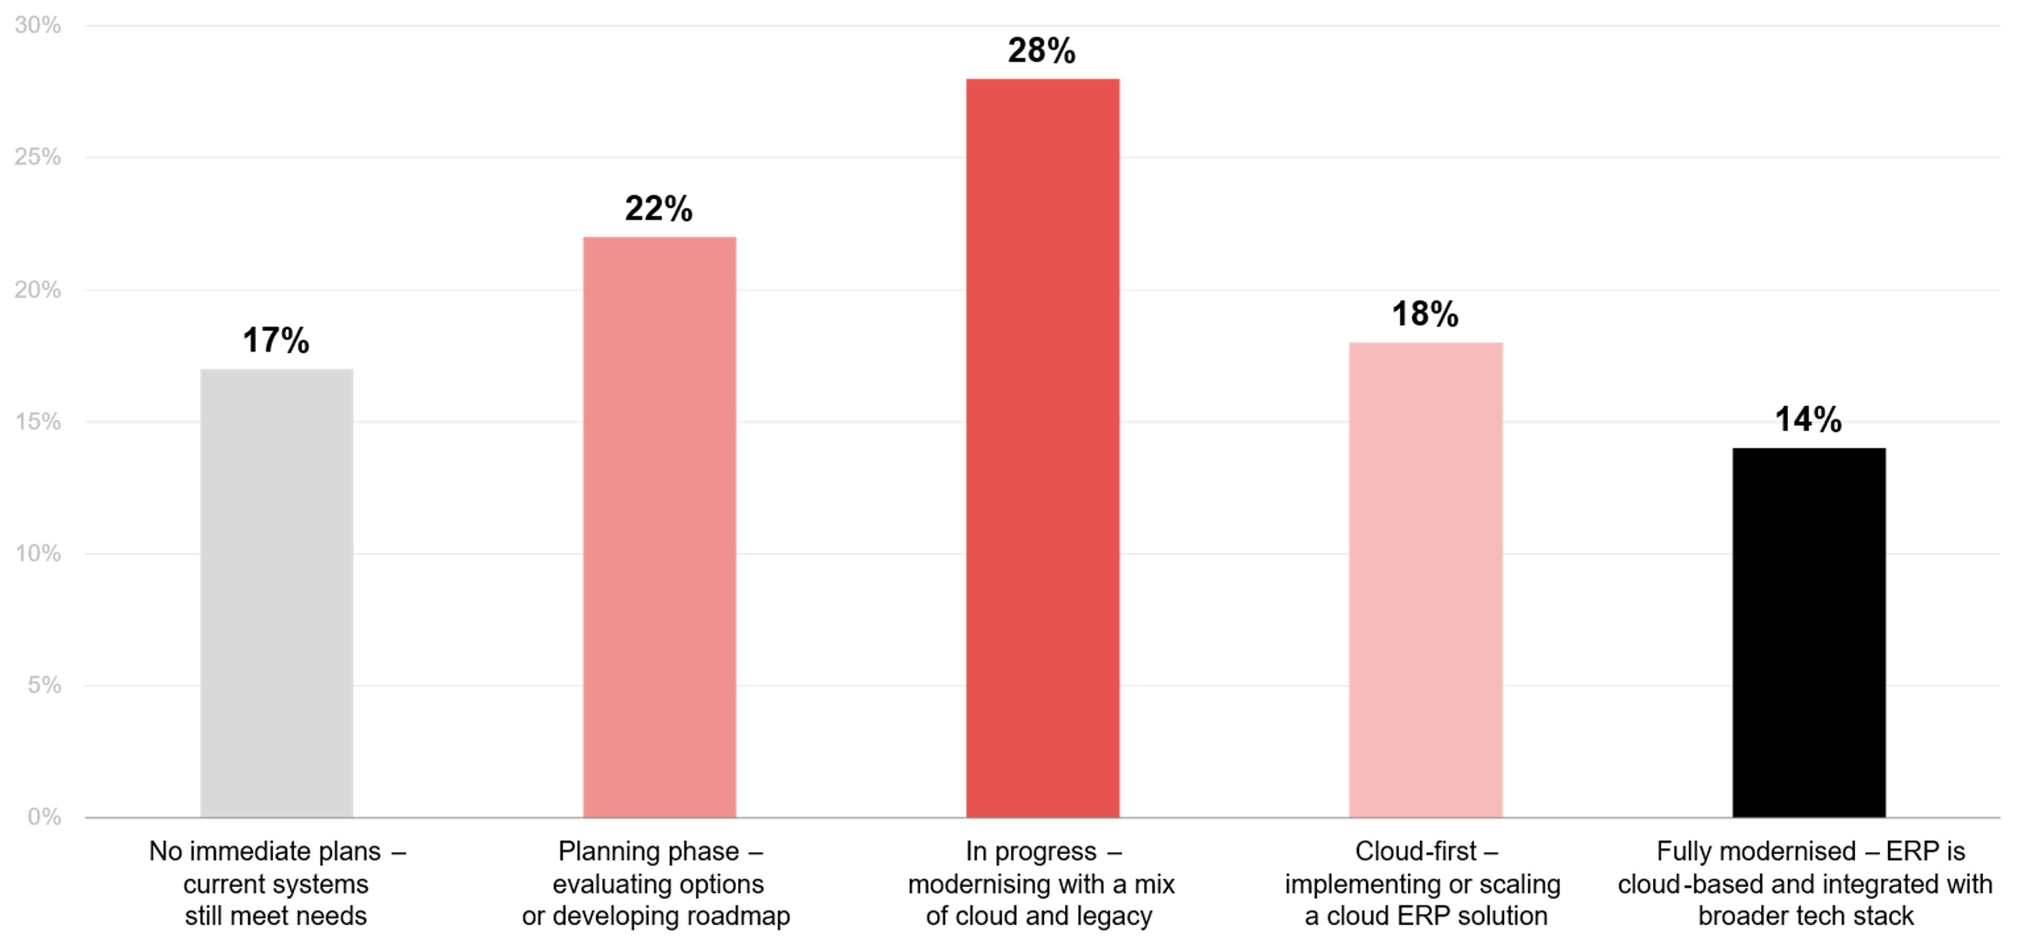
What best describes your organisation’s current approach to ERP and core finance system modernisation?
Source : ADAPT CFO Edge Survey in Nov 2025. Sample size : 126 Australian Chief Financial Officers

Slide 12
Technology Trends
A significant portion of organisational technology remains underused
CFOs report that tech capability adoption improved by 1% from 2024 to 2025, yet a significant portion remains underused. While adoption is rising, most organisations are still far from fully leveraging the systems, tools, and platforms they have invested in.
Tech functions excel in cyber security and resilience, but struggle in finance
CFOs see their tech departments performing strongly in foundational infrastructure and security, but lagging in finance-centric, insight-generating, and value-measurement capabilities, which are the most critical areas to drive modern financial transformation.
Data quality and governance is moderately effective
Tech departments are stronger in cyber security, cloud, and GRC than in finance-specific data capabilities, leading CFOs to rate data quality and governance as only moderately effective. High-quality data requires ERP integration, achieved in just 14% of organisations that have fully integrated ERP with their broader tech stack.
ERP modernization progress
Most organisations have advanced in modernising ERP and core finance systems, aligning with CFOs’ #4 initiative priority. While tech modernisation is no longer a standalone strategic goal, ERP modernisation remains essential. Without it, CFOs will struggle to execute growth initiatives.
As AI strategy rises as a top CFO goal, a modern ERP becomes even more critical.
Assessing technology performance and finance-ready capability
On average, 61% of organisations' current tech capabilities are adopted and in use.
About 54% of CFOs show the highest confidence
in cyber security and operational resilience, followed by 39% of CFOs who indicate effectiveness in cloud infrastructure.
Most tech departments are moderately effective
in data quality control and governance.
About 62% of organisations are progressing in
their ERP and core finance system modernisation.

Slide 13
Survey demographics

Slide 14
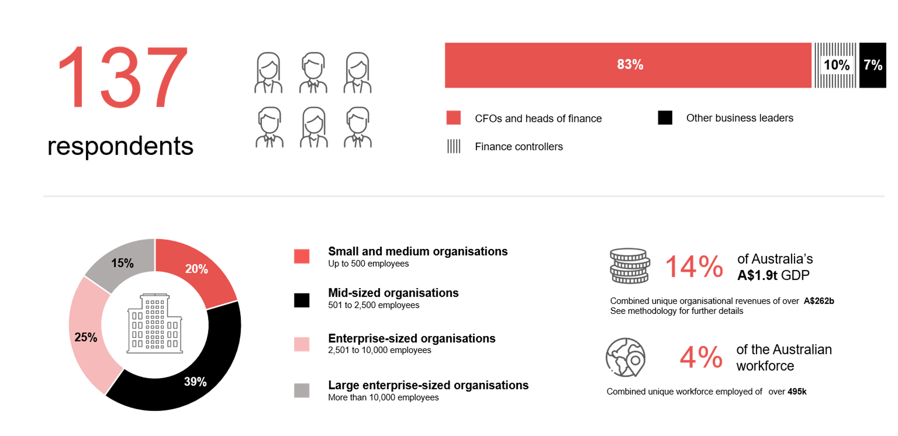
Survey demographics: Australian CFOs in 2025

Slide 15

For sector, segment and persona comparisons
Central limit theorem a fundamental concept in statistics that determines when a sample size is large enough
to be considered reliable. There are different formulas and some debate amongst statisticians about the appropriate sample size. For industry comparisons or other subset analyses, a sample size of ( n > 20 ) is generally considered acceptable for drawing meaningful insights. This threshold aligns with common statistical practices, where a
sample size of 20 to 30 is generally the minimum needed to assume a normal distribution of the data.
Sample sizes below 20, but equal to or greater than 15
When the sample size is between 15 and 20, while not fully representative, it can still offer valuable insights
into trends. These statistics should be viewed as indicative, highlighting general directions in industry efforts
or barriers to investment but treated with some caution due to the smaller number of observations.
Sample sizes less than 15, but greater or equal to 10
For samples between 10 and 15, the data provides a snapshot guideline only. While such small samples can
show early trends, it's important to recognise that this doesn't guarantee future respondents will reflect the same trends. For instance, while 100% of respondents in a sample of 10 might invest in AI, it'd be unrealistic to assume this pattern will hold as the sample size grows. However, if the sample size increases to 20, it's unlikely
that the trend will change drastically, and the next 10 respondents will have no investment.
ADAPT Data Analytics:
Notes on sample sizes
Why does sample size matter?
Each set of statistics is unique with measures,
distribution, variance and sample size. It is generally accepted in statistics that as sample size increases, analysts make fewer assumptions about the data, resulting in statistics that more accurately represent the truth.
ADAPT endeavours to provide transparency of sample size, whereby we provide a source on data slides with
the number of respondents and the survey where those respondents come from. In data and insights slide decks, ADAPT usually provides some insight on the breakdown
of the demographics at the end of the slide deck.
To protect privacy, ADAPT does not release lists
of individual respondents to surveys.

Slide 16


Written by
Gabby Fredkin
Head of Data and Analytics at ADAPT
Honey Mari Gay
Junior Data Analyst at ADAPT
Gabby’s primary role is managing ADAPT’s overall strategy for Data Analytics. He has extensive experience in using data to identify trends in technology that help shape Australian organisations. Using modern data science techniques, he ensures the accuracy and validity of the information that supports ADAPT’s research, advisory services, and events, giving both ADAPT and its customers greater confidence in the insights provided.
With a passion for creating stories with data, Gabby is consistently rated as one of the top speakers at ADAPT Events. In round table discussions, he specialises in using statistics to initiate thought-provoking discussions. Gabby is effective in translating information into insights, enabling ADAPT’s customers to become more data-driven.
As a Junior Data Analyst at ADAPT, Mari enables the discovery and definition of market trends through visually meaningful statistics. She ensures data presentations are accurate and aligned with modern statistical standards.
Mari is passionate about data and transforming it into actionable insights. With over three years of experience in project management and academic research, she has led end-to-end survey and research projects, processed and analysed data using a range of statistical tools and techniques, and provided clients with statistical
consultation and insights.

Slide 17

About ADAPT
ADAPT is a specialist Research & Advisory firm providing local market insights and benchmarking data
to Australia and New Zealand’s senior technology and business community.
Since 2011, we’ve been empowering the leaders of the region’s top enterprise and government organisations
to stay at the forefront of modern trends and build for the future. Our industry leading conferences, private roundtable events and custom research projects equip business leaders with the knowledge, relationships, inspiration and tools they need to make better strategic decisions.
adapt.com.au | hello@adapt.com.au
Data Validation
Results contained in this report (Report) are based on survey responses as provided by our clients and publicly available information. ADAPT does not subject the data contained in the Report to audit or review procedures or any other testing to validate the accuracy or reasonableness of the data provided by the participating clients. While we do not manipulate the survey responses, we do make an effort to identify outlier data or conflicting results that could lead to misinterpretations before the preparation of the Report.
Intended Use of the Report
The Report is designed to help technology executives in Australia and New Zealand make independent decisions regarding financial, resourcing and operational performance matters. The information and data contained in the Report are provided as is and are for information purposes only. They are not intended or implied to be recommendations and in no event will ADAPT be liable for any decisions or actions taken in reliance of the results obtained through the use of the information and/or data contained in the Report.
Research MSA and Privacy Policy
The Report and any other information provided by ADAPT is subject to the Research and Advisory Master Services Agreement and the ADAPT Privacy Policy.

Slide 18




Additional resources you can access
Members of ADAPT’s Research & Advisory platform have access to an entire suite of market leading content, insights and resources to help you execute in your role. For any assistance contact your Account Manager in the help section.
Community case studies and interviews
Case studies detailing the successes
and challenges of projects and initiatives.
Market Trend Reports Access a library of fact-based actionable insights, deep dives on ANZ business & IT trends.
Live access to ADAPT analysts
Through live ADAPT analyst market briefings and Q&A sessions
Downloadable data and insights
Elevate your business cases with downloadable market and industry data.
Industry expert presentations
Watch keynotes or read distilled 1-page executive summaries from our Edge Events.
Bespoke analysis of ADAPT data
Receive custom cuts and analysis of ADAPT proprietary data.
Premier executive community
Unlock access to our exclusive network of Australia’s leading technology and business executives.
Dedicated account manager and impact assessments
Your Account Manager will ensure you and your team are getting the most out of your subscription.
Dedicated analyst briefing
Leverage a dedicated briefing with an ADAPT analyst to help validate your strategies.
*Inclusions may vary depending on subscription level.

