Slide 1

ADAPT Technology Trends
Modernisation Progress
and Maturity of FinOps Practices

Slide 2
Modernisation progress
Tech modernisation is the #1 goal of Australian infrastructure leaders. While their organisations
have made significant progress connecting apps using APIs, the integration process is an
ongoing challenge. Consolidating these apps is also proving to be the most sluggish aspect
of modernisation activities.
Infrastructure automation
About 80% of Australian organisations do not yet have comprehensive DevOps automation or
full-scale GitOps implementations. ADAPT identifies important factors for improving automation maturity among infrastructure leaders. Key elements include solid cloud strategy documentation, effective right-sizing recommendations, cost reviews with engineering teams, cost tracking,
and progress in workflow automation, infrastructure modernisation, and API integration.
Network security architecture for cloud environments
  76% of Australian organisations have not yet fully integrated network security architecture for their cloud environments. ADAPT finds that higher investment priorities in SASE and high-performance compute-as-a-service are associated with higher integration of network security. Other essential factors include progress in infrastructure consolidation and workload interoperability.
  Tech debt and FinOps practices
  While only a few organisations claim that vendor lock-ins and cost visibility are issues, many
  struggle to connect cloud spending to business value. Many organisations are still in the early stages of FinOps maturity, except for their implementation of right-sizing recommendations.
Technology Trends:
Key takeaways
ADAPT’s 2025 Cloud and Infrastructure Edge Survey provides insights into the modernisation progress and maturity of FinOps practices among Australian organisations.
The report covers:
their progress and capability in modernising, infrastructure automation, and network security architecture for cloud environments.
challenges in tech debt and FinOps practices.

Slide 3
Progress, compute
and capabilities

Slide 4
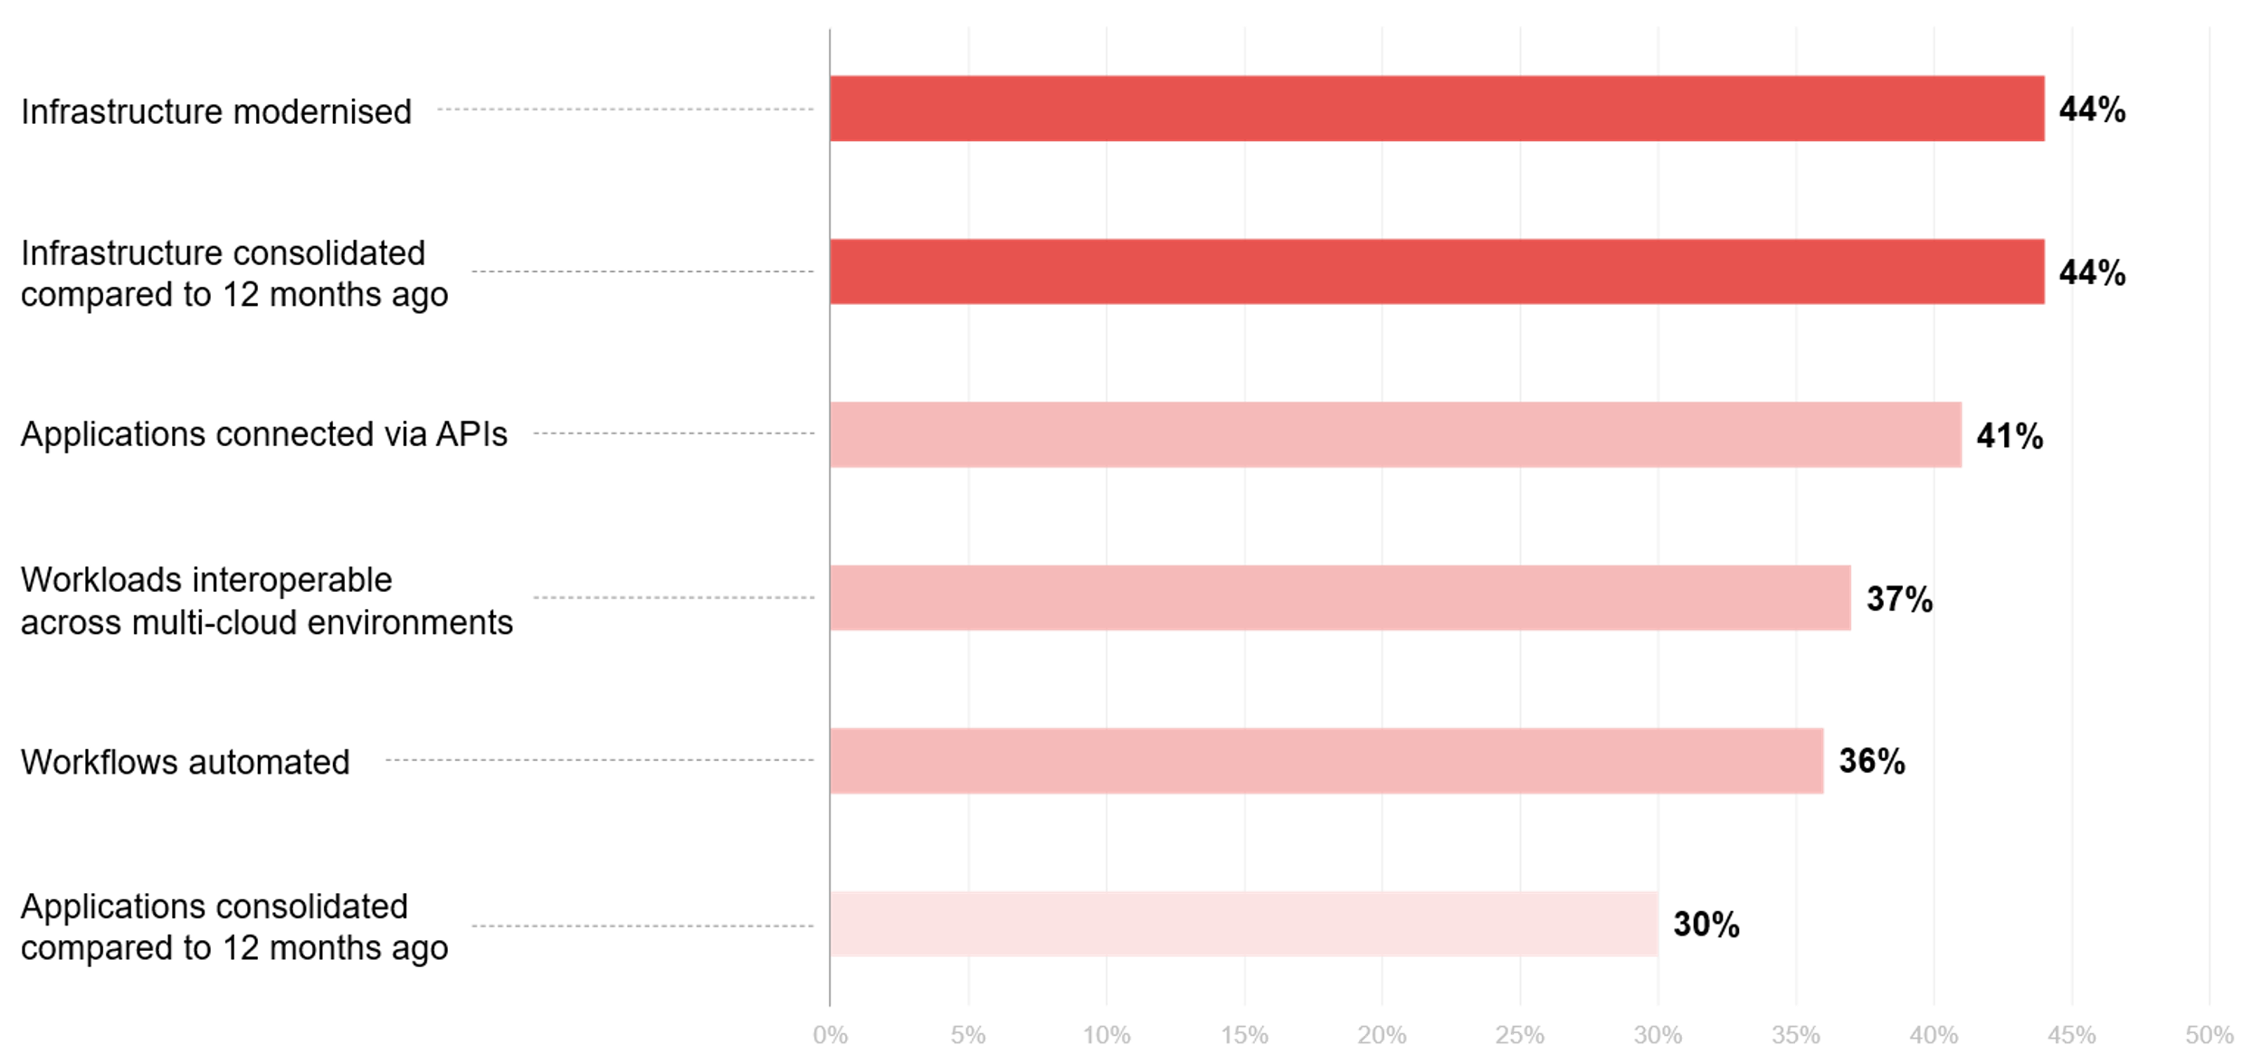
How much progress has your organisation made in the following areas?
Source : ADAPT Cloud and Infrastructure Edge Survey in July 2025. Sample size : 91 Australian infrastructure leaders

Slide 5
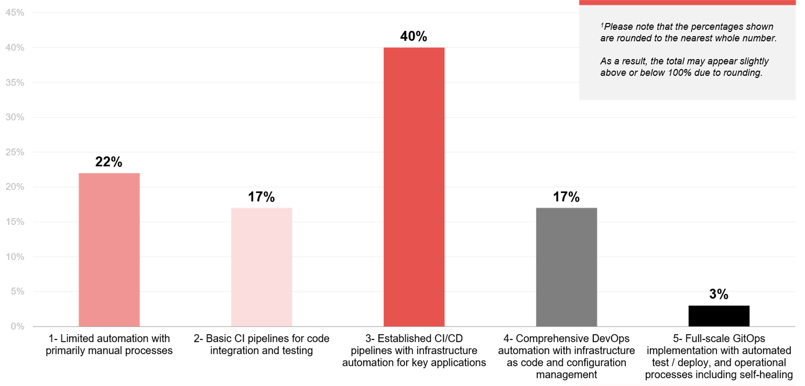
Infrastructure automation maturity across development and operations¹
Source : ADAPT Cloud and Infrastructure Edge Survey in July 2025. Sample size : 104 Australian infrastructure leaders

Slide 6
Modernising and consolidating infrastructure
Organisations are still midway through this process; they have completed upgrades but are still working towards full cloud-native maturity. While there's growing effort to streamline infrastructures, legacy systems and fragmented environments persist. More needs to be done in scaling infrastructure consolidation by simplifying operations and optimising costs.
API enablement is progressing, yet integrating becomes difficult
Modernising applications connected via APIs is progressing, but integration remains a barrier to scale.
This implies that many organisations still depend on outdated integration methods (#2 barrier) or face challenges with inconsistent API governance (#9 barrier).
Low interoperability stems from the complexities of managing workloads across cloud providers
This relates to issues in strategic sourcing and vendor management (#7 barrier). Additionally,
an ADAPT Cloud and Infrastructure Edge Survey in 2025 reveals that the majority of organisations
are repatriating most of their core services. This includes IAM, FinOps, helpdesk, platform engineering/EvOps functions, end-user computing and AI/ML infrastructure management.
Aside from interoperability, automation and application consolidation are still developing
This further suggests a greater need to invest in process simplification, multi-cloud unification
and scalable information architecture.
Infrastructure automation maturity
Most organisations are at intermediate stages of development and operations automation.
While 20% of organisations recognise the importance of automation, there's still considerable
room for improvement in implementing comprehensive infrastructure automation strategies.
Technology Trends
Progress
Australian organisations focus more
on modernising and consolidating
their infrastructure.
Applications connected via APIs have shown progress, but integration is a challenge.
While organisations are still maturing their
multi-cloud unification approaches (refer to
an ADAPT Cloud Infrastructure Tech Trend
report, Aug 2025), modernising workload
interoperability is slow.
Consolidating applications appears to be the slowest part of their modernisation activities.
Just 20% of organisations have either a comprehensive DevOps automation or
a full-scale GitOps implementation.

Slide 7
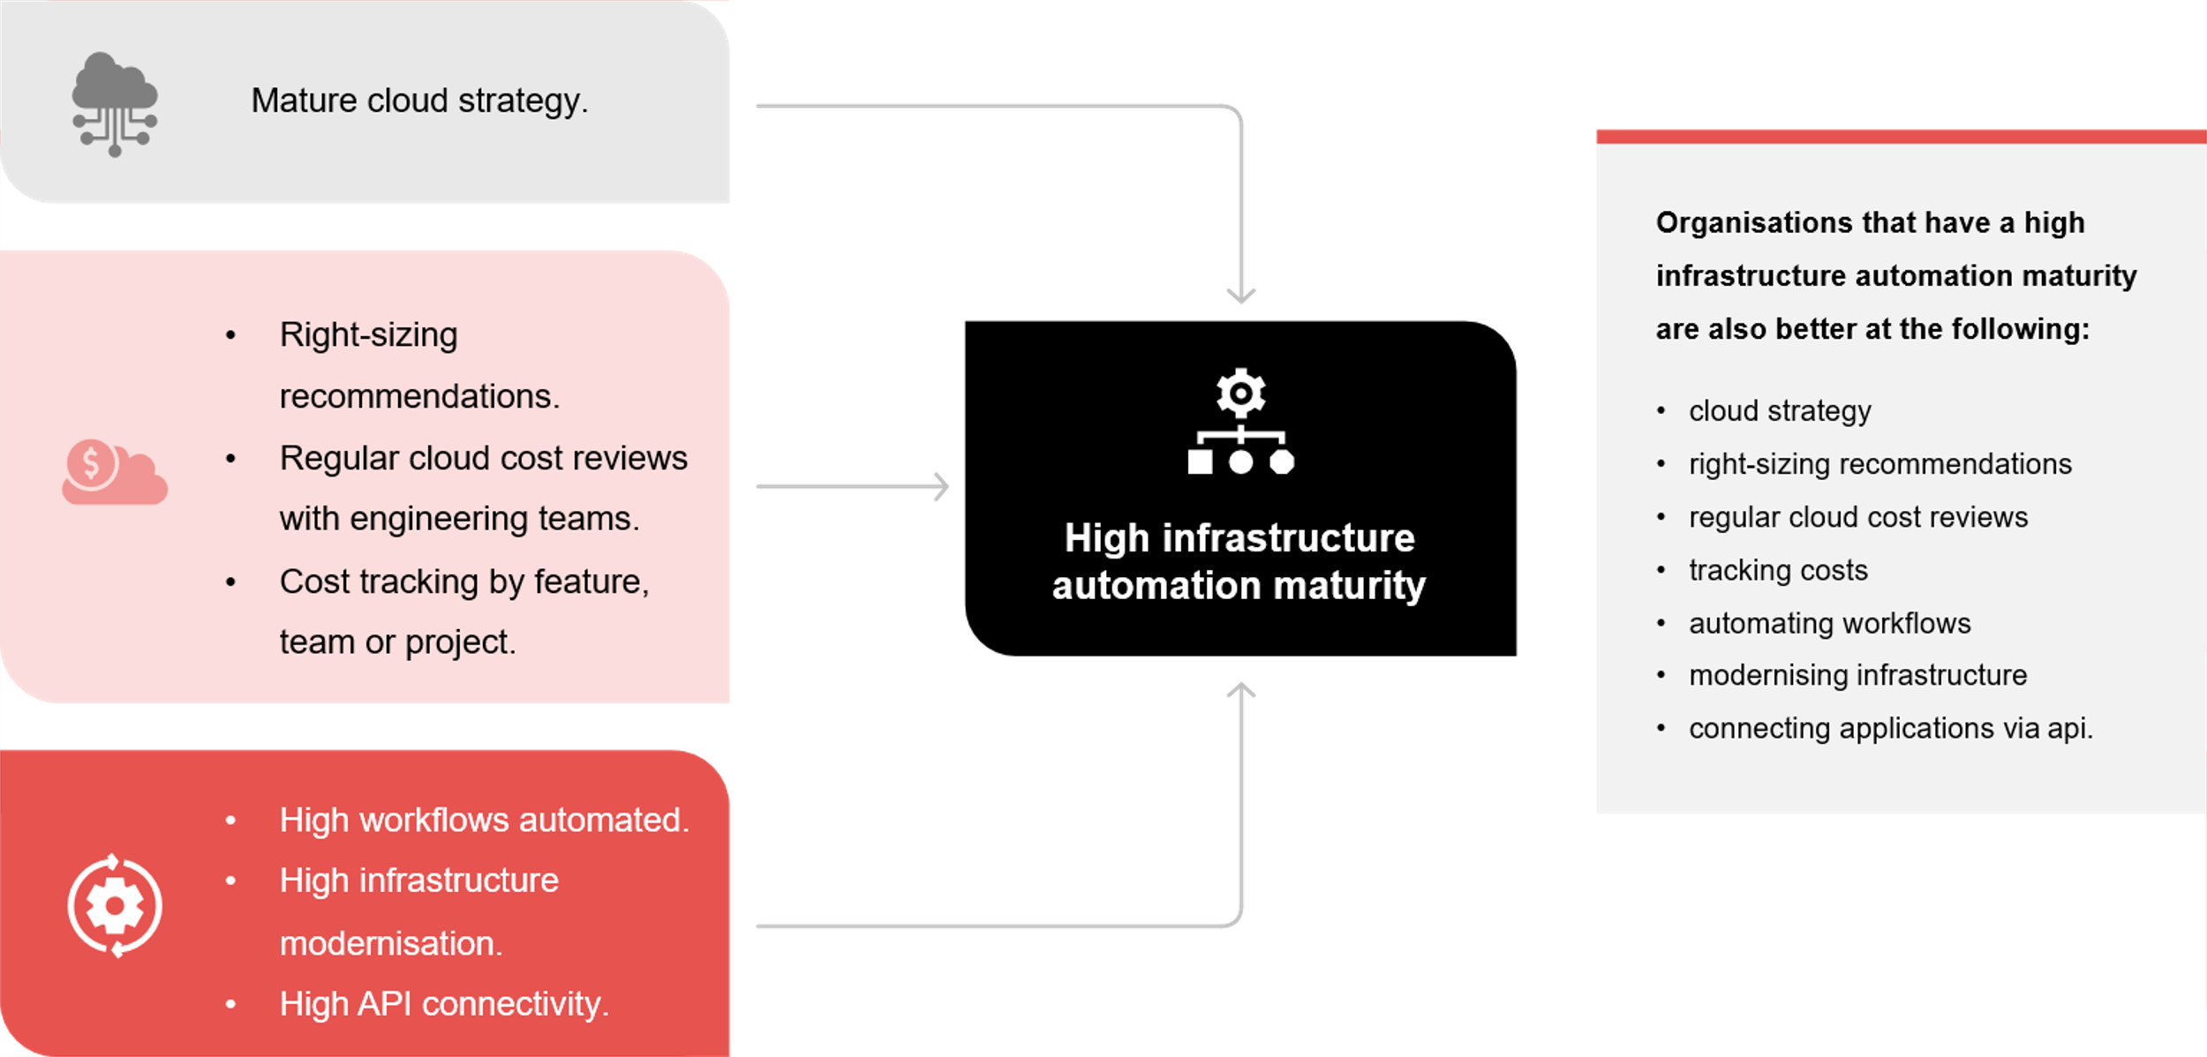
Drivers of infrastructure automation maturity
Source: ADAPT Cloud and Infrastructure Edge Survey in July 2025: Sample size: 104 Australian infrastructure leaders

Slide 8
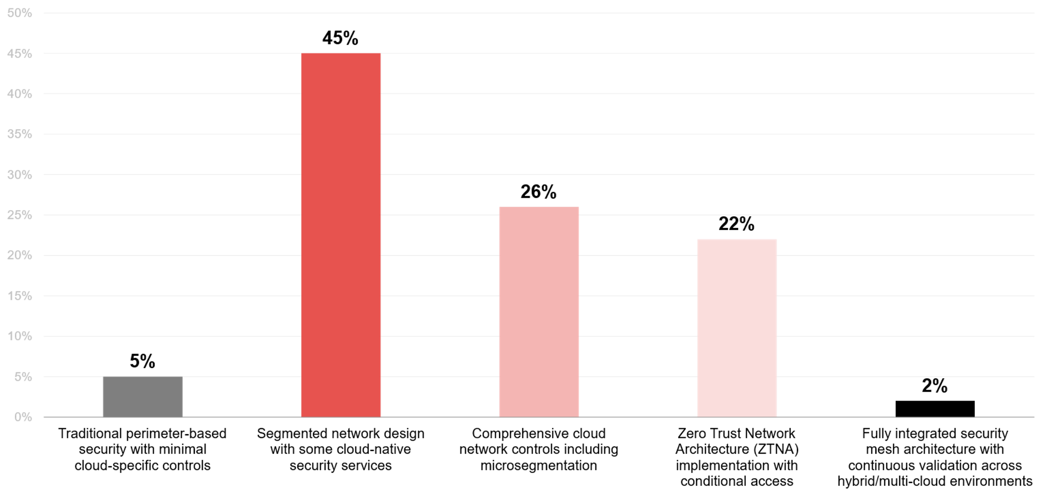
Network security architecture for cloud environments
Source : ADAPT Cloud and Infrastructure Edge Survey in July 2025. Sample size : 96 Australian infrastructure leaders

Slide 9
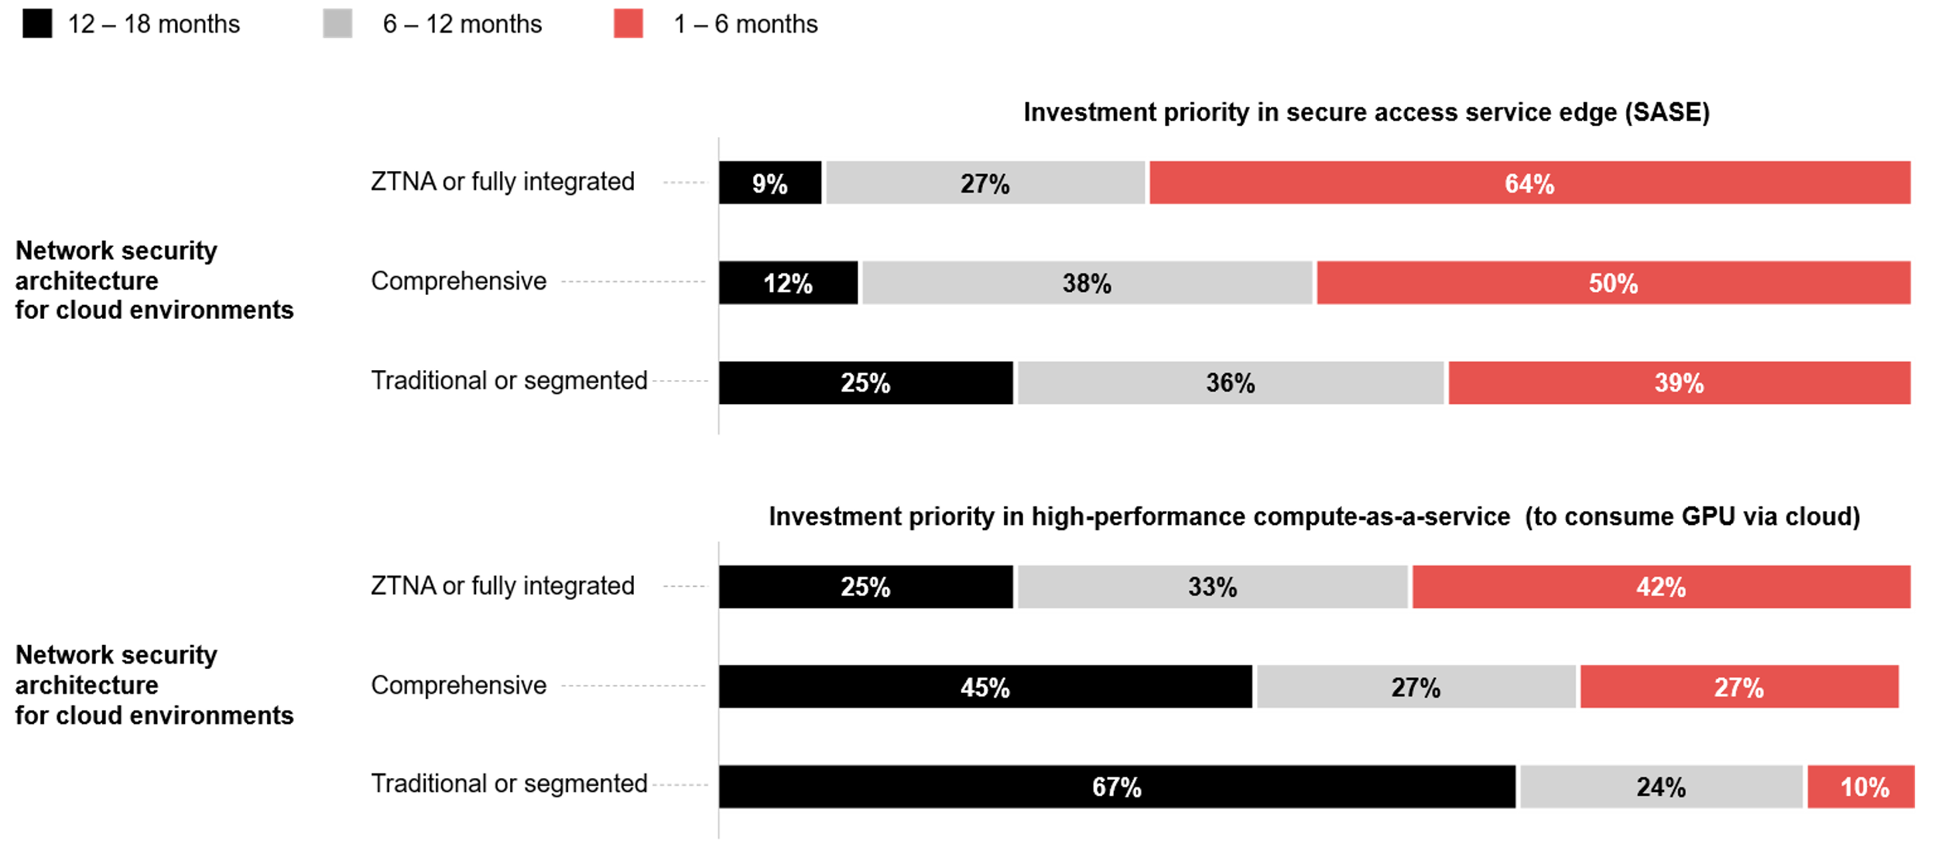
Network security architecture for cloud environments as it relates to IPs in SASE and HPCaaS¹
¹Please note that the percentages shown are rounded to the nearest whole number.
As a result, the total may appear slightly above or below 100% due to rounding.
Source: ADAPT Cloud and Infrastructure Edge Survey in July 2025: Sample size: 96 Australian infrastructure leaders

Slide 10
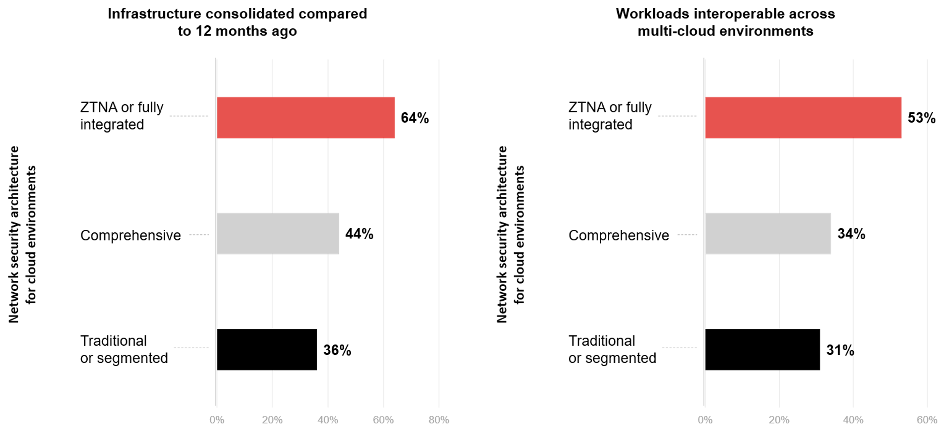
Network security architecture for cloud environments as it relates to progress in modernisation
Source: ADAPT Cloud and Infrastructure Edge Survey in July 2025: Sample size: 96 Australian infrastructure leaders

Slide 11
The following describes the significant factors that drive mature infrastructure automation.
Mature cloud strategy documentation: Organisations with mature cloud strategies tend to be more effective in aligning automation with business and IT goals. They can outline the target cloud operating model and enable standardisation across tools and teams. This ensures that automated infrastructure maximises value, supports team alignment and future-proofs the cloud environment.
Maturity of some FinOps areas: Implementing right-sizing recommendations is crucial for automating infrastructure since it ensures automation drives efficiency while maintaining a cost-effective automated cloud environment. Having regular cloud cost reviews with engineering teams and cost tracking is essential to drive financial accountability while optimising architectural needs.
Progress in modernisation: Modernising workflows enables end-to-end automation. Without APIs, automation becomes reliant on outdated integration capabilities (see slide 6). Moreover, modernised infrastructure can effectively scale automation.
Network security architecture for cloud environments
The percentage distribution suggests a trend towards more integrated and adaptive security approaches that can effectively manage complexities in multi-cloud and hybrid cloud environments.
Drivers of a ZTNA or fully integrated network security architecture for cloud environments
Investing in SASE enables seamless integration of network and security, while HPCaaS
allows organisations to leverage high-performance computing resources without investing
in high-cost hardware.
Consolidating infrastructure helps organisations to simplify the environment for secure
management, while workload interoperability ensures consistency in cloud-native security controls.
Technology Trends
Infrastructure automation and network security architecture
ADAPT’s correlation analyses identify key drivers that contribute to high maturity in infrastructure automation.
This involves a mature cloud strategy, maturity of some FinOps areas and high modernisation.
About 45% of organisations have segmented network design with cloud-native security services, while only 2% of organisations have fully integrated security mesh architectures.
ADAPT also identifies significant drivers that enable seamless integration of network security architectures. These are investment priorities in SASE and HPCaaS, infrastructure consolidation and workload interoperability.

Slide 12
Tech debt and FinOps

Slide 13
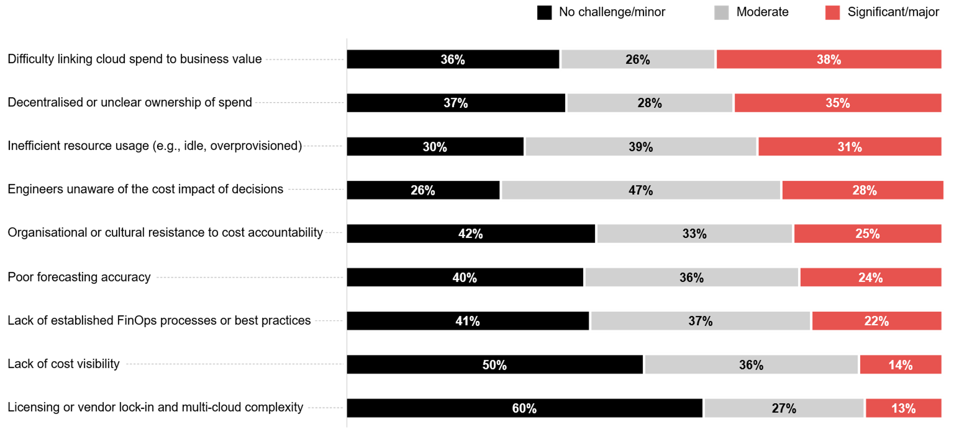
Top challenges that impact organisations’ ability to effectively manage cloud spend¹
¹Please note that the percentages shown are rounded to the nearest whole number.
As a result, the total may appear slightly above or below 100% due to rounding.
Source : ADAPT Cloud and Infrastructure Edge Survey in July 2025. Sample size :
87 Australian infrastructure leaders

Slide 14
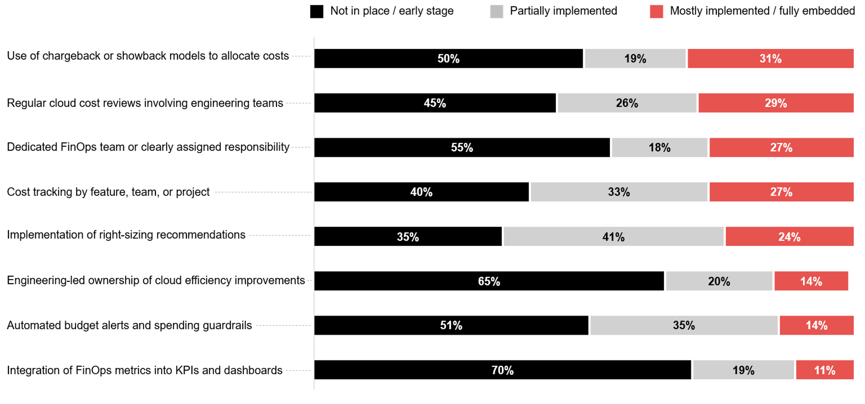
How mature is your organisation in adopting the following FinOps practices?¹
¹Please note that the percentages shown are rounded to the nearest whole number.
As a result, the total may appear slightly above or below 100% due to rounding.
Source : ADAPT Cloud and Infrastructure Edge Survey in July 2025. Sample size :
86 Australian infrastructure leaders

Slide 15
While traditional blockers are no longer issues, driving business value has become a challenge
While vendor lock-in and lack of cost visibility appear less problematic, there's a significant struggle
in deriving tangible business value from cloud investments.
This aligns closely with the tech modernisation and cost optimisation goals of Australian infrastructure leaders, indicating a critical gap in strategic cloud financial management.
Other areas are not viewed as major pain points
These involve organisational or cultural resistance to cost accountability, lack of established FinOps processes, and poor forecasting accuracy. Unclear spending ownership is also emerging as a significant barrier, with 35% of organisations citing it as a challenge—just 2% fewer than those who do not.
Engineers’ cost awareness and resource inefficiency are at a moderate stage.
Engineers' cost awareness shows the most dramatic shift, with only 26% seeing no challenge,
while 28% consider it a major challenge.
Resource inefficiency is increasingly recognised, with 31% identifying it as a major challenge.
Infrastructure leaders are experiencing significant FinOps maturity challenges
Organisations are struggling to establish cost visibility, develop cross-functional ownership models
(such as engineering-led ownership and FinOps teams), and implement automated cost
management mechanisms.
While some FinOps areas are already integrated, the majority are still in the process of adoption
While most organisations have already partially implemented right-sizing recommendations,
others do not yet use chargeback models to allocate costs, implement regular cloud cost
reviews with engineering teams, and perform cost tracking by feature, team, or project.
Technology Trends
Challenges in tech debt and FinOps
While vendor lock-ins and cost visibility may not pose significant issues, the real challenge lies in effectively linking cloud expenditures to tangible business value.
Many organisations do not find cultural resistance to cost accountability (42%),
lack of established FinOps processes (41%), and poor forecasting accuracy (40%)
as major pain points.
Engineer’s cost awareness and resource inefficiency are at a moderate stage.
All areas of FinOps maturity, except for implementing right-sizing recommendations, are either not yet established or still in the early stages.

Slide 16
Survey demographics

Slide 17
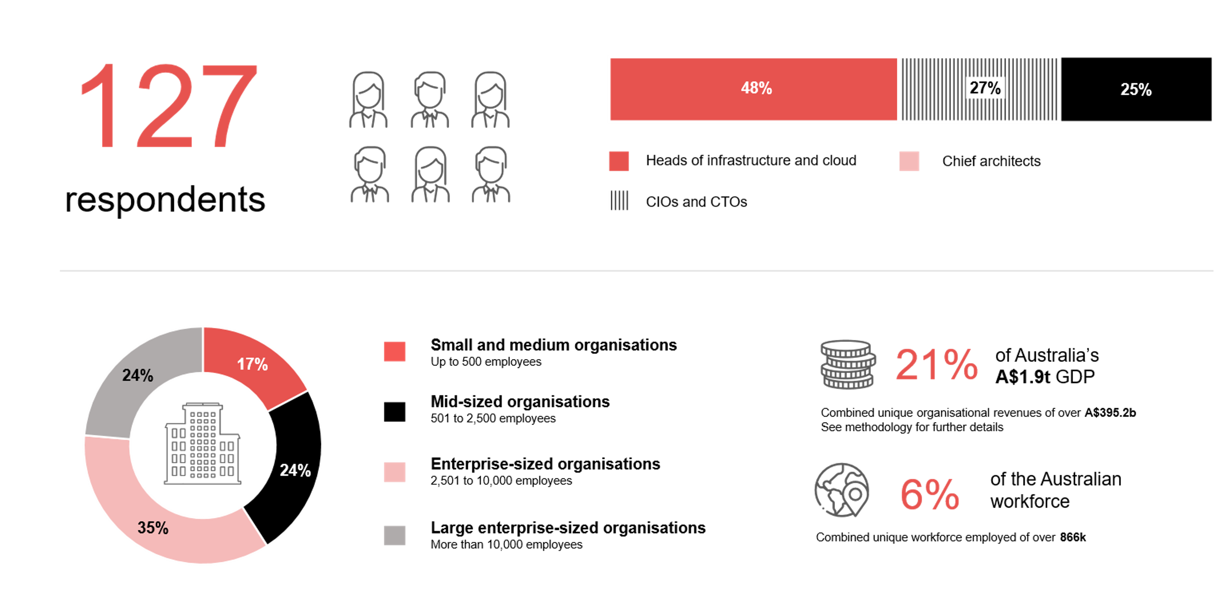
Survey demographics: Australian Infrastructure Leaders in 2025

Slide 18

For sector, segment and persona comparisons
Central limit theorem a fundamental concept in statistics that determines when a sample size is large enough
to be considered reliable. There are different formulas and some debate amongst statisticians about the appropriate sample size. For industry comparisons or other subset analyses, a sample size of ( n > 20 ) is generally considered acceptable for drawing meaningful insights. This threshold aligns with common statistical practices, where a
sample size of 20 to 30 is generally the minimum needed to assume a normal distribution of the data.
Sample sizes below 20, but equal to or greater than 15
When the sample size is between 15 and 20, while not fully representative, it can still offer valuable insights
into trends. These statistics should be viewed as indicative, highlighting general directions in industry efforts
or barriers to investment but treated with some caution due to the smaller number of observations.
Sample sizes less than 15, but greater or equal to 10
For samples between 10 and 15, the data provides a snapshot guideline only. While such small samples can
show early trends, it's important to recognise that this doesn't guarantee future respondents will reflect the same trends. For instance, while 100% of respondents in a sample of 10 might invest in AI, it'd be unrealistic to assume this pattern will hold as the sample size grows. However, if the sample size increases to 20, it's unlikely
that the trend will change drastically, and the next 10 respondents will have no investment.
ADAPT Data Analytics
Notes on sample sizes
Why does sample size matter?
Each set of statistics is unique with measures,
distribution, variance and sample size. It is generally accepted in statistics that as sample size increases, analysts make fewer assumptions about the data, resulting in statistics that more accurately represent the truth.
ADAPT endeavours to provide transparency of sample size, whereby we provide a source on data slides with
the number of respondents and the survey where those respondents come from. In data and insights slide decks, ADAPT usually provides some insight on the breakdown
of the demographics at the end of the slide deck.
To protect privacy, ADAPT does not release lists
of individual respondents to surveys.

Slide 19


Written by
Gabby Fredkin
Head of Data and Analytics at ADAPT
Honey Mari Gay
Junior Data Analyst at ADAPT
Gabby’s primary role is managing ADAPT’s overall strategy for Data Analytics. He has extensive experience in using data to identify trends in technology that help shape Australian organisations. Using modern data science techniques, he ensures the accuracy and validity of the information that supports ADAPT’s research, advisory services, and events, giving both ADAPT and its customers greater confidence in the insights provided.
With a passion for creating stories with data, Gabby is consistently rated as one of the top speakers at ADAPT Events. In round table discussions, he specialises in using statistics to initiate thought-provoking discussions. Gabby is effective in translating information into insights, enabling ADAPT’s customers to become more data-driven.
As a Junior Data Analyst at ADAPT, Mari enables the discovery and definition of market trends through visually meaningful statistics. She ensures data presentations are accurate and aligned with modern statistical standards.
Mari is passionate about data and transforming it into actionable insights. With over three years of experience in project management and academic research, she has led end-to-end survey and research projects, processed and analysed data using a range of statistical tools and techniques, and provided clients with statistical
consultation and insights.

Slide 20

About ADAPT
ADAPT is a specialist Research & Advisory firm providing local market insights and benchmarking data
to Australia and New Zealand’s senior technology and business community.
Since 2011, we’ve been empowering the leaders of the region’s top enterprise and government organisations
to stay at the forefront of modern trends and build for the future. Our industry leading conferences, private roundtable events and custom research projects equip business leaders with the knowledge, relationships, inspiration and tools they need to make better strategic decisions.
adapt.com.au | hello@adapt.com.au
Data Validation
Results contained in this report (Report) are based on survey responses as provided by our clients and publicly available information. ADAPT does not subject the data contained in the Report to audit or review procedures or any other testing to validate the accuracy or reasonableness of the data provided by the participating clients. While we do not manipulate the survey responses, we do make an effort to identify outlier data or conflicting results that could lead to misinterpretations before the preparation of the Report.
Intended Use of the Report
The Report is designed to help technology executives in Australia and New Zealand make independent decisions regarding financial, resourcing and operational performance matters. The information and data contained in the Report are provided as is and are for information purposes only. They are not intended or implied to be recommendations and in no event will ADAPT be liable for any decisions or actions taken in reliance of the results obtained through the use of the information and/or data contained in the Report.
Research MSA and Privacy Policy
The Report and any other information provided by ADAPT is subject to the Research and Advisory Master Services Agreement and the ADAPT Privacy Policy.

Slide 21




Additional resources you can access
Members of ADAPT’s Research & Advisory platform have access to an entire suite of market leading content, insights and resources to help you execute in your role. For any assistance contact your Account Manager in the help section.
Community case studies and interviews
Case studies detailing the successes
and challenges of projects and initiatives.
Market Trend Reports Access a library of fact-based actionable insights, deep dives on ANZ business & IT trends.
Live access to ADAPT analysts
Through live ADAPT analyst market briefings and Q&A sessions
Downloadable data and insights
Elevate your business cases with downloadable market and industry data.
Industry expert presentations
Watch keynotes or read distilled 1-page executive summaries from our Edge Events.
Bespoke analysis of ADAPT data
Receive custom cuts and analysis of ADAPT proprietary data.
Premier executive community
Unlock access to our exclusive network of Australia’s leading technology and business executives.
Dedicated account manager and impact assessments
Your Account Manager will ensure you and your team are getting the most out of your subscription.
Dedicated analyst briefing
Leverage a dedicated briefing with an ADAPT analyst to help validate your strategies.
*Inclusions may vary depending on subscription level.

