Slide 1

ADAPT Persona Map
Infrastructure Leaders Modernising Tech at Optimised Costs

Slide 2
In this report, you'll find insights into why Australian infrastructure leaders continue to prioritise modernisation in their cloud strategies while optimising their costs.
The key areas of focus are:
Modernising at optimised costs
Modernisation is viewed as the primary outcome of cloud and infrastructure initiatives.
Modernising tech requires a big upfront investment so cost optimisation is essential.
Aligning top initiatives with modernisation goals
The first two initiatives are highly aligned with the need to modernise while optimising costs.
Infrastructure leaders want more value from every dollar spent in the cloud.
A higher focus on bolstering cyber resilience and improving observability is also crucial to ensure secure modernisation changes and safe AI adoption.
Optimising cloud strategies
Organisations are increasing the use of hybrid cloud solutions as they reduce workload consumption from public cloud services. Repatriating these workloads is driven by the need to align them with internal environments. Private cloud workloads only show slight fluctuations, while in-house workloads are being shifted towards cloud-based solutions.
Challenges in funding and resources
Optimising costs is not just about reducing expenditure. Migrating to cloud and modernising
legacy systems requires a significant amount of investment. Driving modernisation changes
has become challenging due to competing priorities and a lack of sufficient staff and skills.
Persona Mapping: Infrastructure leader
Key takeaways
The #1 goal of Australian infrastructure leaders is to modernise and simplify their tech environments. Cost optimisation is #2.
Their #1 investment priority is cloud cost optimisation.
Public cloud migration has declined from 46% in 2024 to 36% in 2025, while hybrid cloud workload consumption has significantly increased from 5% in 2024 to 21% in 2025.
Repatriation of workloads from public cloud increased from 17% in 2024 to 25% in 2025.
The #1 barrier is the lack of funding/resources.

Slide 3

Goals, initiatives and investment priorities

Slide 4
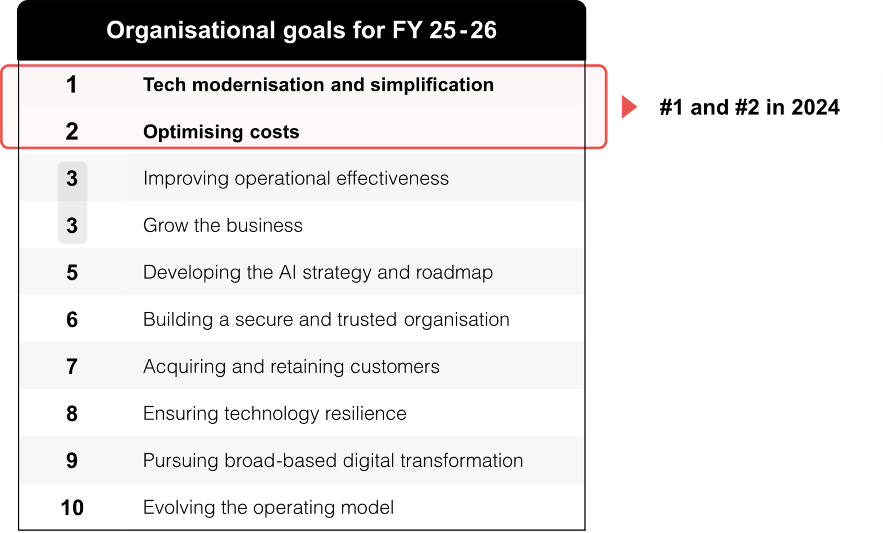
Infrastructure leaders’ organisational goals (July 2025)
Source : ADAPT Cloud and Infrastructure Edge Survey in July 2025. Sample size : 115 Australian infrastructure leaders

Slide 5
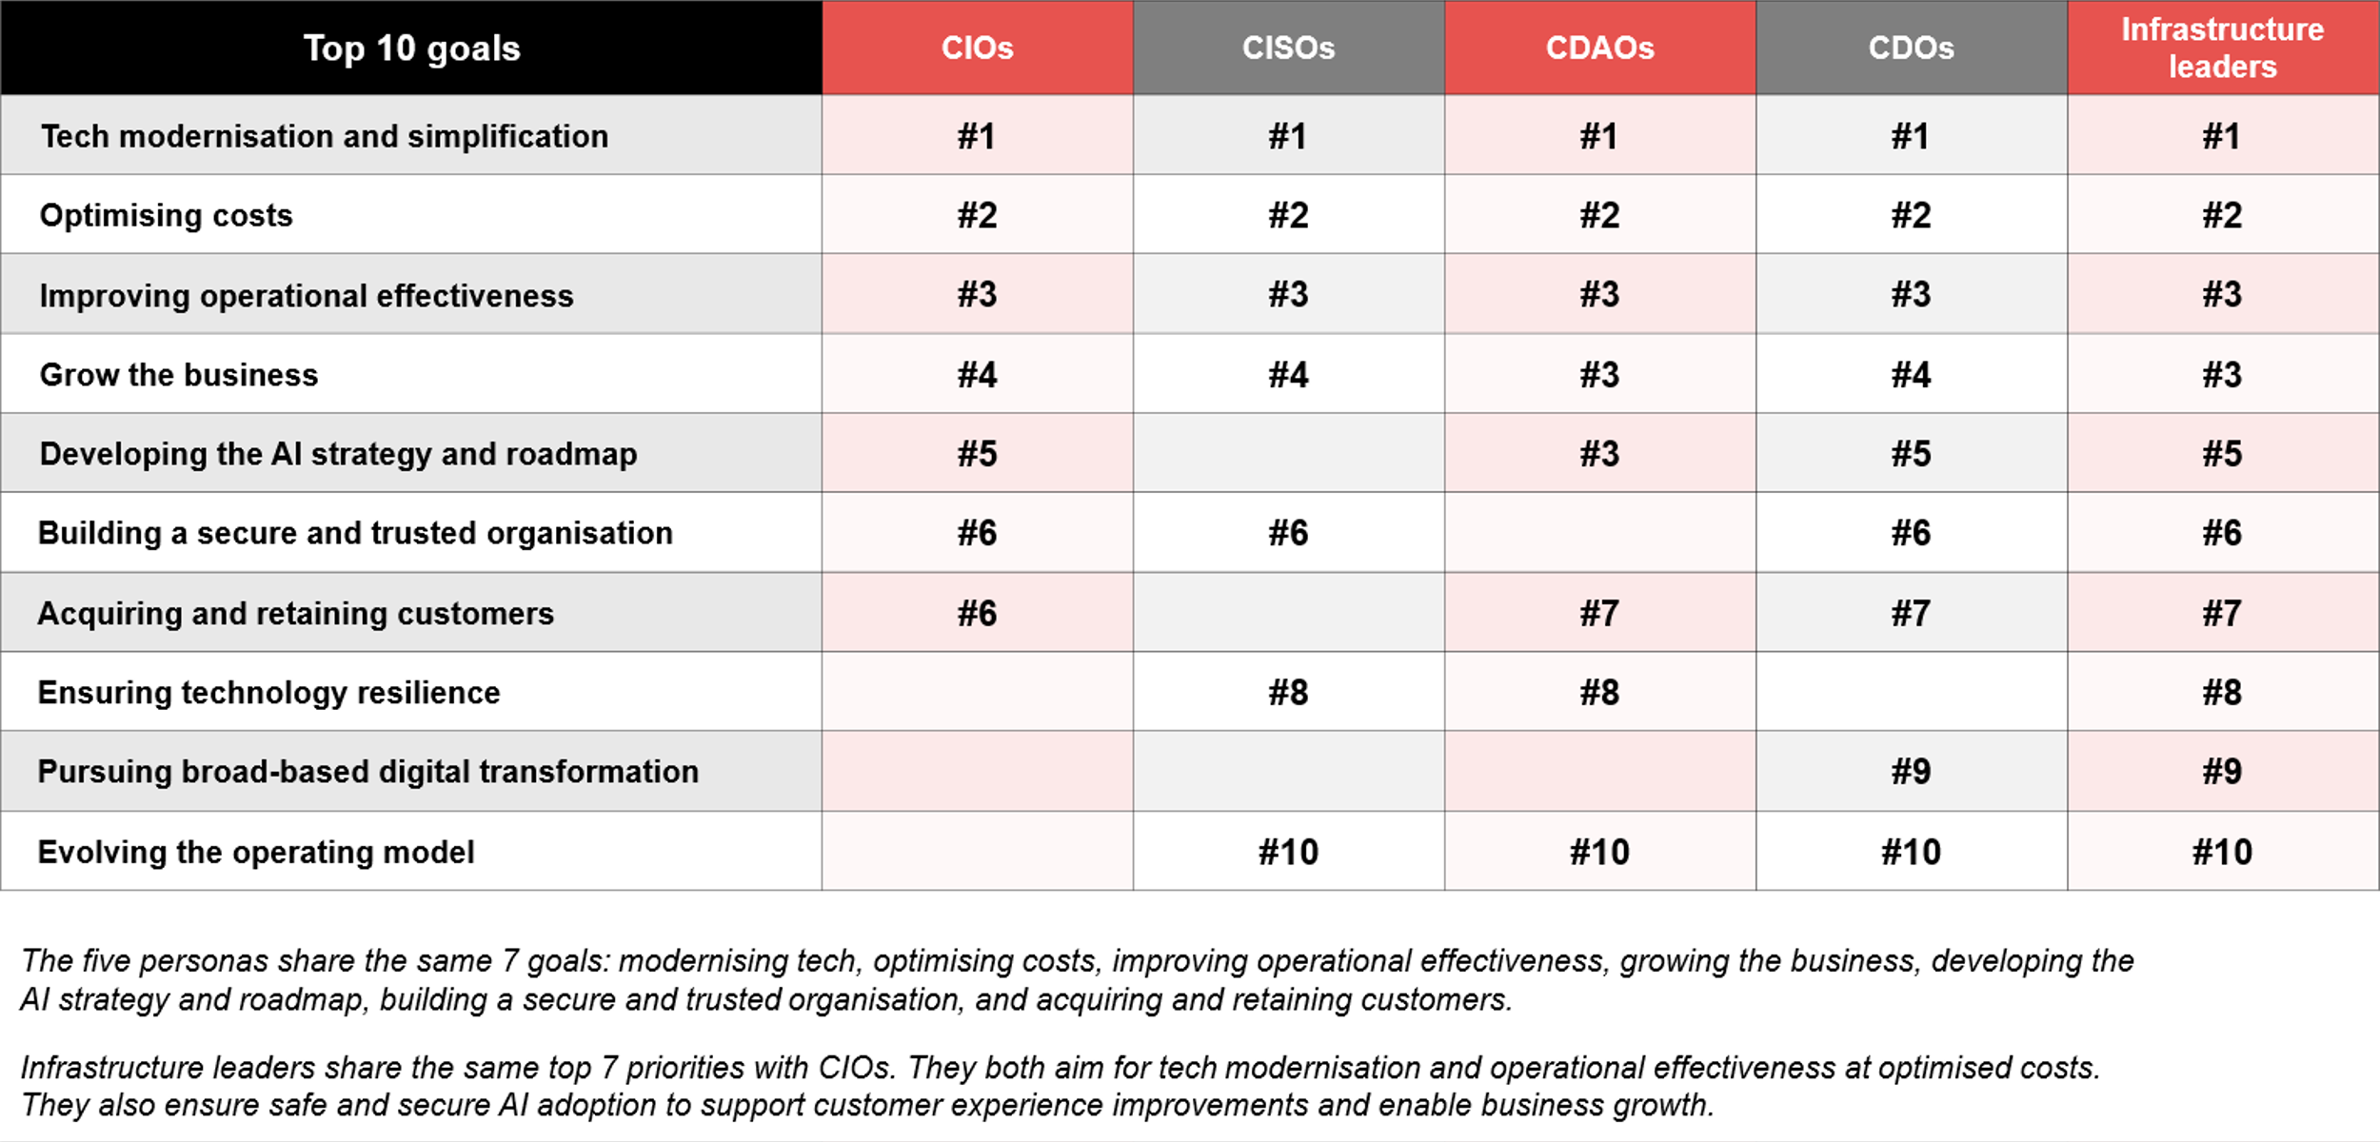
Top goals: Comparison across different personas (Feb to Jul 2025)
ADAPT CIO, CISO, Data, Digital and Cloud and Infrastructure Edge Surveys from Feb to Jul 2025. Sample size: 769 Australian CIOs, CISOs, CDAOs, CDOs and infrastructure leaders

Slide 6
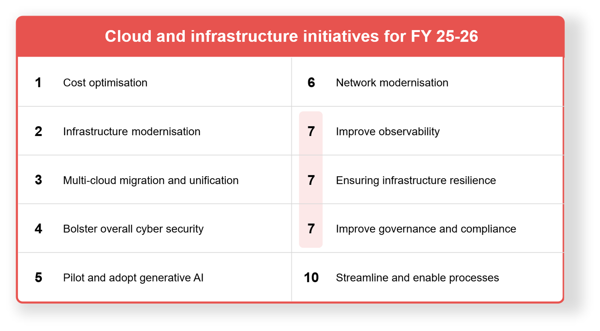
Infrastructure leaders’ top initiatives (July 2025)
Source : ADAPT Cloud and Infrastructure Edge Survey in July 2025. Sample size : 115 Australian infrastructure leaders

Slide 7
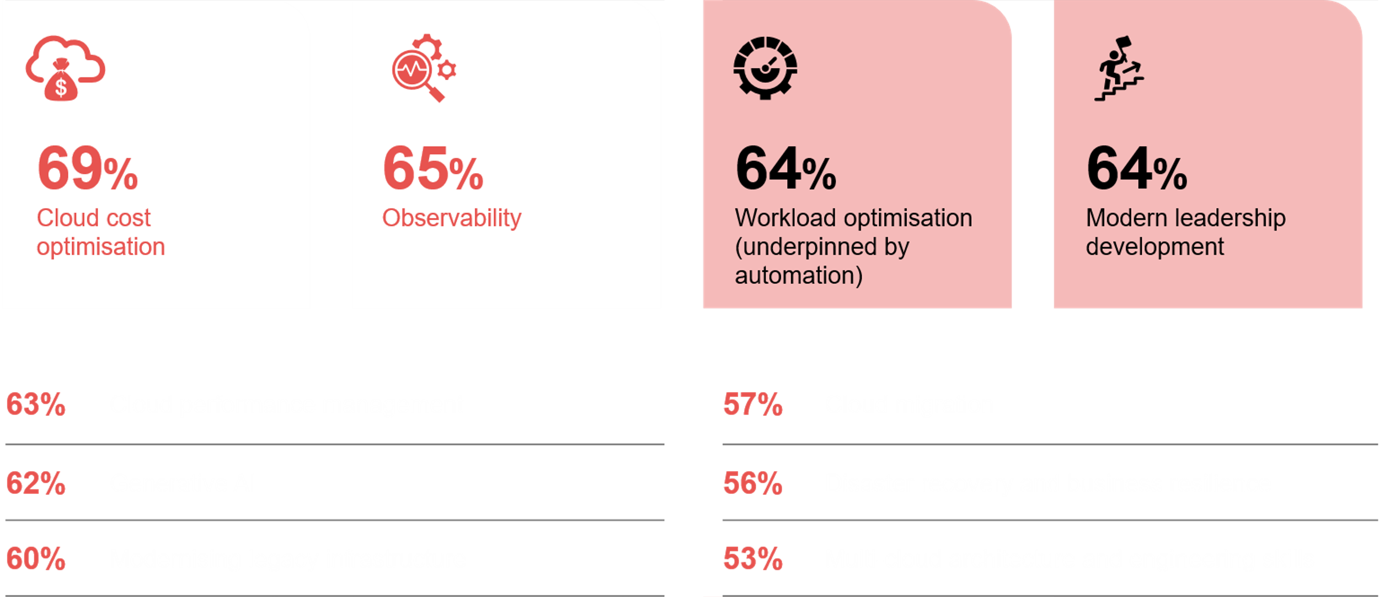
Infrastructure leaders' investment priorities in the next 12 months
Source : ADAPT Cloud and Infrastructure Edge Survey in July 2025. Sample size : 121 Australian Infrastructure Leaders

Slide 8
Modernisation at optimised cost
Australian infrastructure leaders aim to modernise technology to help them optimise costs.
Modernisation helps address the cost of ineffective architectures and the sunken cost of legacy technology.
Infrastructure leaders intend to improve operational effectiveness and grow the business by adopting AI and strengthening security to ensure tech resilience.
To modernise effectively, digital transformation and the creation of new operating models are essential.
Modernisation priorities across personas
Infrastructure leaders share the same top 7 priorities with CIOs, while CISOs aim for a secure modernisation.
CDAOs prioritise operational effectiveness to improve customer experience by modernising tech and adopting AI. CDOs focus on growing the business by acquiring and retaining more customers. They also support this outcome by achieving operational excellence, transforming digitally and modernising tech.
Greater alignment with top initiatives
The #1 and #2 initiatives strongly suggest a greater need for modernisation at optimised cost. They also plan to deploy multi-cloud infrastructure, adopt AI, integrate their networks and streamline processes.
Additionally, infrastructure leaders aim to secure modernisation by ensuring infrastructure resilience and strengthening governance. Improving observability is also crucial to measure performance metrics.
Delivering more value from every dollar spent in the cloud
Cost optimisation has moved from being a finance-led exercise to a cross-functional discipline.
Investing in observability and resilience is crucial to secure multi-cloud environments. Organisations also continue to migrate core workloads to the cloud and modernise infrastructure to improve compatibility.
Modern leadership and muti-cloud architecture skills investment is essential for AI preparedness.
Persona Mapping: Infrastructure leader
Modernising at optimised cost
The #1 goal of Australian infrastructure leaders is tech modernisation and simplification. Their #2 goal is cost optimisation.
Other personas perceive tech modernisation as essential to deliver greater value to their organisations.
The #1 initiative is infrastructure modernisation, while the #2 initiative
is optimising costs.
The #1 investment priority is cloud
cost optimisation.

Slide 9
Modernisation

Slide 10
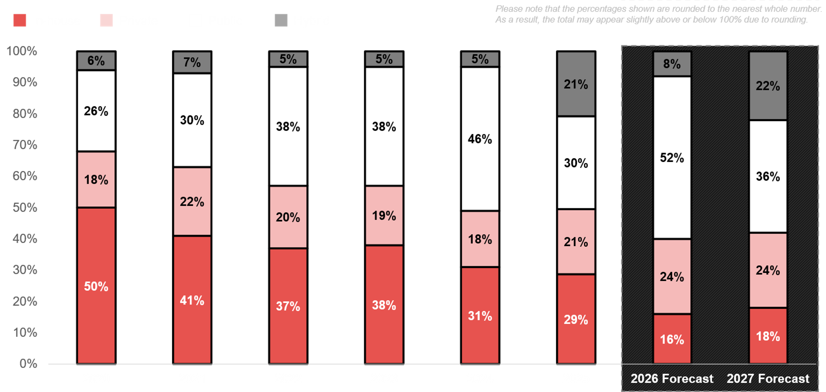
Cloud migration 2020 – 2027
ADAPT CIO and Cloud and Infrastructure Edge Surveys in 2020 to 2025. Sample size: 2, 215 Australian CIOs and Infrastructure leaders

Slide 11
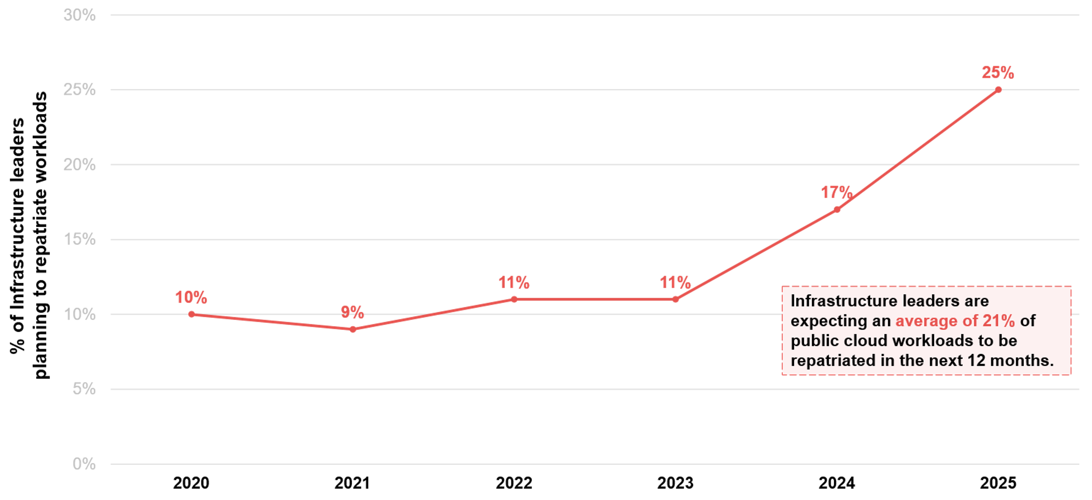
Are infrastructure leaders planning to repatriate workloads from the public cloud?
Source: ADAPT Cloud and Infrastructure Edge Surveys in Mar 2020 to Jul 2024. Sample size: 699 Australian infrastructure leaders

Slide 12
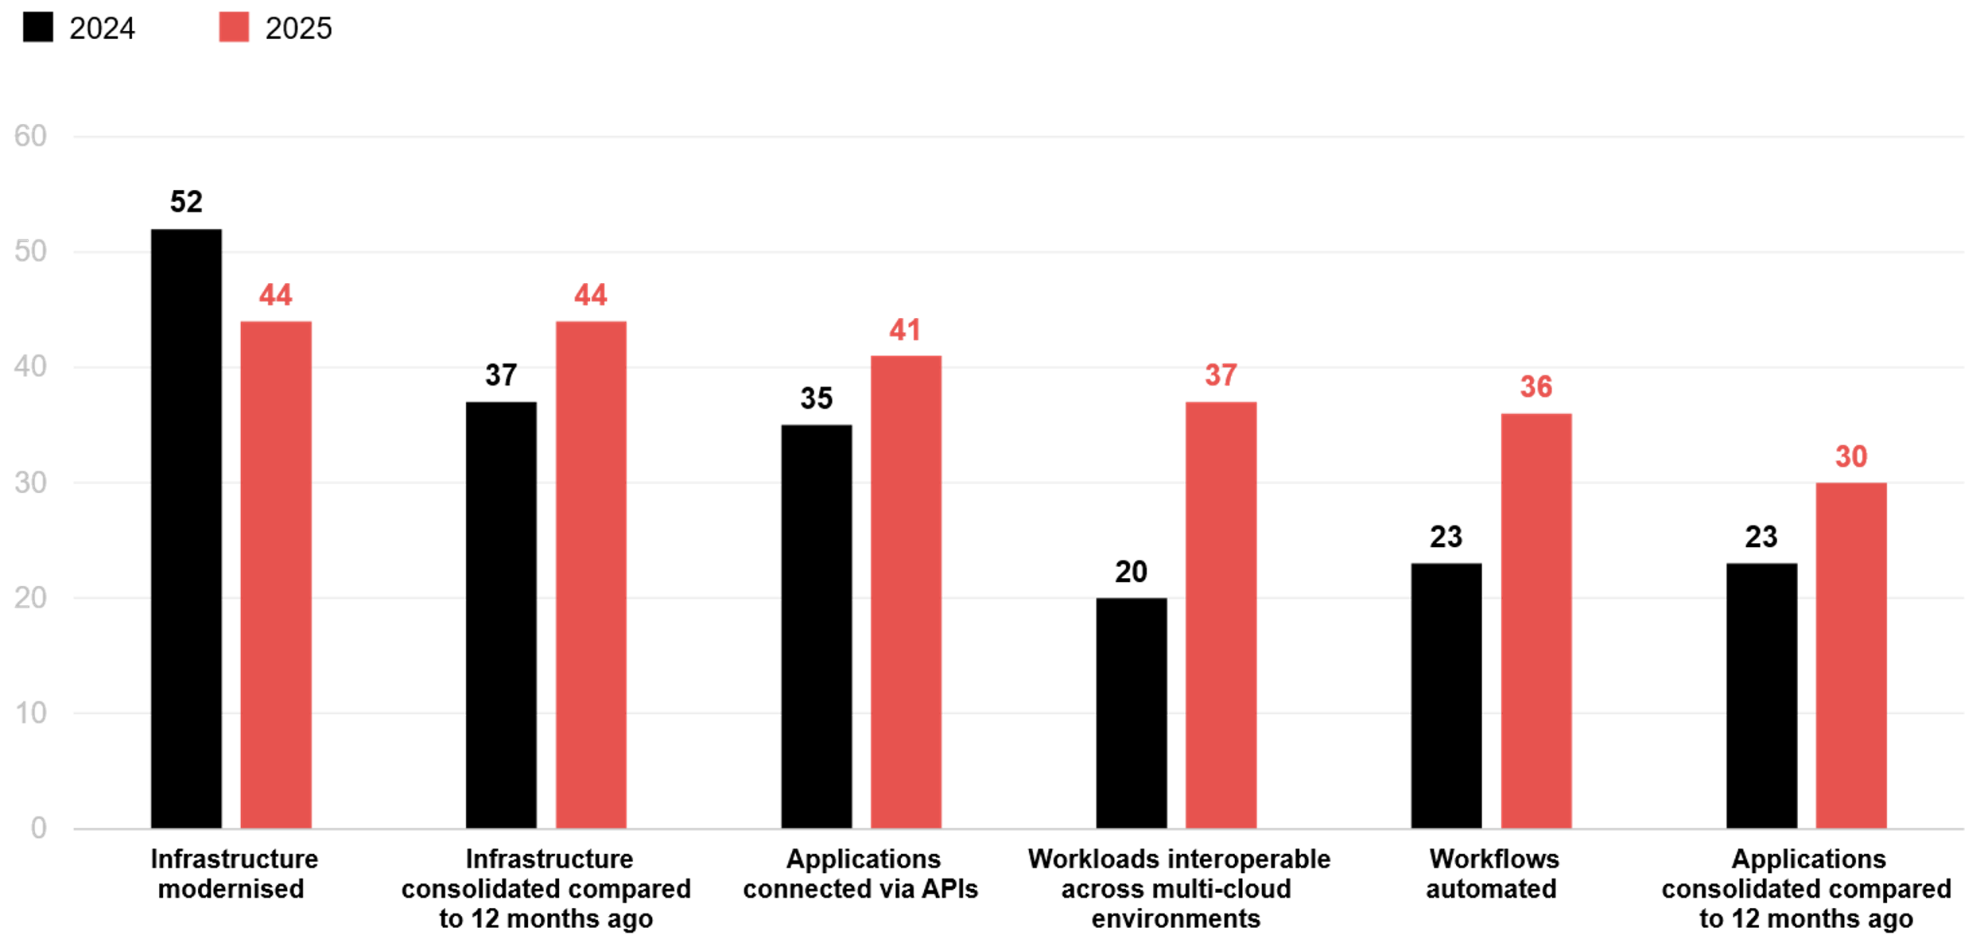
How much progress has your organisation made in these areas? (%)
Source : ADAPT Cloud and Infrastructure Edge Surveys in July 2024 and July 2025. Sample size : 199 Australian infrastructure leaders

Slide 13
On-premise to cloud-based workloads
In-house workload distribution changes indicate a clear strategic shift towards cloud-based solutions.
Public cloud workload consumption is experiencing significant growth, escalating from 26% in 2020 to 46% in 2024. In 2025, it has dropped to 30%. This equates to only 15% of organisations having an advanced or fully unified approach to multi-cloud unification (ADAPT Cloud and Infrastructure Edge Survey, Jul 2025).
Private cloud workload consistency
This suggests that most organisations have already migrated their mission-critical workloads to private cloud environments. These workloads are stable and mature, and only require infrequent change. There is less urgency to move or rearchitect them further as they are already optimised.
The rise of hybrid cloud workloads
This change indicates a mature and risk-aware strategy, where measured technology adoption is preferred over radical transformation. The growth of hybrid cloud helps address legacy system challenges and technical debt by providing a transitional architecture that enables gradual migration and the coexistence of traditional and cloud-native infrastructures. This aligns with the strong investment in workload optimisation and automation.
Increase in public cloud workload repatriation
This may mean organisations recognise that some workloads are not suited to the public cloud. Bringing them back in-house can create better alignment with internal environments.
Progress in modernisation
Infrastructure modernisation is the #2 initiative, but it has declined compared to 2024. This suggests
that other modernisation priorities are gaining focus, including consolidated infrastructure and
applications, API-connected applications, and interoperable, automated workloads.
Persona Mapping: Infrastructure leader
Cloud migration and progress in modernisation
In-house workloads distribution demonstrates a substantial decline, dropping from 50% in 2020 to a
projected 18% by 2027.
Private cloud workloads only show slight fluctuations, which are predicted to increase from 21% in 2025 to 24% in 2027.
Hybrid cloud is emerging. From a modest 6% in 2020 to a projected 22% by 2027.
There is an increase of public cloud workload repatriation from 17% in 2024
to 25% in 2025.
Progress in modernisation has increased since 2024, except for infrastructure.

Slide 14
Execution barriers

Slide 15
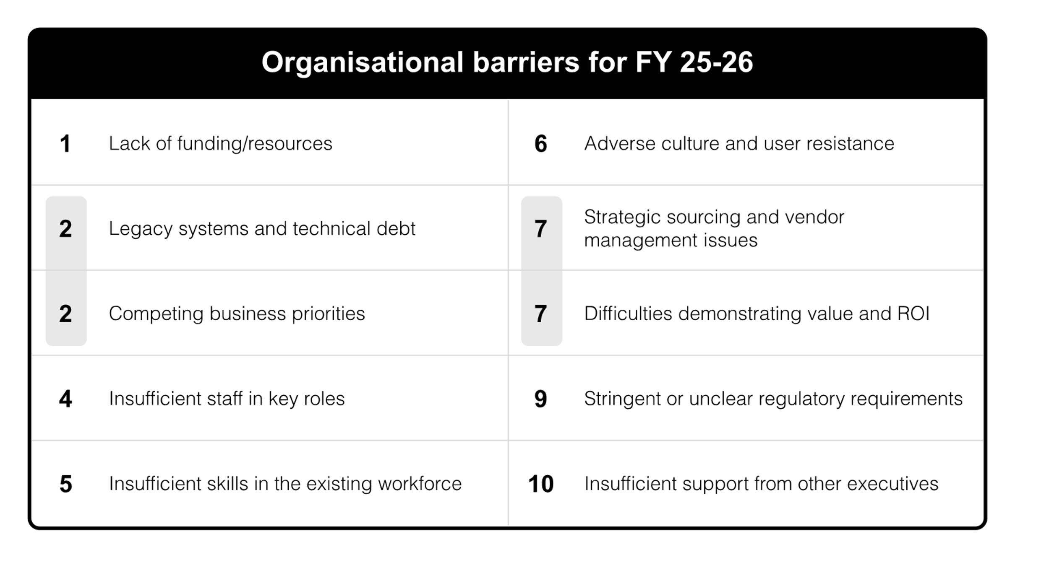
Infrastructure leaders’ organisational barriers (July 2025)
Source : ADAPT Cloud and Infrastructure Edge Survey in July 2025. Sample size : 111 Australian infrastructure leaders

Slide 16
Efficient modernisation is not the same as low-cost modernisation
Insufficient funding and resources remain a significant challenge for infrastructure executives. This shows that cost optimisation does not necessarily mean cost reduction. Modernising technology requires substantial upfront investment, as cloud migrations, legacy system upgrades, and talent development all demand larger budgets.
Competing priorities with other strategic initiatives
Cloud and infrastructure programs often compete with other organisational initiatives for attention and investment. Without strong executive support, infrastructure leaders may struggle to maintain momentum and achieve progress, making it harder to realise value and ROI.
A change resistant culture is also a significant barrier.
Driving change requires a cultural shift, not just technical improvement
Even when modern infrastructure is in place, user resistance and entrenched operational habits can hinder adoption. Overcoming this requires not just technical upgrades, but a cultural shift supported by change management and enhanced user engagement.
Vendor and regulatory requirements issues
Dependencies on third-party vendors and shifting regulatory requirements can delay modernisation execution. Unclear regulations can make infrastructure leaders hesitant to progress with cloud and infrastructure initiatives.
Persona Mapping: Infrastructure leader
Modernisation
and cloud barriers
The #1 execution barrier of Australian infrastructure leaders is the lack of
funding or resources.
The next top barriers are legacy
systems and competing priorities.
A cultural shift in mindset is essential to drive modernisation.
Vendor challenges and unclear regulatory requirements are also significant obstacles.
The #1 barrier to cloud adoption is the additional cost caused by architectural or engineering issues.

Slide 17
Survey demographics

Slide 18
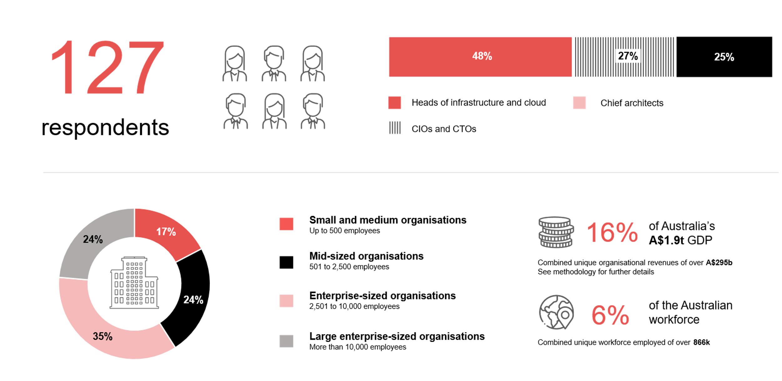
Survey demographics: Australian infrastructure leaders in 2025

Slide 19

For sector, segment and persona comparisons
Central limit theorem a fundamental concept in statistics that determines when a sample size is large enough
to be considered reliable. There are different formulas and some debate amongst statisticians about the appropriate sample size. For industry comparisons or other subset analyses, a sample size of ( n > 20 ) is generally considered acceptable for drawing meaningful insights. This threshold aligns with common statistical practices, where a
sample size of 20 to 30 is generally the minimum needed to assume a normal distribution of the data.
Sample sizes below 20, but equal to or greater than 15
When the sample size is between 15 and 20, while not fully representative, it can still offer valuable insights
into trends. These statistics should be viewed as indicative, highlighting general directions in industry efforts
or barriers to investment but treated with some caution due to the smaller number of observations.
Sample sizes less than 15, but greater or equal to 10
For samples between 10 and 15, the data provides a snapshot guideline only. While such small samples can
show early trends, it's important to recognise that this doesn't guarantee future respondents will reflect the same trends. For instance, while 100% of respondents in a sample of 10 might invest in AI, it'd be unrealistic to assume this pattern will hold as the sample size grows. However, if the sample size increases to 20, it's unlikely
that the trend will change drastically, and the next 10 respondents will have no investment.
ADAPT Data Analytics:
Notes on sample sizes
Why does sample size matter?
Each set of statistics is unique with measures,
distribution, variance and sample size. It is generally accepted in statistics that as sample size increases, analysts make fewer assumptions about the data, resulting in statistics that more accurately represent the truth.
ADAPT endeavours to provide transparency of sample size, whereby we provide a source on data slides with
the number of respondents and the survey where those respondents come from. In data and insights slide decks, ADAPT usually provides some insight on the breakdown
of the demographics at the end of the slide deck.
To protect privacy, ADAPT does not release lists
of individual respondents to surveys.

Slide 20

Written by
Honey Mari Gay
Junior Data Analyst at ADAPT
As a Junior Data Analyst at ADAPT, Mari enables the discovery and definition of market trends through visually meaningful statistics.
She ensures data presentations are accurate and aligned with modern statistical standards.
Mari is passionate about data and transforming it into actionable insights. With over three years of experience in project management and academic research, she has led end-to-end survey and research projects, processed and analysed data using a range of statistical tools
and techniques, and provided clients with statistical consultation and insights.

Slide 21

About ADAPT
ADAPT is a specialist Research & Advisory firm providing local market insights and benchmarking data
to Australia and New Zealand’s senior technology and business community.
Since 2011, we’ve been empowering the leaders of the region’s top enterprise and government organisations
to stay at the forefront of modern trends and build for the future. Our industry leading conferences, private roundtable events and custom research projects equip business leaders with the knowledge, relationships, inspiration and tools they need to make better strategic decisions.
adapt.com.au | hello@adapt.com.au
Data Validation
Results contained in this report (Report) are based on survey responses as provided by our clients and publicly available information. ADAPT does not subject the data contained in the Report to audit or review procedures or any other testing to validate the accuracy or reasonableness of the data provided by the participating clients. While we do not manipulate the survey responses, we do make an effort to identify outlier data or conflicting results that could lead to misinterpretations before the preparation of the Report.
Intended Use of the Report
The Report is designed to help technology executives in Australia and New Zealand make independent decisions regarding financial, resourcing and operational performance matters. The information and data contained in the Report are provided as is and are for information purposes only. They are not intended or implied to be recommendations and in no event will ADAPT be liable for any decisions or actions taken in reliance of the results obtained through the use of the information and/or data contained in the Report.
Research MSA and Privacy Policy
The Report and any other information provided by ADAPT is subject to the Research and Advisory Master Services Agreement and the ADAPT Privacy Policy.

Slide 22




Additional resources you can access
Members of ADAPT’s Research & Advisory platform have access to an entire suite of market leading content, insights and resources to help you execute in your role. For any assistance contact your Account Manager in the help section.
Community case studies and interviews
Case studies detailing the successes
and challenges of projects and initiatives.
Market Trend Reports Access a library of fact-based actionable insights, deep dives on ANZ business & IT trends.
Live access to ADAPT analysts
Through live ADAPT analyst market briefings and Q&A sessions
Downloadable data and insights
Elevate your business cases with downloadable market and industry data.
Industry expert presentations
Watch keynotes or read distilled 1-page executive summaries from our Edge Events.
Bespoke analysis of ADAPT data
Receive custom cuts and analysis of ADAPT proprietary data.
Premier executive community
Unlock access to our exclusive network of Australia’s leading technology and business executives.
Dedicated account manager and impact assessments
Your Account Manager will ensure you and your team are getting the most out of your subscription.
Dedicated analyst briefing
Leverage a dedicated briefing with an ADAPT analyst to help validate your strategies.
*Inclusions may vary depending on subscription level.

Slide 23

adapt.com.au | hello@adapt.com.au | +61 (2) 9435 3535

