Slide 1

ADAPT Technology Trends
How Are Australian Infrastructure Leaders Preparing Their Cloud Migration Journeys?

Slide 2
Cloud migration readiness
Organisations are reducing their use of public cloud workloads while significantly increasing adoption of hybrid cloud environments.
Although 34% of organisations have migrated their core enterprise applications to the cloud,
many are still developing their overall cloud strategy and approach to multi-cloud unification.
How organisations drive effective cloud strategy, multi-cloud unification
and cloud migration readiness
Cloud strategy documentation and roadmap: Increased investment in machine learning (ML) platforms and natural language processing (NLP) reflects a more advanced cloud strategy, delivering significant value.
Multi-cloud unification approach: Achieving a unified and cost-effective multi-cloud environment requires regular cloud cost reviews with engineering teams and implementing
right-sizing recommendations.
Core enterprise apps cloud migration readiness: Investing in cloud migration and security infrastructure is essential for higher maturity in cloud adoption, while ensuring migrations
remain secure and compliant.
Technology Trends: Cloud migration
Key takeaways
ADAPT’s Cloud and Infrastructure Edge Survey (Jul 2025), reveals how Australian infrastructure leaders are preparing for their cloud migration journeys.
The report covers:
Progress in developing cloud strategy documents and roadmaps, unifying multi-cloud environments, and preparing to migrate core enterprise applications.
Key factors that contribute to improvements
in these areas.

Slide 3
Cloud strategy, multi-cloud unification and cloud
migration readiness

Slide 4
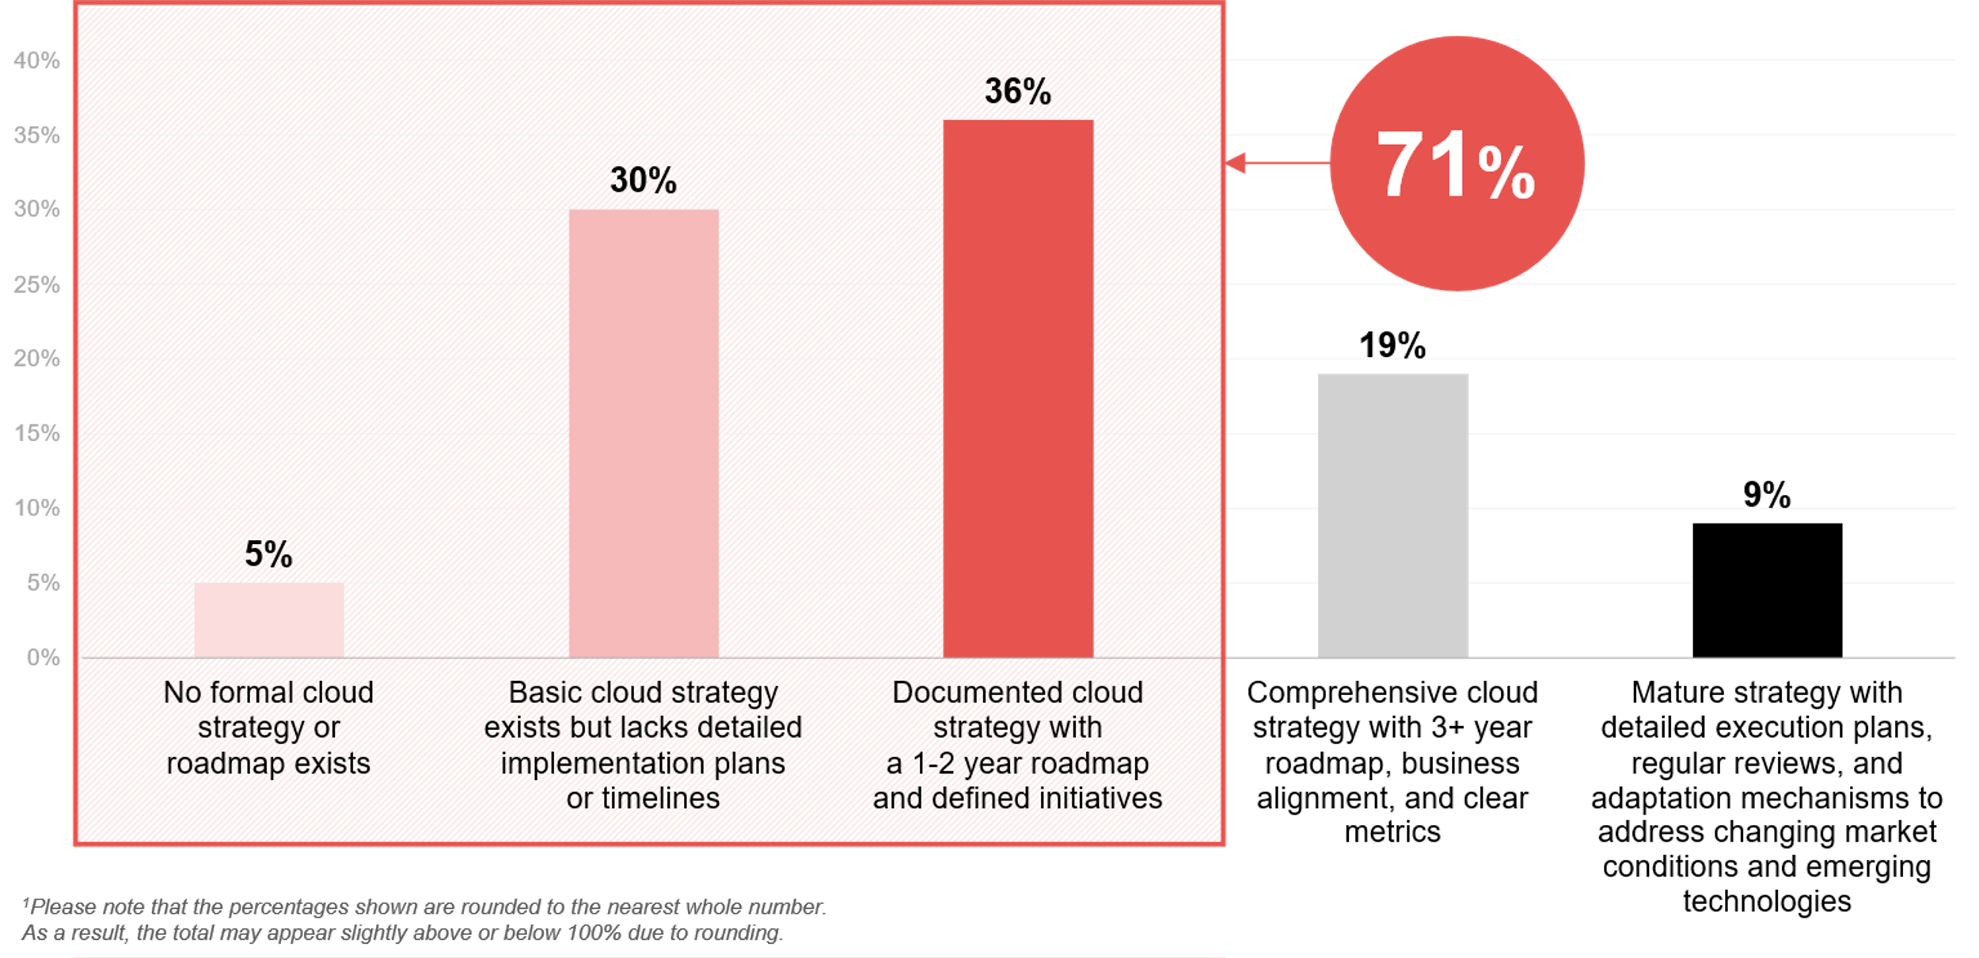
How would you characterise your organisation’s cloud strategy documentation and roadmap?¹
Source : ADAPT Cloud and Infrastructure Edge Survey in July 2025. Sample size : 110 Australian Infrastructure Leaders

Slide 5
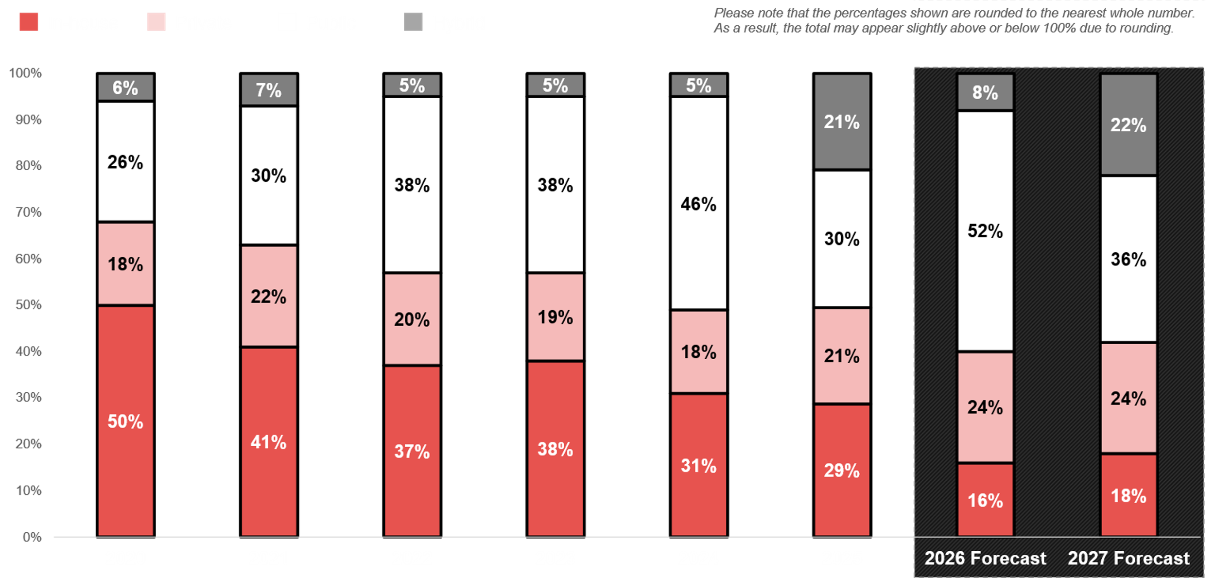
Cloud migration 2020 – 2027
ADAPT CIO and Cloud and Infrastructure Edge Surveys in 2020 to 2025. Sample size: 2,215 Australian CIOs and Infrastructure leaders

Slide 6
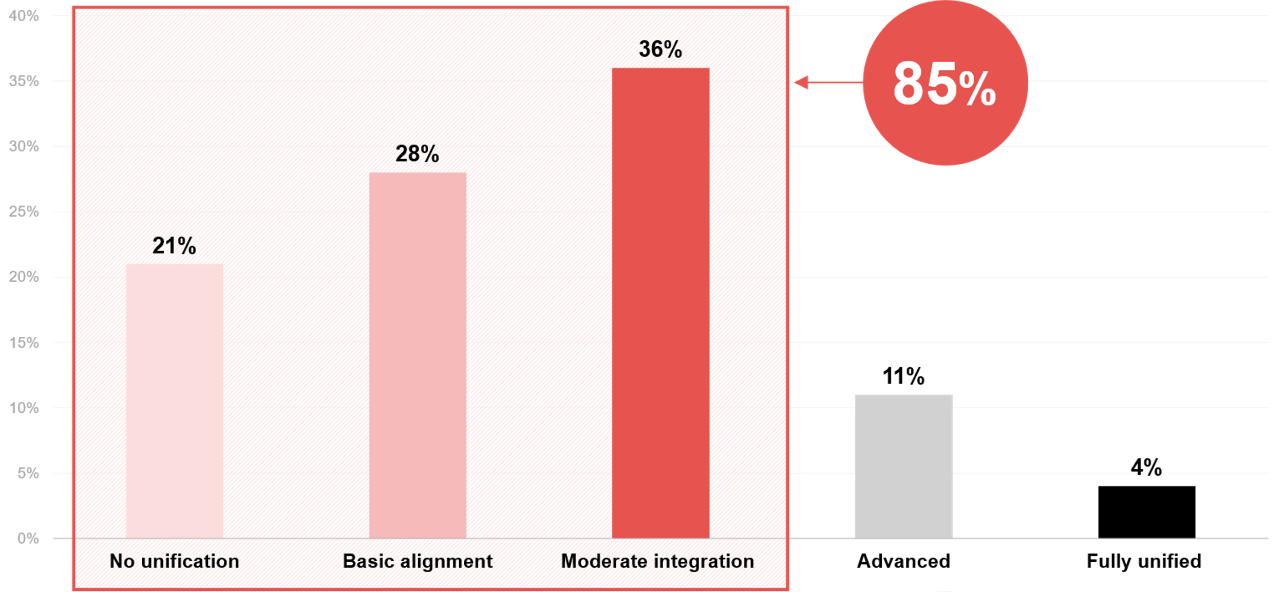
Select which statement best describes your organisation’s current approach to multi-cloud unification?
Source : ADAPT Cloud and Infrastructure Edge Survey in July 2025. Sample size : 107 Australian Infrastructure Leaders

Slide 7
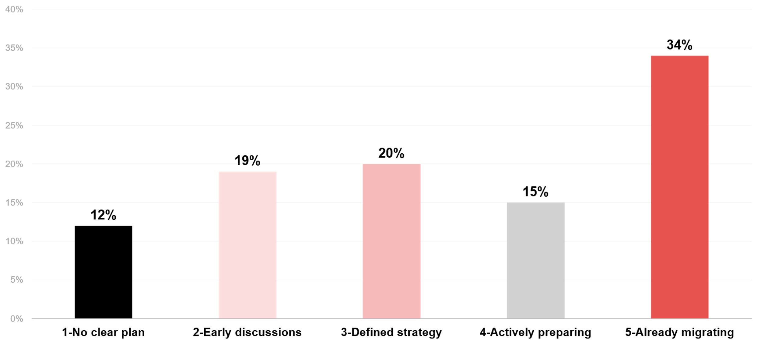
How ready is your organisation to migrate its core enterprise apps (e.g., ERP) to the cloud?
Source : ADAPT Cloud and Infrastructure Edge Survey in July 2025. Sample size : 106 Australian Infrastructure Leaders

Slide 8
Cloud strategy and documentation roadmap
Cloud strategy documentation reveals a significant maturity gap among Australian organisations.
Most organisations have only a partially defined cloud strategy, indicating an evolving approach
to cloud adoption. With just 9% possessing mature cloud strategy documentation and roadmaps, there is a clear need for a more structured cloud transformation.
Cloud migration progress
Organisations have significantly diminished their reliance on public cloud workloads, while embracing hybrid cloud solutions at an exceptional rate. While in-house workload allocation is gradually declining, there is a slow but steady rise in private cloud usage. These changes reflect organisations maturing their cloud strategies while working to unify their multi-cloud migration approaches.
Approach to multi-cloud unification
Multi-cloud environments are becoming the norm. However, many organisations struggle with unification strategies. This indicates that these organisations are still operating in siloed cloud environments.
Poor readiness for migrating core enterprise applications can slow multi-cloud maturity, as legacy apps often have limited flexibility for cloud adoption.
Cloud migration readiness for core enterprise apps
The migration of mission-critical applications is proceeding cautiously, with some organisations lacking clear plans or only holding preliminary discussions about moving their core enterprise systems to the cloud. This highlights the significant challenges involved in migrating
core systems to cloud environments.
Technology Trends
Cloud strategy
and migration
Australian organisations are still in the early stages of cloud maturity, with 71% lacking comprehensive or mature cloud strategy documentation and clear migration roadmaps.
Consistent with this, organisations are reducing public cloud workload usage while increasingly adopting hybrid cloud solutions. For more insights on the progress of cloud migration, refer to an ADAPT Infrastructure Leader Persona Map
(Jul 2025).
85% of organisations do not have an advanced
or fully unified approach to multi-cloud migration.
34% of organisations are already migrating their core enterprise apps to the cloud.

Slide 9
Key factors for effective cloud strategy, multi-cloud unification and migration readiness

Slide 10
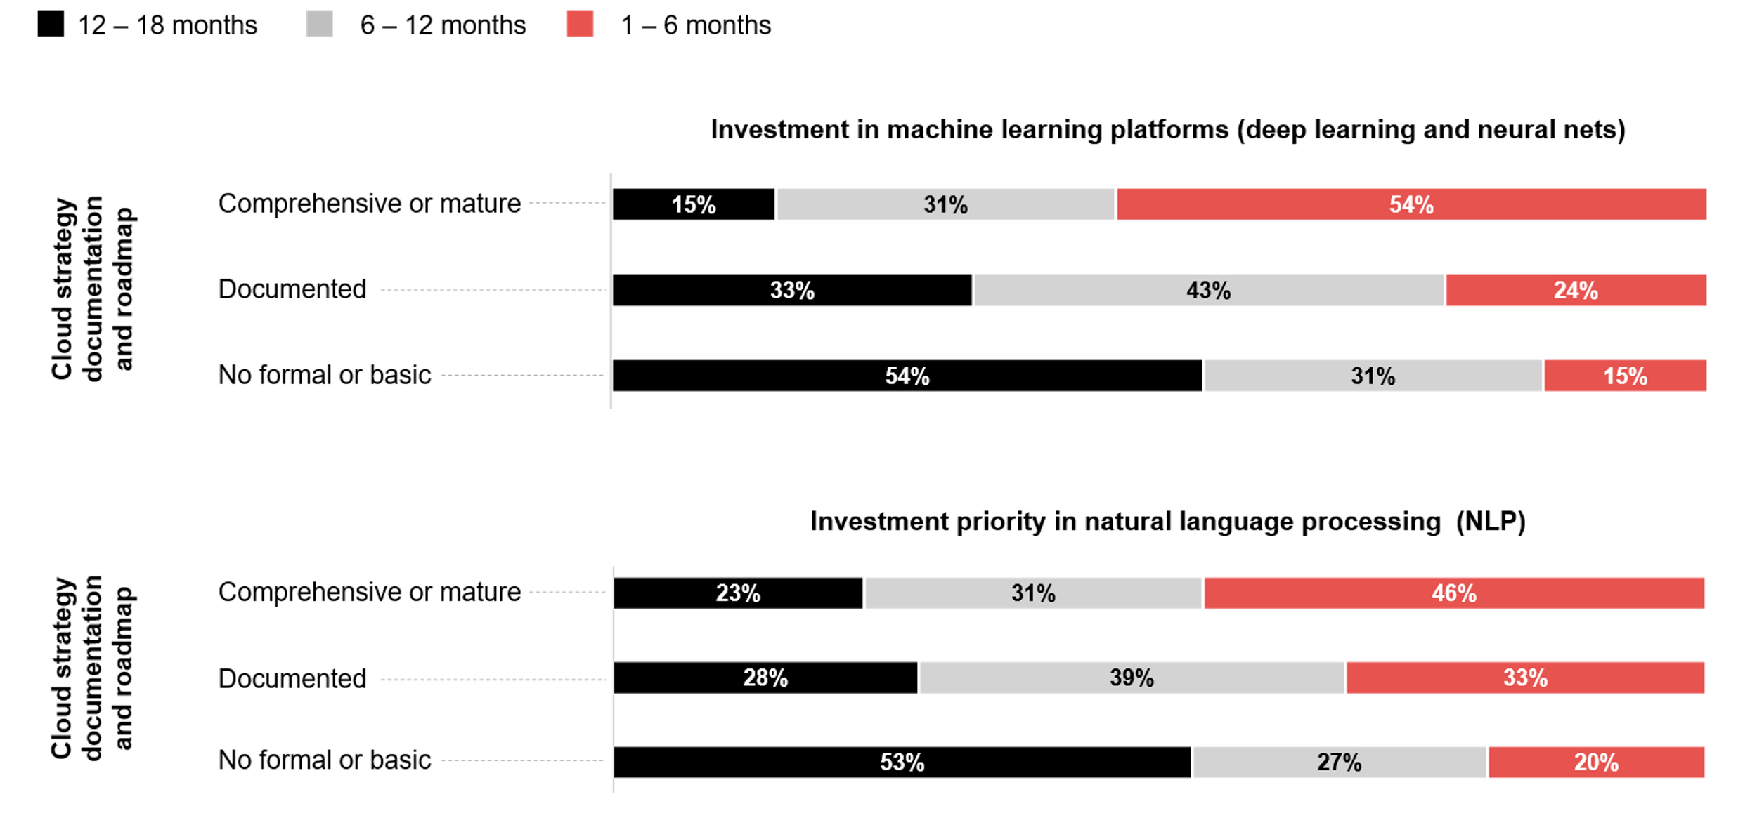
AI investment priorities as drivers of cloud strategy documentation and roadmap
Source: ADAPT Cloud and Infrastructure Edge Survey in July 2025: Sample size: 110 Australian Infrastructure Leaders

Slide 11
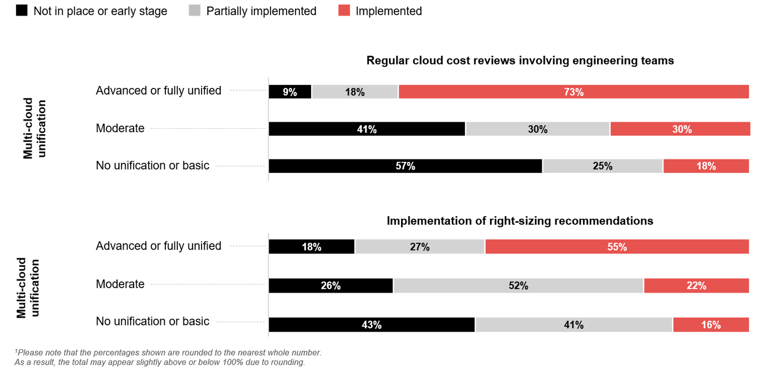
Maturity of FinOps practices as drivers of multi-cloud unification¹
Source: ADAPT Cloud and Infrastructure Edge Survey in July 2025: Sample size: 107 Australian Infrastructure Leaders

Slide 12
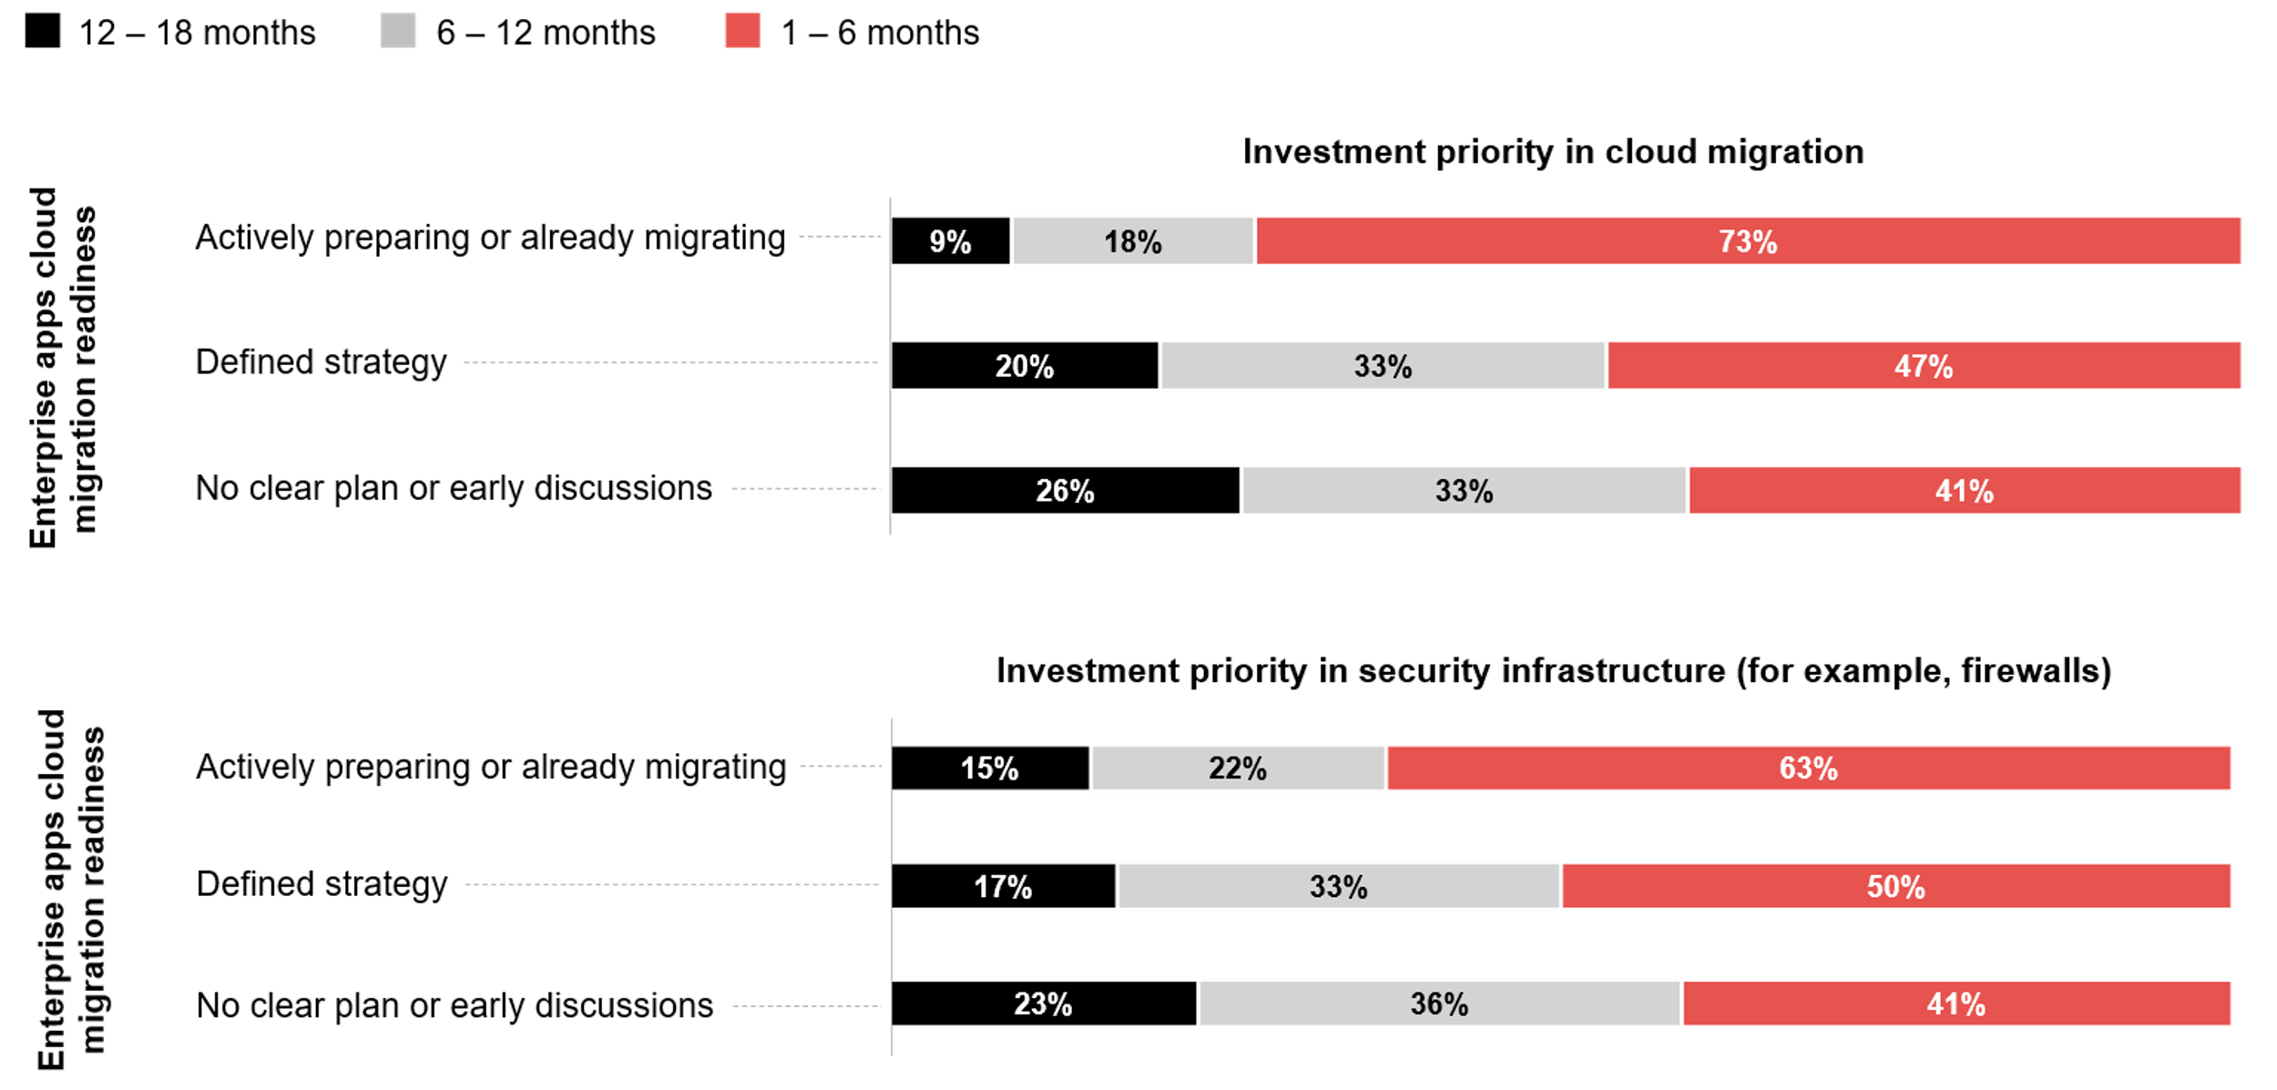
IP in cloud migration and security infrastructure as drivers of cloud migration readiness
Source: ADAPT Cloud and Infrastructure Edge Survey in July 2025: Sample size: 106 Australian Infrastructure Leaders

Slide 13
Investment priorities in ML and NLP as drivers of cloud strategy, documentation and roadmap
Investing in ML, including deep learning and neural networks, shows that organisations aim to unlock significant value from their data and infrastructure investments, reflecting cloud maturity.
A greater focus on NLP highlights data and AI readiness within cloud maturity, as organisations shift from traditional infrastructure management to value-driven, AI-powered services.
Achieving a more unified and cost-effective multi-cloud environment
Organisations that conduct regular cloud cost reviews with engineering teams foster cross-functional accountability, financial visibility, and architectural alignment.
As organisations implement right-sizing recommendations, they optimise cloud infrastructure costs to improve overall cloud resource efficiency.
Cloud migration capabilities and security measures
When organisations actively invest in modernising core enterprise applications, they demonstrate higher maturity in cloud adoption strategies.
Investing in advanced firewalls and security tools is crucial to ensure secure and compliant cloud migration. This reflects a mature approach to managing risks in digital transformation.
Technology Trends
Driving factors
ADAPT correlation analysis identifies significant factors that drive effective cloud strategies, multi-cloud unification, and migration readiness.
Organisations that invest in machine learning (ML) and natural language processing (NLP) are more likely to increase maturity in their cloud strategy documentation and roadmap.
Implementing regular cloud cost reviews with engineering teams and right-sizing recommendations is crucial for a unified multi-cloud approach.
A stronger focus on investment in cloud migration and security infrastructure is essential to drive readiness for core enterprise app migration.

Slide 14
Survey demographics

Slide 15
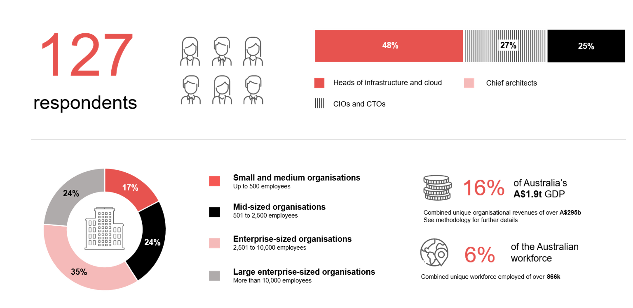
Survey demographics: Australian infrastructure leaders in 2025

Slide 16

For sector, segment and persona comparisons
Central limit theorem a fundamental concept in statistics that determines when a sample size is large enough
to be considered reliable. There are different formulas and some debate amongst statisticians about the appropriate sample size. For industry comparisons or other subset analyses, a sample size of ( n > 20 ) is generally considered acceptable for drawing meaningful insights. This threshold aligns with common statistical practices, where a
sample size of 20 to 30 is generally the minimum needed to assume a normal distribution of the data.
Sample sizes below 20, but equal to or greater than 15
When the sample size is between 15 and 20, while not fully representative, it can still offer valuable insights
into trends. These statistics should be viewed as indicative, highlighting general directions in industry efforts
or barriers to investment but treated with some caution due to the smaller number of observations.
Sample sizes less than 15, but greater or equal to 10
For samples between 10 and 15, the data provides a snapshot guideline only. While such small samples can
show early trends, it's important to recognise that this doesn't guarantee future respondents will reflect the same trends. For instance, while 100% of respondents in a sample of 10 might invest in AI, it'd be unrealistic to assume this pattern will hold as the sample size grows. However, if the sample size increases to 20, it's unlikely
that the trend will change drastically, and the next 10 respondents will have no investment.
ADAPT Data Analytics
Notes on sample sizes
Why does sample size matter?
Each set of statistics is unique with measures,
distribution, variance and sample size. It is generally accepted in statistics that as sample size increases, analysts make fewer assumptions about the data, resulting in statistics that more accurately represent the truth.
ADAPT endeavours to provide transparency of sample size, whereby we provide a source on data slides with
the number of respondents and the survey where those respondents come from. In data and insights slide decks, ADAPT usually provides some insight on the breakdown
of the demographics at the end of the slide deck.
To protect privacy, ADAPT does not release lists
of individual respondents to surveys.

Slide 17


Written by
Gabby Fredkin
Head of Data and Analytics at ADAPT
Honey Mari Gay
Junior Data Analyst at ADAPT
Gabby’s primary role is managing ADAPT’s overall strategy for Data Analytics. He has extensive experience in using data to identify trends in technology that help shape Australian organisations. Using modern data science techniques, he ensures the accuracy and validity of the information that supports ADAPT’s research, advisory services, and events, giving both ADAPT and its customers greater confidence in the insights provided.
With a passion for creating stories with data, Gabby is consistently rated as one of the top speakers at ADAPT Events. In round table discussions, he specialises in using statistics to initiate thought-provoking discussions. Gabby is effective in translating information into insights, enabling ADAPT’s customers to become more data-driven.
As a Junior Data Analyst at ADAPT, Mari enables the discovery and definition of market trends through visually meaningful statistics. She ensures data presentations are accurate and aligned with modern statistical standards.
Mari is passionate about data and transforming it into actionable insights. With over three years of experience in project management and academic research, she has led end-to-end survey and research projects, processed and analysed data using a range of statistical tools and techniques, and provided clients with statistical
consultation and insights.

Slide 18

About ADAPT
ADAPT is a specialist Research & Advisory firm providing local market insights and benchmarking data
to Australia and New Zealand’s senior technology and business community.
Since 2011, we’ve been empowering the leaders of the region’s top enterprise and government organisations
to stay at the forefront of modern trends and build for the future. Our industry leading conferences, private roundtable events and custom research projects equip business leaders with the knowledge, relationships, inspiration and tools they need to make better strategic decisions.
adapt.com.au | hello@adapt.com.au
Data Validation
Results contained in this report (Report) are based on survey responses as provided by our clients and publicly available information. ADAPT does not subject the data contained in the Report to audit or review procedures or any other testing to validate the accuracy or reasonableness of the data provided by the participating clients. While we do not manipulate the survey responses, we do make an effort to identify outlier data or conflicting results that could lead to misinterpretations before the preparation of the Report.
Intended Use of the Report
The Report is designed to help technology executives in Australia and New Zealand make independent decisions regarding financial, resourcing and operational performance matters. The information and data contained in the Report are provided as is and are for information purposes only. They are not intended or implied to be recommendations and in no event will ADAPT be liable for any decisions or actions taken in reliance of the results obtained through the use of the information and/or data contained in the Report.
Research MSA and Privacy Policy
The Report and any other information provided by ADAPT is subject to the Research and Advisory Master Services Agreement and the ADAPT Privacy Policy.

Slide 19




Additional resources you can access
Members of ADAPT’s Research & Advisory platform have access to an entire suite of market leading content, insights and resources to help you execute in your role. For any assistance contact your Account Manager in the help section.
Community case studies and interviews
Case studies detailing the successes
and challenges of projects and initiatives.
Market Trend Reports Access a library of fact-based actionable insights, deep dives on ANZ business & IT trends.
Live access to ADAPT analysts
Through live ADAPT analyst market briefings and Q&A sessions
Downloadable data and insights
Elevate your business cases with downloadable market and industry data.
Industry expert presentations
Watch keynotes or read distilled 1-page executive summaries from our Edge Events.
Bespoke analysis of ADAPT data
Receive custom cuts and analysis of ADAPT proprietary data.
Premier executive community
Unlock access to our exclusive network of Australia’s leading technology and business executives.
Dedicated account manager and impact assessments
Your Account Manager will ensure you and your team are getting the most out of your subscription.
Dedicated analyst briefing
Leverage a dedicated briefing with an ADAPT analyst to help validate your strategies.
*Inclusions may vary depending on subscription level.

